Slide 1
Isaiah 49:1-13
The Greater Need

Slide 2



Slide 3


Slide 4
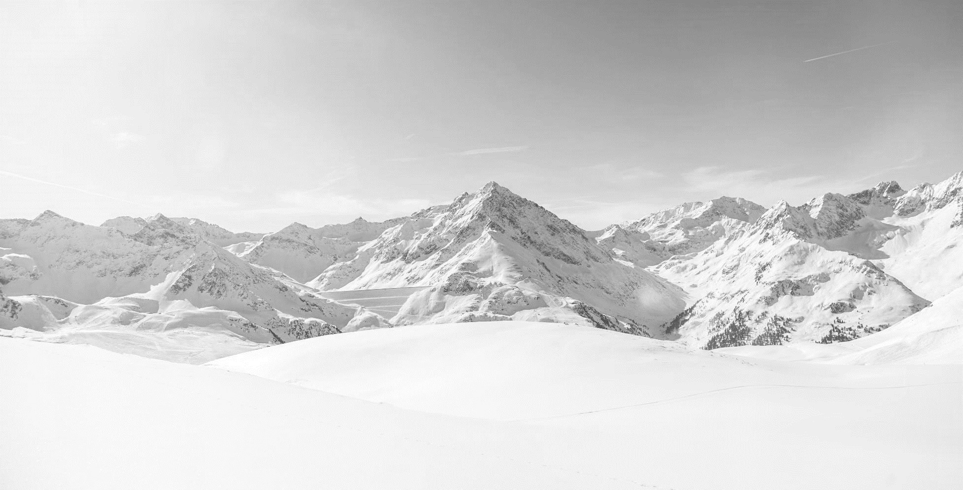


Slide 5


Slide 6
1 Listen to me, O coastlands,
and give attention, you peoples from afar.
The LORD called me from the womb,
from the body of my mother he named my name.
2 He made my mouth like a sharp sword;
in the shadow of his hand he hid me;
he made me a polished arrow;
in his quiver he hid me away.
3 And he said to me, “You are my servant,
Israel, in whom I will be glorified.”
4 But I said, “I have labored in vain;
I have spent my strength for nothing and vanity;
yet surely my right is with the LORD,
and my recompense with my God.”
5 And now the LORD says,
he who formed me from the womb to be his servant,
to bring Jacob back to him;
and that Israel might be gathered to him—
for I am honored in the eyes of the LORD,
and my God has become my strength—
6 he says:
“It is too light a thing that you should be my servant
to raise up the tribes of Jacob
and to bring back the preserved of Israel;
I will make you as a light for the nations,
that my salvation may reach to the end of the earth.”
7 Thus says the LORD,
the Redeemer of Israel and his Holy One,
to one deeply despised, abhorred by the nation,
the servant of rulers:
“Kings shall see and arise;
princes, and they shall prostrate themselves;
because of the LORD, who is faithful,
the Holy One of Israel, who has chosen you.”
(Isaiah 49:1-7, ESV)

Slide 7
8 Thus says the LORD:
“In a time of favor I have answered you;
in a day of salvation I have helped you;
I will keep you and give you
as a covenant to the people,
to establish the land,
to apportion the desolate heritages,
9 saying to the prisoners, ‘Come out,’
to those who are in darkness, ‘Appear.’
They shall feed along the ways;
on all bare heights shall be their pasture;
10 they shall not hunger or thirst,
neither scorching wind nor sun shall strike them,
for he who has pity on them will lead them,
and by springs of water will guide them.
11 And I will make all my mountains a road,
and my highways shall be raised up.
12 Behold, these shall come from afar,
and behold, these from the north and from the west,
and these from the land of Syene.”
13 Sing for joy, O heavens, and exult, O earth;
break forth, O mountains, into singing!
For the LORD has comforted his people
and will have compassion on his afflicted.
(Isaiah 49:8-13, ESV)

Slide 8
Main Point
These verses establish a new theme in Isaiah
The focus had been on God’s redemption from the Babylonian exile
Now, God begins to deal with a more serious problem
The problem is their sinfulness
God will deal with this through His Servant
All that is left to do is praise God for his deliverance

Slide 9
Application Points
The Greater Need
  Throughout the previous chapters of Isaiah we have seen many needs for the people
  Deliverance from Assyria, and then from Babylon
  They are in need of physical deliverance from their enemies
  There is a need for God to act for his people
  The Babylonian exile has brought an interesting thought…
  Has God been defeated?
  Has He abandoned the people?
  God has not been defeated
  God has not abandoned His people

Slide 10
Application Points
The Greater Need (2)
  What we have seen is God’s hands in both judgment and chastisement against His people for their faithlessness
  God acts in and through history to bring about His purposes
  God is dealing with one of the problems His people face
  Their separation from Jerusalem
  Thus we find they should not trust idols but trust the Living God
  He is going to act and redeem them
  This does not deal with the other problem which is their relationship with God
  Their relationship with God has been broken
  They have need to return to Jerusalem, but their greater need is in returning to God

Slide 11
Application Points
The Greater Need (3)
  Their sin has caused a rift between them and God
  It has caused brokenness in their relationship which must be repaired
  Even if they should return to Jerusalem, it will mean nothing if in the end it will lead to their destruction again
  It will only mean judgment against them
  The goal of Cyrus is that they should return home, the goal of the Servant is that they should return to God
  It is not only the people of Jacob, but those in the world
  This Servant will be the guiding light for all people everywhere

Slide 12
Application Points
The Greater Need (4)
  Not only this, but the Servant is going to prepare a way which the people will traverse
  They will make it back to God Himself…the foundation of all things
  This Servant is going to provide the way and nothing will hinder those who follow
  The reward will be attained by those who persevere
  The reward is God Himself
  In these verses, then, we see God doing something new
  He is going to provide redemption from sin in order that their relationship can be restored
  God has promised to provide for them in their need
  How can we not join with the cosmos in rejoicing in what we have just learned?
  The greater need will be met by God

Slide 13
Application Points
The Gospel of Christ
  Origins
    Where we began
  Fall
    What went wrong
  Redemption
    How it is fixed
  Glorification
    Where it at leads

