Slide 1
Isaiah 45:14-46:13
For God’s Purpose

Slide 2



Slide 3


Slide 4
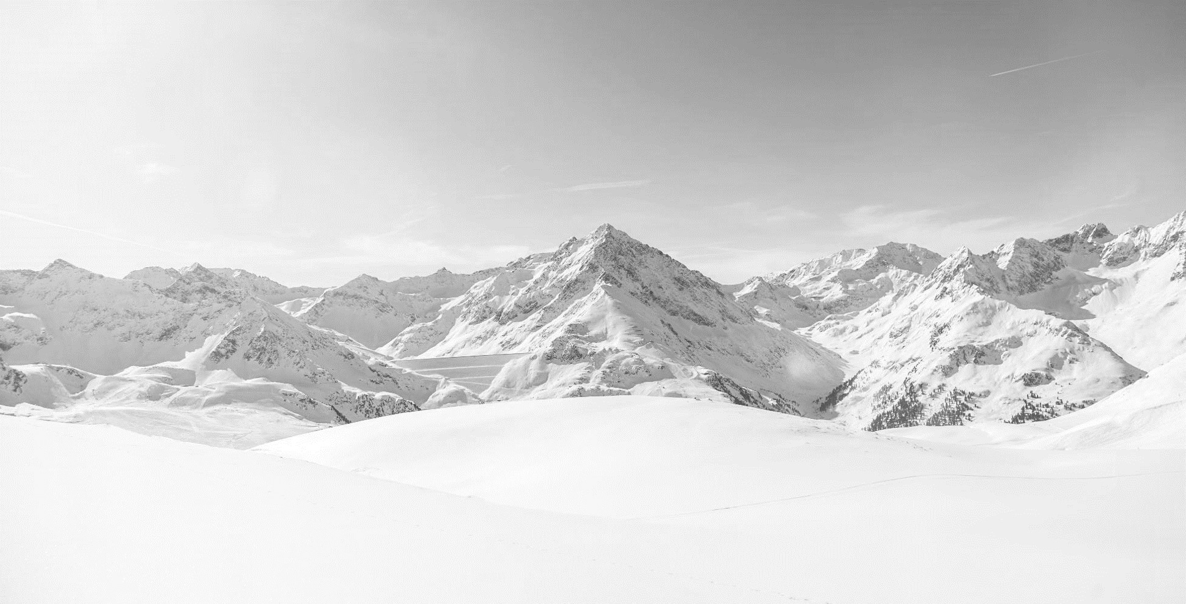


Slide 5


Slide 6
14 Thus says the LORD:
“The wealth of Egypt and the merchandise of Cush,
and the Sabeans, men of stature,
shall come over to you and be yours;
they shall follow you;
they shall come over in chains and bow down to you.
They will plead with you, saying:
‘Surely God is in you, and there is no other,
no god besides him.’”
15 Truly, you are a God who hides himself,
O God of Israel, the Savior.
16 All of them are put to shame and confounded;
the makers of idols go in confusion together.
17 But Israel is saved by the LORD
with everlasting salvation;
you shall not be put to shame or confounded
to all eternity.
18 For thus says the LORD,
who created the heavens
(he is God!),
who formed the earth and made it
(he established it;
he did not create it empty,
he formed it to be inhabited!):
“I am the LORD, and there is no other.
19 I did not speak in secret,
in a land of darkness;
I did not say to the offspring of Jacob,
‘Seek me in vain.’
I the LORD speak the truth;
I declare what is right.
(Isaiah 45:14-19, ESV)

Slide 7
20 “Assemble yourselves and come;
draw near together,
you survivors of the nations!
They have no knowledge
who carry about their wooden idols,
and keep on praying to a god
that cannot save.
21 Declare and present your case;
let them take counsel together!
Who told this long ago?
Who declared it of old?
Was it not I, the LORD?
And there is no other god besides me,
a righteous God and a Savior;
there is none besides me.
22 “Turn to me and be saved,
all the ends of the earth!
For I am God, and there is no other.
23 By myself I have sworn;
from my mouth has gone out in righteousness
a word that shall not return:
‘To me every knee shall bow,
every tongue shall swear allegiance.’
24 “Only in the LORD, it shall be said of me,
are righteousness and strength;
to him shall come and be ashamed
all who were incensed against him.
25 In the LORD all the offspring of Israel
shall be justified and shall glory.”
(Isaiah 45:20-25, ESV)

Slide 8
1 Bel bows down; Nebo stoops;
their idols are on beasts and livestock;
these things you carry are borne
as burdens on weary beasts.
2 They stoop; they bow down together;
they cannot save the burden,
but themselves go into captivity.
3 “Listen to me, O house of Jacob,
all the remnant of the house of Israel,
who have been borne by me from before your birth,
carried from the womb;
4 even to your old age I am he,
and to gray hairs I will carry you.
I have made, and I will bear;
I will carry and will save.
5 “To whom will you liken me and make me equal,
and compare me, that we may be alike?
6 Those who lavish gold from the purse,
and weigh out silver in the scales,
hire a goldsmith, and he makes it into a god;
then they fall down and worship!
7 They lift it to their shoulders, they carry it,
they set it in its place, and it stands there;
it cannot move from its place.
If one cries to it, it does not answer
or save him from his trouble.
(Isaiah 46:1-7, ESV)

Slide 9
8 “Remember this and stand firm,
recall it to mind, you transgressors,
9 remember the former things of old;
for I am God, and there is no other;
I am God, and there is none like me,
10 declaring the end from the beginning
and from ancient times things not yet done,
saying, ‘My counsel shall stand,
and I will accomplish all my purpose,’
11 calling a bird of prey from the east,
the man of my counsel from a far country.
I have spoken, and I will bring it to pass;
I have purposed, and I will do it.
12 “Listen to me, you stubborn of heart,
you who are far from righteousness:
13 I bring near my righteousness; it is not far off,
and my salvation will not delay;
I will put salvation in Zion,
for Israel my glory.”
(Isaiah 46:8-13, ESV)

Slide 10
Main Point
The main point of these verses are to establish God’s greatness against pagan belief
God has offered Himself as the only truth for reality
Salvation for them is far away the more they rely on themselves
Yet it is also near, since God always near

Slide 11
Application Points
The Righteous Savior
  Isaiah’s criticisms of pagan belief is important for us to consider
  What is also significant about the prophets is that they spoke the truth
  Truth about the failure of the people...human shortcomings when it comes to righteousness and salvation
  The only way that the prophets could have such knowledge is if it came from God Himself
  There is no God apart from God
  The question comes to mind, why does this God reserve such right?
  How can the people of God, and the people of the world know that this is the God of all things?

Slide 12
Application Points
The Righteous Savior (2)
  The answer is that the this God is the only One who as acted
  He has claimed things in the past that would be in the present and future
  We would also be missing something if we assumed God only predicts
  He also acts
  Even with our limited human freedom He is able to know, act, and even place humans exactly where we need to be in order for our decisions to matter
  Such is the case for Cyrus
  That also means He places all other humans in their time and place in order for Cyrus to accomplish God’s design
  It is because God acts Cyrus is able to exist at all
  He has brought forth this incredible universe
  In the end God will not be usurped by us

Slide 13
Application Points
The Righteous Savior (3)
  God reminds us in this text that He is truly Sovereign over all things
  This seems to be the mantra since chapter 40
  Our responsibility is to continue to honor God and live in this faith knowing it leads to righteousness, not our own, but His
  At almost all points in human history we have been in perilous times
  There have been despots and evil rulers
  There have been sinful people living in a dark world
  It is just as important for us to remember what is being said in today’s text
  Isaiah offers a clear warning, “Remember this and stand firm”
  It is in forgetting the truth that we will fall into fallacies and lies

Slide 14
Application Points
The Righteous Savior (4)
  Too many are ignoring the warnings
  Too many are forgetting that our God is the great God of the universe
  Too many are believing in the powers of the world over the power of God
  Too many are ignoring the reality of God Almighty
  Let us not be deceived, let us not forget
  From Egypt to Cush indeed
  If God can have this effect on the world, then let us trust Him not this world
  Because if we should forget then we will not find righteousness but unrighteousness
  If we forget we will find despair instead of salvation
  We will never be able to stand if we forget
  Thanks be to God that He has brought righteousness and salvation
  That He alone is the Righteous Savior

Slide 15
Application Points
The Gospel of Christ
  Origins
    Where we began
  Fall
    What went wrong
  Redemption
    How it is fixed
  Glorification
    Where it at leads

