Slide 1
Isaiah 44:23-45:13
For God’s Purpose

Slide 2



Slide 3


Slide 4
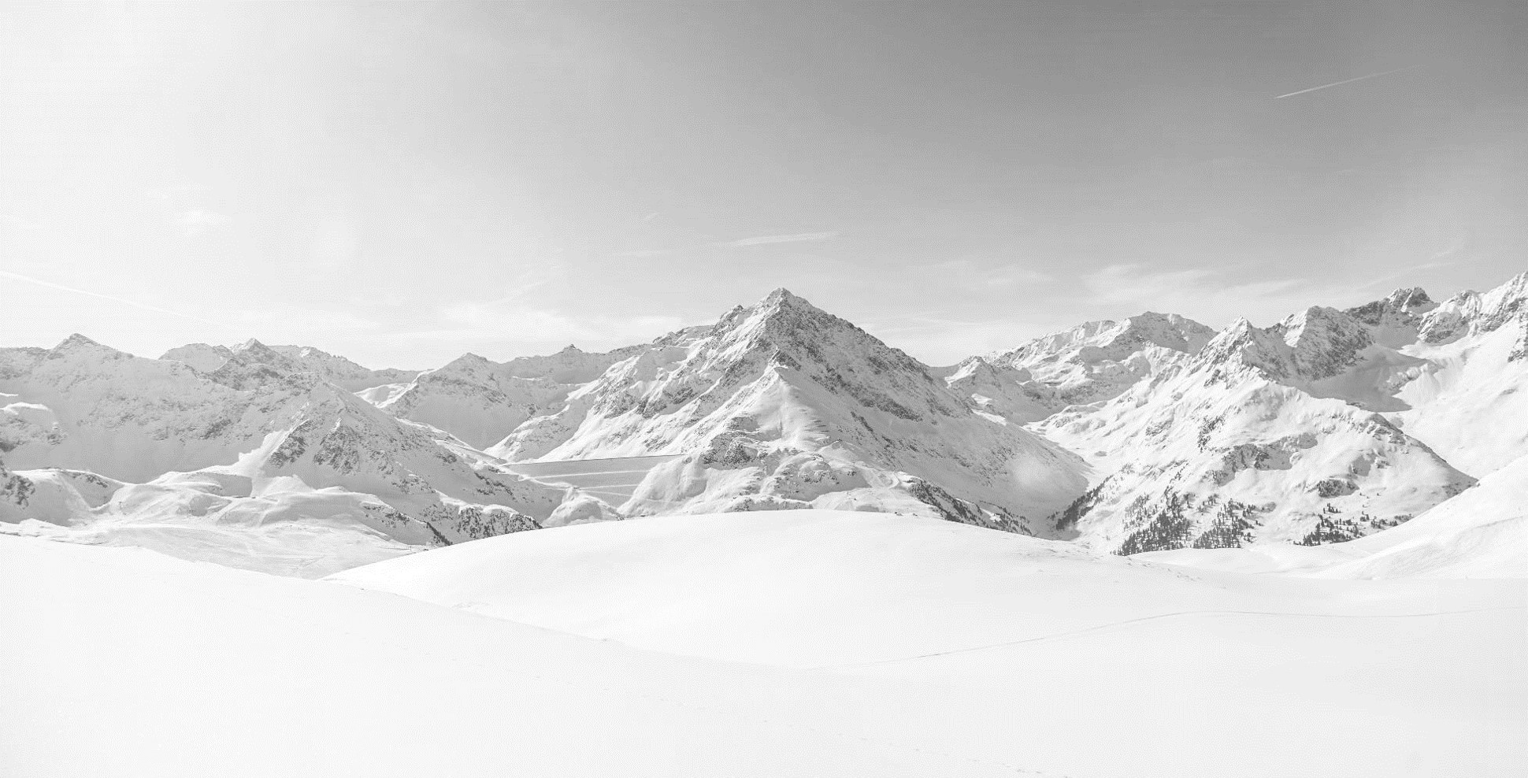


Slide 5


Slide 6
23 Sing, O heavens, for the LORD has done it;
shout, O depths of the earth;
break forth into singing, O mountains,
O forest, and every tree in it!
For the LORD has redeemed Jacob,
and will be glorified in Israel.
24 Thus says the LORD, your Redeemer,
who formed you from the womb:
“I am the LORD, who made all things,
who alone stretched out the heavens,
who spread out the earth by myself,
25 who frustrates the signs of liars
and makes fools of diviners,
who turns wise men back
and makes their knowledge foolish,
26 who confirms the word of his servant
and fulfills the counsel of his messengers,
who says of Jerusalem, ‘She shall be inhabited,’
and of the cities of Judah, ‘They shall be built,
and I will raise up their ruins’;
27 who says to the deep, ‘Be dry;
I will dry up your rivers’;
28 who says of Cyrus, ‘He is my shepherd,
and he shall fulfill all my purpose’;
saying of Jerusalem, ‘She shall be built,’
and of the temple, ‘Your foundation shall be laid.’”
(Isaiah 44:23-28, ESV)

Slide 7
1 Thus says the LORD to his anointed, to Cyrus,
whose right hand I have grasped,
to subdue nations before him
and to loose the belts of kings,
to open doors before him
that gates may not be closed:
2 “I will go before you
and level the exalted places,
I will break in pieces the doors of bronze
and cut through the bars of iron,
3 I will give you the treasures of darkness
and the hoards in secret places,
that you may know that it is I, the LORD,
the God of Israel, who call you by your name.
4 For the sake of my servant Jacob,
and Israel my chosen,
I call you by your name,
I name you, though you do not know me.
5 I am the LORD, and there is no other,
besides me there is no God;
I equip you, though you do not know me,
6 that people may know, from the rising of the sun
and from the west, that there is none besides me;
I am the LORD, and there is no other.
7 I form light and create darkness;
I make well-being and create calamity;
I am the LORD, who does all these things.
8 “Shower, O heavens, from above,
and let the clouds rain down righteousness;
let the earth open, that salvation and righteousness may bear fruit;
let the earth cause them both to sprout;
I the LORD have created it.
(Isaiah 45:1-8ESV)

Slide 8
9 “Woe to him who strives with him who formed him,
a pot among earthen pots!
Does the clay say to him who forms it, ‘What are you making?’
or ‘Your work has no handles’?
10 Woe to him who says to a father, ‘What are you begetting?’
or to a woman, ‘With what are you in labor?’”
11 Thus says the LORD,
the Holy One of Israel, and the one who formed him:
“Ask me of things to come;
will you command me concerning my children and the work of my hands?
12 I made the earth
and created man on it;
it was my hands that stretched out the heavens,
and I commanded all their host.
13 I have stirred him up in righteousness,
and I will make all his ways level;
he shall build my city
and set my exiles free,
not for price or reward,”
says the LORD of hosts.
(Isaiah 45:9-13, ESV)

Slide 9
Main Point
The main point of these verses are to identify who God will utilize in order to bring about His plans
The surprise is Cyrus, pagan king of Persia
No human is outside the bounds of God’s ability to act
He utilize humanity in order to bring about His intended purposes

Slide 10
Application Points
For God’s Purpose
  Isaiah, indeed God, has been reminding us of God’s superiority as compared to all others
  There was nothing before Him and nothing will be apart from Him
  We are being offered an understanding of God, which, we cannot attain on our own
  Unless God comes to us, we would be unable to grasp Him
  Yet this is exactly what the prophets proclaimed
  If what we learn about God is true from the prophets, then the concepts we face today should not surprise us
  God is intimately familiar with our world, He is intimately familiar with each person, knowing each of us in a profound way

Slide 11
Application Points
For God’s Purpose (2)
  In knowing us and knowing what each person will do in whatever circumstance they are in, He is capable of placing each person in their respective place for His purposes
  He Himself does things in this world knowing the repercussions
  Some may wonder about free will, God’s justice, and the like
  Do our actions have meaning?
  God proclaims prior to the coming of Cyrus that Cyrus will come, and that Cyrus will have an incredible effect on the world
  God is able to mold the clay as He wills for all His purposes

Slide 12
“14 What shall we say then? Is there injustice on God’s part? By no means! 15 For he says to Moses, “I will have mercy on whom I have mercy, and I will have compassion on whom I have compassion.” 16 So then it depends not on human will or exertion, but on God, who has mercy. 17 For the Scripture says to Pharaoh, “For this very purpose I have raised you up, that I might show my power in you, and that my name might be proclaimed in all the earth.” 18 So then he has mercy on whomever he wills, and he hardens whomever he wills.

Slide 13
19 You will say to me then, “Why does he still find fault? For who can resist his will?” 20 But who are you, O man, to answer back to God? Will what is molded say to its molder, “Why have you made me like this?” 21 Has the potter no right over the clay, to make out of the same lump one vessel for honorable use and another for dishonorable use? 22 What if God, desiring to show his wrath and to make known his power, has endured with much patience vessels of wrath prepared for destruction, 23 in order to make known the riches of his glory for vessels of mercy, which he has prepared beforehand for glory— 24 even us whom he has called, not from the Jews only but also from the Gentiles?”
(Romans 9:14-24, ESV)

Slide 14
Application Points
For God’s Purpose (3)
  In Romans Paul argued that we are saved by grace through faith in Christ and that it is not our own righteousness but the righteousness of Christ
  This truth is not only for the Jewish people, but Gentiles as well
  The Jews could ask, demand, complain, that God would utilize a pagan king for His purposes
  For Paul the same is true of salvation itself
  There can be an assumption on our part that nothing good can come from pagans
  We can even rejoice in the fact that good comes
  However, this does not mean that because good can come from them they are saved
  God can utilize any person to bring about His purposes in the world
  Sometimes those purposes are for good, sometimes for judgment

Slide 15
Application Points
For God’s Purpose (4)
  In either case God is glorified because He is the One who is in Sovereign control
  This should cause us to realize just how significant and knowledgeable God is, but also realize how important each of us are for His purpose
  Because God knows us so perfectly as to know where to place us and when for His purposes
  It is only concerning if we know nothing about God…and we know He is good, just, righteous, and loving
  Instead of us fighting against God’s sovereignty…perhaps the better thing to do is be humble before our God
  He has a design in place for the whole of existence
  Our responsibility is to be faithful, to be obedient, to what He has called us to be

Slide 16
Application Points
For God’s Purpose (5)
  All of this should give us incredible peace
  If God had no plan, then none of it matters
  If God does a plan then we can find hope, even joy, knowing that whatever we go through God will utilize it in this world
  This does not excuse our moral failures, but it does give us courage, strength, and peace for when we struggle
  Let’s rejoice in the Sovereignty of our God
  Let’s also recognize our own limitations and finiteness, but rejoice that our God is limitless and infinite
  Let us be humble before our God…recognizing that though we are not always able to see it, there is a purpose
  It is God’s purpose

Slide 17
Application Points
The Gospel of Christ
  Origins
    Where we began
  Fall
    What went wrong
  Redemption
    How it is fixed
  Glorification
    Where it at leads

