Slide 1
Isaiah 43:8-44:5
I, I Am He

Slide 2



Slide 3


Slide 4
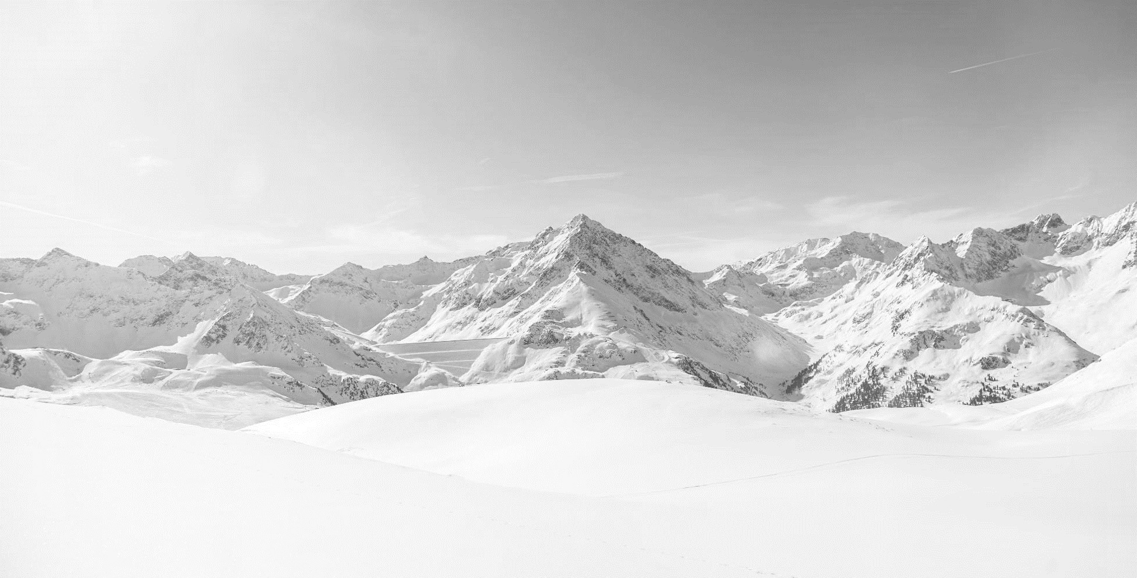


Slide 5


Slide 6
8 Bring out the people who are blind, yet have eyes,
who are deaf, yet have ears!
9 All the nations gather together,
and the peoples assemble.
Who among them can declare this,
and show us the former things?
Let them bring their witnesses to prove them right,
and let them hear and say, It is true.
10 “You are my witnesses,” declares the LORD,
“and my servant whom I have chosen,
that you may know and believe me
and understand that I am he.
Before me no god was formed,
nor shall there be any after me.
11 I, I am the LORD,
and besides me there is no savior.
12 I declared and saved and proclaimed,
when there was no strange god among you;
and you are my witnesses,” declares the LORD, “and I am God.
13 Also henceforth I am he;
there is none who can deliver from my hand;
I work, and who can turn it back?”
(Isaiah 43:8-13, ESV)

Slide 7
14 Thus says the LORD,
your Redeemer, the Holy One of Israel:
“For your sake I send to Babylon
and bring them all down as fugitives,
even the Chaldeans, in the ships in which they rejoice.
15 I am the LORD, your Holy One,
the Creator of Israel, your King.”
16 Thus says the LORD,
who makes a way in the sea,
a path in the mighty waters,
17 who brings forth chariot and horse,
army and warrior;
they lie down, they cannot rise,
they are extinguished, quenched like a wick:
18 “Remember not the former things,
nor consider the things of old.
19 Behold, I am doing a new thing;
now it springs forth, do you not perceive it?
I will make a way in the wilderness
and rivers in the desert.
20 The wild beasts will honor me,
the jackals and the ostriches,
for I give water in the wilderness,
rivers in the desert,
to give drink to my chosen people,
21 the people whom I formed for myself
that they might declare my praise.
(Isaiah 43:14-21, ESV)

Slide 8
22 “Yet you did not call upon me, O Jacob;
but you have been weary of me, O Israel!
23 You have not brought me your sheep for burnt offerings,
or honored me with your sacrifices.
I have not burdened you with offerings,
or wearied you with frankincense.
24 You have not bought me sweet cane with money,
or satisfied me with the fat of your sacrifices.
But you have burdened me with your sins;
you have wearied me with your iniquities.
25 “I, I am he
who blots out your transgressions for my own sake,
and I will not remember your sins.
26 Put me in remembrance; let us argue together;
set forth your case, that you may be proved right.
27 Your first father sinned,
and your mediators transgressed against me.
28 Therefore I will profane the princes of the sanctuary,
and deliver Jacob to utter destruction
and Israel to reviling.
(Isaiah 43:22-28, ESV)

Slide 9
1 “But now hear, O Jacob my servant,
Israel whom I have chosen!
2 Thus says the LORD who made you,
who formed you from the womb and will help you:
Fear not, O Jacob my servant,
Jeshurun whom I have chosen.
3 For I will pour water on the thirsty land,
and streams on the dry ground;
I will pour my Spirit upon your offspring,
and my blessing on your descendants.
4 They shall spring up among the grass
like willows by flowing streams.
5 This one will say, ‘I am the LORD’s,’
another will call on the name of Jacob,
and another will write on his hand, ‘The LORD’s,’
and name himself by the name of Israel.”
(Isaiah 44:1-5, ESV)

Slide 10
Main Point
These verses show a court room scene in which God allows the peoples to present their case
They are challenged
In the end they are silenced and only God is shown to provide salvation
On their own it leads to judgment
By God’s grace they can experience salvation

Slide 11
Application Points
I, I am He
  We see the reality of God and His people
  They are left speechless
  Only God provides an answer
  We continue to see the power of God on full display
  The Church cannot fall into the same mistakes
  We can fall sway to our religious cultic practices…believing we will find salvation
  By believing that if we attend Church, volunteer, do good deeds etc. we will find salvation is no different than the ancients
  These things are good and should be encouraged…but they do not lead to salvation

Slide 12
Application Points
I, I am He (2)
  These things are done because we understand salvation has already been attained
  He has accomplished providing water which is sufficient for life
  He has done it through Jesus Christ
  He is the One who has accomplished it
  We can do everything in our power to attain salvation…but in the end it only leads to destruction
  God’s grace is great here, because it reminds it is He who accomplishes all these things
  God has walked with us and given us a path which is safe and secure for us
  He has done all that He claimed, all that He declared to do

Slide 13
Application Points
I, I am He (3)
  It is His actions which leads to new things for us
  It is because of His action which allows our actions to provide the evidence that our God is so mighty
  Our very lives are the witnesses to God’s design and grace when it comes to His salvation
  In this coupling with the person of Jesus Christ we find the answer to it all
  A life giving religion which provides the sacrifice itself, and gives us all we need
  We must have further caution
  This does not mean we are to remain blind and deaf
  He has opened our eyes and ears by the power of the blood of His Son

Slide 14
Application Points
I, I am He (4)
  In this way God takes the burden off of our backs, and gives us a reason and purpose to it all
  Why should we seek good instead of evil?
  Because God has saved
  Why should we desire to live in godliness?
  Because God has redeemed
  Why should we desire to be a witness to the power of God?
  Because God has delivered
  We rejoice in the way in which God has accomplished all these things
  He has accomplished, redeemed, delivered, He is the only Savior
  The Great I Am, the One who opened the pathways in the waters and desert, He redeems Still

Slide 15
Application Points
The Gospel of Christ
  Origins
    Where we began
  Fall
    What went wrong
  Redemption
    How it is fixed
  Glorification
    Where it at leads

