Slide 1
Opening Thoughts on Isaiah 40-66
Isaiah changes in both minor and significant ways in chapter 40
  The text describes the people differently (different experiences with God)
  During 1-39 the focus was on Assyria (around 700 BC)
  Now the focus is on the Babylonian exile and Persia (536 BC)
The Babylonian exile occurred in 586 BC
  It was not until 536 BC that Cyrus of the Persian empire that the exiles returned
  Because of this many scholars have broken Isaiah into three parts
  First Isaiah: 1-39
  Second Isaiah 40-55
  Third Isaiah 56-66
This has caused some scholars to argue second and third Isaiah were not written by the original Isaiah
  Theories of an “Isaianic” school of prophets
  Or a single or handful of followers of Isaiah
  Or one editor who added these things together under “Isaiah”
  The dating for these range from the Babylonian exile period to well into the 300’s BC

Slide 2
Opening Thoughts on Isaiah 40-66
One reason for the assumption is because of the time difference
  Isaiah could not have written about events that far into the future
  One professor argued this, that the people should have accepted God instead of turned away
Response 1
  The first assumption is unwarranted because it was from God the statements were made, as such God could have easily given Isaiah such messages
Response 2
  After the Babylonian exile the Jewish people had an incredible change
  Prior to the exile the people often worshipped pagan gods (See I-II Kings/Chronicles/All the prophets!)
  After the exile this ceases almost entirely, where by the time of Jesus we find just how disciplined the people were to the Law
  What would cause the people to turn from their polytheism and idolatry?

Slide 3
Opening Thoughts on Isaiah 40-66
Ultimately if it was another hand that wrote second and third Isaiah they did seem to want us to believe it was meant to go with Isaiah
  Could God have used a later prophet? Sure it’s possible
  It is also possible God utilized one prophet named Isaiah to give all these messages
  The full book of Isaiah we have today is what God wants us to have in order for us to know Him, His purposes, His promises, and ultimately what He would do in this world

Slide 4
Isaiah 40-66
Bibliography

Slide 5
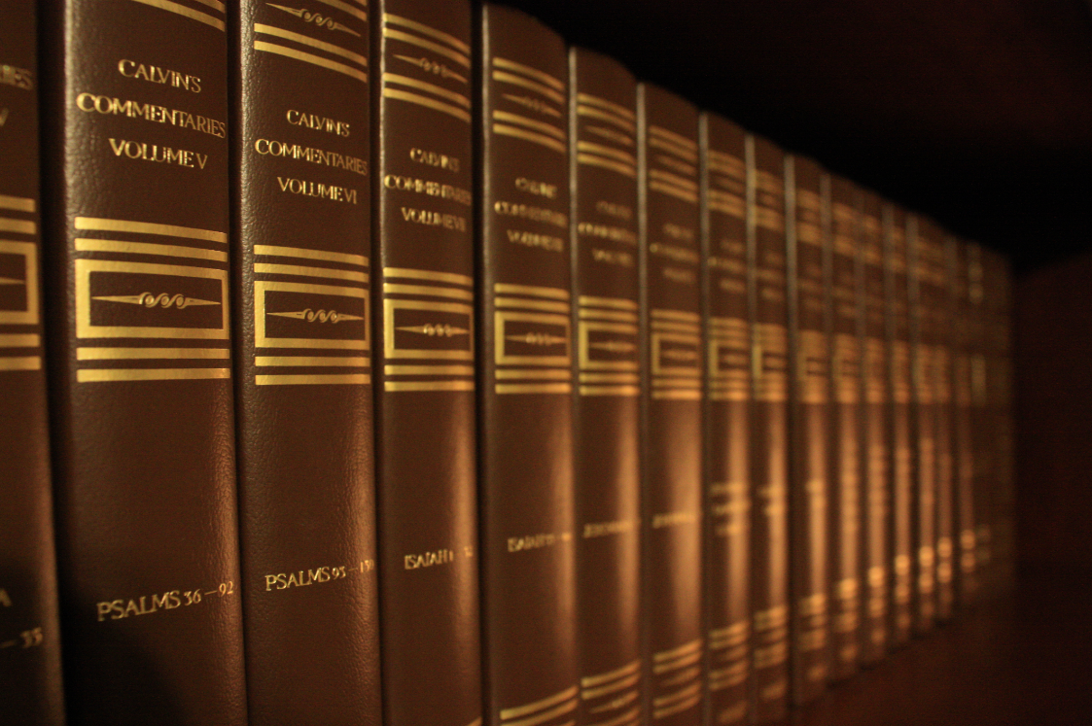
Calvin, John. Commentary on the Book of the Prophet Isaiah. Translated by Pringle, William. Baker Books. Reprinted 2009.

Slide 6
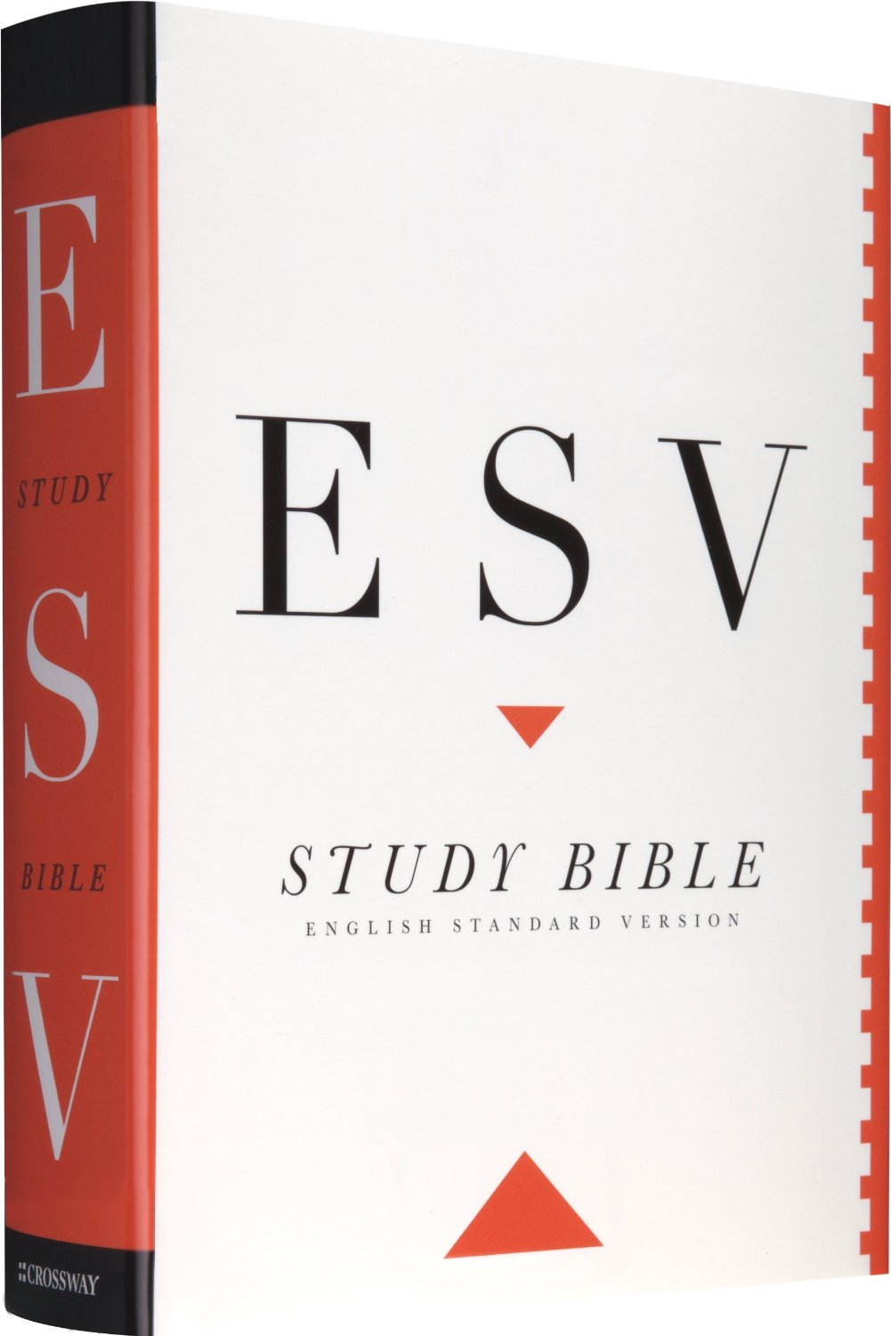
English Standard Version Study Bible. Crossway. 2012

Slide 7
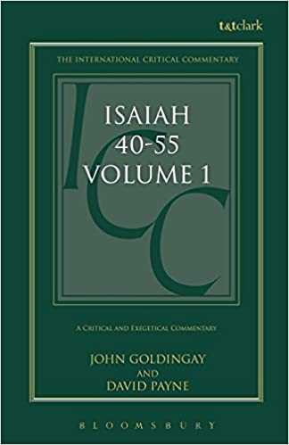
Goldingjay, John & Payne, David. Isaiah 40-55: A Critical and Exegetical Commentary 2 Volumes. International Critical Commentary, Bloomsbury, 2006.

Slide 8
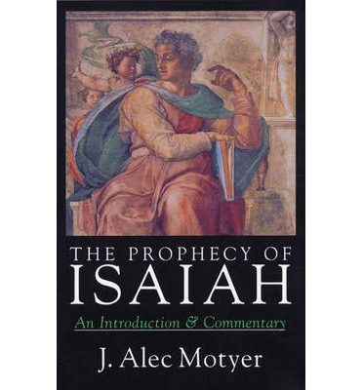
Motyer, J. Alec. The Prophecy of Isaiah: An Introduction & Commentary. InterVarsity, 1993.

Slide 9
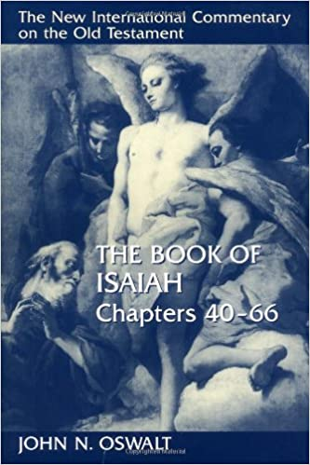
Oswalt, John N. The Book of Isaiah. 2 volumes. NICOT. Eerdmans, 1986, 1998.

Slide 10
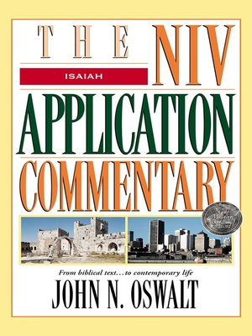
Oswalt, John N. The Book of Isaiah. NIVAC. Zondervan, 2003.

Slide 11
Isaiah 40:1-11
Unstoppable

Slide 12



Slide 13


Slide 14
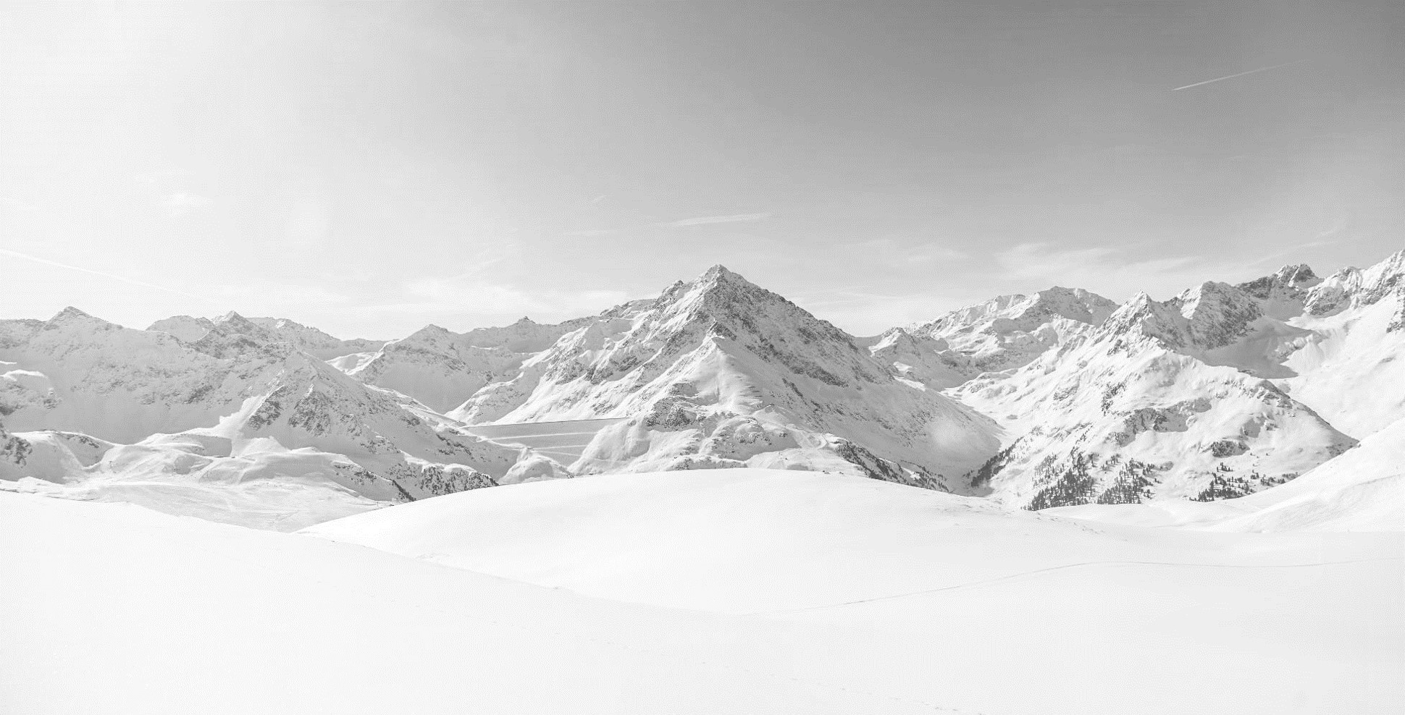


Slide 15


Slide 16
1 Comfort, comfort my people, says your God.
2 Speak tenderly to Jerusalem,
and cry to her
that her warfare is ended,
that her iniquity is pardoned,
that she has received from the LORD’s hand
double for all her sins.
(Isaiah 40:1-2, ESV)

Slide 17
3 A voice cries:
“In the wilderness prepare the way of the LORD;
make straight in the desert a highway for our God.
4 Every valley shall be lifted up,
and every mountain and hill be made low;
the uneven ground shall become level,
and the rough places a plain.
5 And the glory of the LORD shall be revealed,
and all flesh shall see it together,
for the mouth of the LORD has spoken.”
(Isaiah 40:3-5, ESV)

Slide 18
9 Go on up to a high mountain,
O Zion, herald of good news;
lift up your voice with strength,
O Jerusalem, herald of good news;
lift it up, fear not;
say to the cities of Judah,
“Behold your God!”
10 Behold, the Lord GOD comes with might,
and his arm rules for him;
behold, his reward is with him,
and his recompense before him.
11 He will tend his flock like a shepherd;
he will gather the lambs in his arms;
he will carry them in his bosom,
and gently lead those that are with young.
(Isaiah 40:9-11, ESV)

Slide 19
Main Point
The main point of these verses are to establish the mercy and grace of God given to His people
God will defeat their enemies and provide comfort
He is the mighty warrior, but also the gentle shepherd

Slide 20
Application Points
Unstoppable
  God is beyond all others
  There is none like Him, none that can compare
  Our God is unstoppable
  A Word was given to the people which would speak judgment for their wickedness
  God was unstoppable then
  The Word was fulfilled according to the righteousness of God Almighty
  The same is true now
  God is for His people and will be for them
  Their enemies, in the end, will not be the ones who conquer
  All must be held accountable to God

Slide 21
Application Points
Unstoppable (2)
  He will lead His captive people home again
  His Word…will lead to peace for His people
  Isaiah has been told to declare a very real Gospel
  The very reality of God having conquered sin and death through Jesus Christ
  All flesh is able to see the glory of God, for all people can experience the great redemption
  We are to see the glory which had been promised of old
  Through the wilderness would come our redemption
  Our Savior died
  He walked the wilderness, yet it was through the wilderness that came life and salvation
  John the Baptist proclaimed with a loud voice the Lord is coming
  We are outside of the shadows but still live in the shadow land
  We see it around us day by day
  Yet we know the hope, for we have a living hope in Christ
  We can be like the prophet who is told to proclaim, “Behold God!”
  We can know that the Word of the Lord is our assurance for it is from the Word life would come, and it has come

Slide 22
Application Points
Unstoppable (3)
  It is only int eh Word we can find truth
  Let us not be distracted by the world, or even fall into he same patterns and beliefs of the world
  Instead, believe the truth of the Word given
  Our God has told us something
  The world may seek to stop Him, the truth is it cant!
  We can’t stop Him either
  Let’s, then, be faithful to join Him
  Knowing that His Word, His promises, His power, His wisdom, His knowledge, His grace, His mercy, and His love are unstoppable
  He is unstoppable

Slide 23
Application Points
The Gospel of Christ
  Origins
    Where we began
  Fall
    What went wrong
  Redemption
    How it is fixed
  Glorification
    Where it at leads

