Slide 1
Isaiah 36:1-37:7
Overcoming

Slide 2
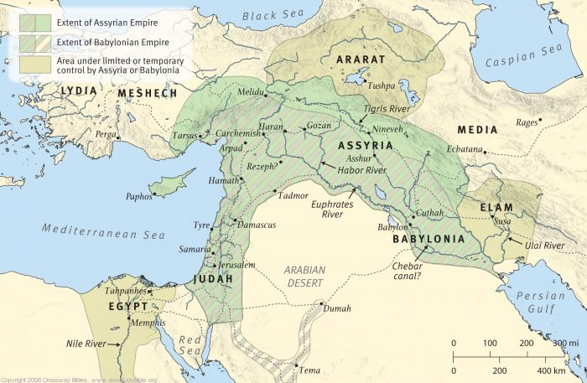

Slide 3
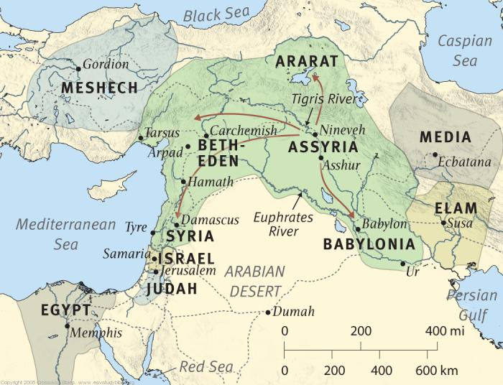

Slide 4
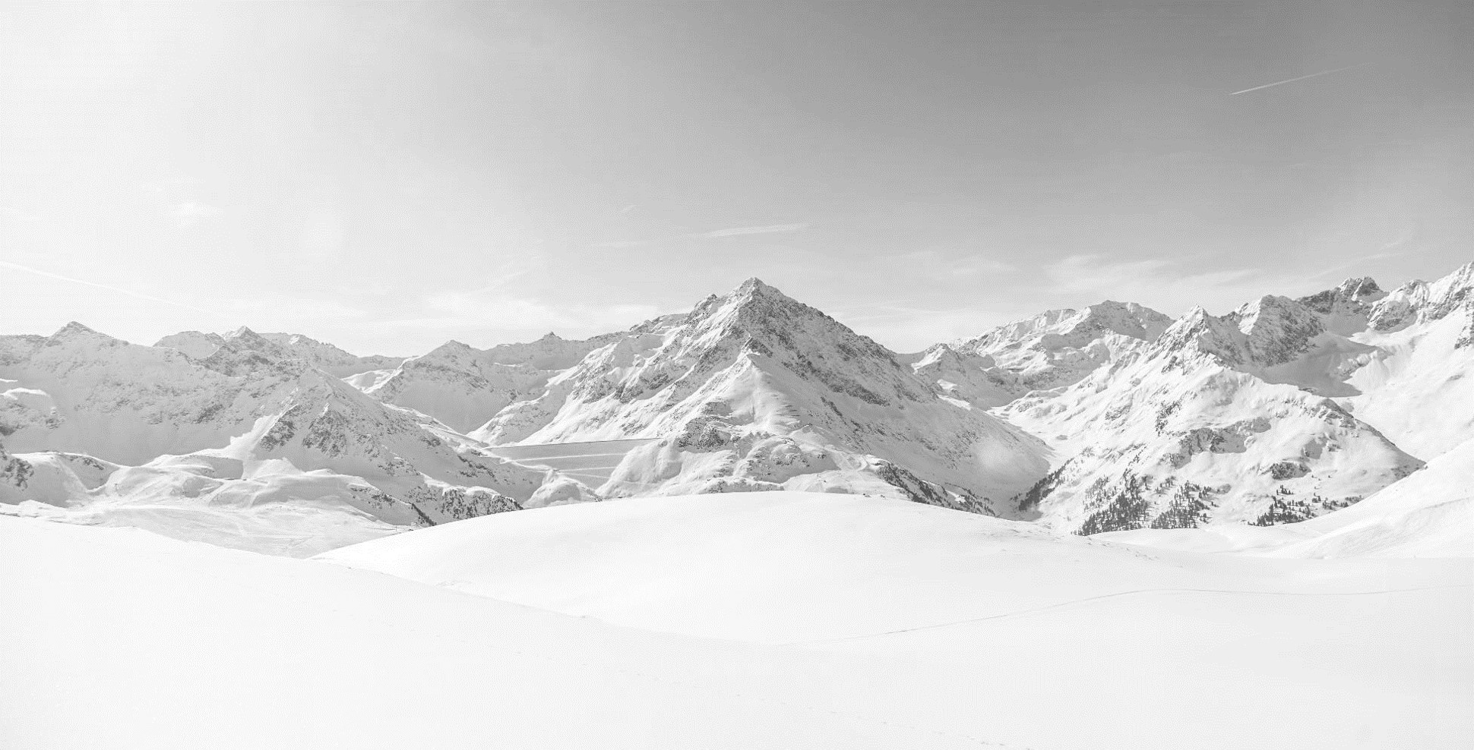


Slide 5

1 In the fourteenth year of King Hezekiah, Sennacherib king of Assyria came up against all the fortified cities of Judah and took them. 2 And the king of Assyria sent the Rabshakeh from Lachish to King Hezekiah at Jerusalem, with a great army. And he stood by the conduit of the upper pool on the highway to the Washer’s Field. 3 And there came out to him Eliakim the son of Hilkiah, who was over the household, and Shebna the secretary, and Joah the son of Asaph, the recorder.
(Isaiah 36:1-3, ESV)

Slide 6
4 And the Rabshakeh said to them, “Say to Hezekiah, ‘Thus says the great king, the king of Assyria: On what do you rest this trust of yours? 5 Do you think that mere words are strategy and power for war? In whom do you now trust, that you have rebelled against me? 6 Behold, you are trusting in Egypt, that broken reed of a staff, which will pierce the hand of any man who leans on it. Such is Pharaoh king of Egypt to all who trust in him. 7 But if you say to me, “We trust in the LORD our God,” is it not he whose high places and altars Hezekiah has removed, saying to Judah and to Jerusalem, “You shall worship before this altar”? 8 Come now, make a wager with my master the king of Assyria: I will give you two thousand horses, if you are able on your part to set riders on them. 9 How then can you repulse a single captain among the least of my master’s servants, when you trust in Egypt for chariots and for horsemen? 10 Moreover, is it without the LORD that I have come up against this land to destroy it? The LORD said to me, “Go up against this land and destroy it.”’
(Isaiah 36:4-10, ESV)

Slide 7
11 Then Eliakim, Shebna, and Joah said to the Rabshakeh, “Please speak to your servants in Aramaic, for we understand it. Do not speak to us in the language of Judah within the hearing of the people who are on the wall.” 12 But the Rabshakeh said, “Has my master sent me to speak these words to your master and to you, and not to the men sitting on the wall, who are doomed with you to eat their own dung and drink their own urine?”
(Isaiah 36:11-12, ESV)

Slide 8
13 Then the Rabshakeh stood and called out in a loud voice in the language of Judah: “Hear the words of the great king, the king of Assyria! 14 Thus says the king: ‘Do not let Hezekiah deceive you, for he will not be able to deliver you. 15 Do not let Hezekiah make you trust in the LORD by saying, “The LORD will surely deliver us. This city will not be given into the hand of the king of Assyria.” 16 Do not listen to Hezekiah. For thus says the king of Assyria: Make your peace with me and come out to me. Then each one of you will eat of his own vine, and each one of his own fig tree, and each one of you will drink the water of his own cistern, 17 until I come and take you away to a land like your own land, a land of grain and wine, a land of bread and vineyards. 18 Beware lest Hezekiah mislead you by saying, “The LORD will deliver us.” Has any of the gods of the nations delivered his land out of the hand of the king of Assyria? 19 Where are the gods of Hamath and Arpad? Where are the gods of Sepharvaim? Have they delivered Samaria out of my hand? 20 Who among all the gods of these lands have delivered their lands out of my hand, that the LORD should deliver Jerusalem out of my hand?’”
(Isaiah 36:13-20, ESV)

Slide 9
21 But they were silent and answered him not a word, for the king’s command was, “Do not answer him.” 22 Then Eliakim the son of Hilkiah, who was over the household, and Shebna the secretary, and Joah the son of Asaph, the recorder, came to Hezekiah with their clothes torn, and told him the words of the Rabshakeh.
(Isaiah 36:21-22, ESV)

Slide 10
37:1 As soon as King Hezekiah heard it, he tore his clothes and covered himself with sackcloth and went into the house of the LORD. 2 And he sent Eliakim, who was over the household, and Shebna the secretary, and the senior priests, covered with sackcloth, to the prophet Isaiah the son of Amoz. 3 They said to him, “Thus says Hezekiah, ‘This day is a day of distress, of rebuke, and of disgrace; children have come to the point of birth, and there is no strength to bring them forth. 4 It may be that the LORD your God will hear the words of the Rabshakeh, whom his master the king of Assyria has sent to mock the living God, and will rebuke the words that the LORD your God has heard; therefore lift up your prayer for the remnant that is left.’”
(Isaiah 37:1-4, ESV)

Slide 11
5 When the servants of King Hezekiah came to Isaiah, 6 Isaiah said to them, “Say to your master, ‘Thus says the LORD: Do not be afraid because of the words that you have heard, with which the young men of the king of Assyria have reviled me. 7 Behold, I will put a spirit in him, so that he shall hear a rumor and return to his own land, and I will make him fall by the sword in his own land.’”
(Isaiah 37:5-7, ESV)

Slide 12
Main Point
These show the historical event which occurred with the Assyrians
The advisor for Sennacherib speaks with honey mixed with acid
He encourages the people to reject Hezekiah
A fearful and mourning Hezekiah asks Isaiah to intercede, while God gives a word declaring the victory already won

Slide 13
Application Points
Prescription and Description
  It seems a good idea to talk about the difference between prescriptive texts and descriptive texts
  Oftentimes, individual try to justify actions because they occurred in the Bible
  All because something happens in the Bible doesn’t mean that what they did is warranted, or good
  The Bible has different genres
  Sometimes the Scriptures give us an account of what happened
  It is Describing the events that took place…it is a Descriptive text

Slide 14
Application Points
Prescription and Description (2)
  Other times there are prescriptive texts
  Jesus says, “Love the Lord your God with all of you heart, mind, soul, and Strength” and “Love your neighbor as yourself”
  These are prescriptive in that they should be followed
  Much of the Law, the prophets, the New Testament writings are of this sort

Slide 15
Application Points
Prescription and Description (3)
  This does not mean that there is no purpose to descriptive texts
  We learn what they did wrong and seek to not do the same
  We learn what they did right and seek to emulate the good
  It is in knowing all the Scriptures, however, that helps us determine what we are to learn from the descriptive texts
  When someone tells you someone did something in the Bible therefore it is justified…remember that is not necessarily the case
  The Bible has descriptions of events which we can learn from and understand considering the prescriptive texts

Slide 16
Application Points
How to Overcome
  Today we see an event that took place in the past
  Assyria has conquered the majority of the region
  Sieges were/are horrific
  As the onslaught continues there becomes an increased recognition hat death is imminent
  This is what the people were facing
  Do they take the Assyrians at their word?
  They are mocked, God is mocked, and there seems little hope

Slide 17
Application Points
How to Overcome (2)
  In our times we can often feel as though we are under siege
  The Biblical doctrines we hold dear, that God exists, He created humanity as male and female to bear His image, we are guilty because of our sins, we attain salvation by grace through faith in Christ, that this causes a transformation, that we will attain eternal life…are all being discarded
  The world is becoming increasingly hostile to the Christian faith because it is particular
  This will not do in a world of pluralism in which all beliefs are equally true

Slide 18
Application Points
How to Overcome (3)
  If we proclaim the truth as we know it, we are branded
  We this occurring in Canada right now
  Never mind that the pluralists are oppressing other for not holding their particular view
  Never mind that to be logically consistent each worldview and each faith by definition will have contradictions with each other

Slide 19
Application Points
How to Overcome (4)
  In the end, it doesn’t change the fact that though we have our own weapons of reason and truth…we still find ourselves in a hostile environment
  We aren't barricading our Churches…but we are engaged in warfare
  How do we stand against such power?
  For though we may tear our clothes and mourn what is happening…we can also withstand the onslaught by remembering there is only One God
  Our hope is not in ourselves, our power, but in Him

Slide 20
Application Points
How to Overcome (5)
  Isaiah was sure that God would do all He set out to do
  God is capable of bringing good out of evil, and that He has conquered evil, conquered death, through His Son Jesus Christ
  Though this world seems to be falling apart, and though we may have fearful moments…let us not lose hope
  The onslaught is for a while
  Even if we should suffer persecutions, spiritual or physical, we believe, we know, God will one day rise up
  How do we survive the onslaught? By seeking God as our shelter
  How do we overcome?
  By remembering God is our strength

Slide 21
Application Points
The Gospel of Christ
  Origins
    Where we began
  Fall
    What went wrong
  Redemption
    How it is fixed
  Glorification
    Where it at leads

