Slide 1
Isaiah 40:12-31
Maximally Great

Slide 2



Slide 3


Slide 4
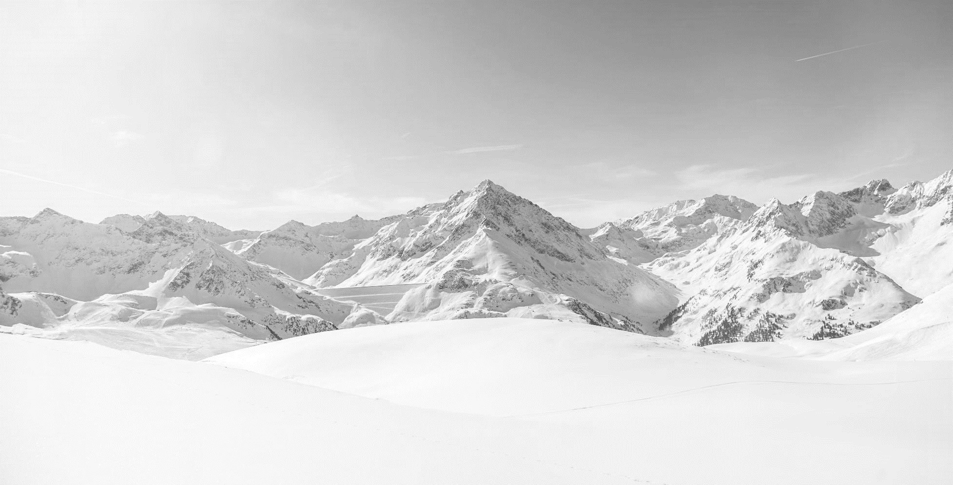


Slide 5


Slide 6
12 Who has measured the waters in the hollow of his hand
and marked off the heavens with a span,
enclosed the dust of the earth in a measure
and weighed the mountains in scales
and the hills in a balance?
13 Who has measured the Spirit of the LORD,
or what man shows him his counsel?
14 Whom did he consult,
and who made him understand?
Who taught him the path of justice,
and taught him knowledge,
and showed him the way of understanding?
15 Behold, the nations are like a drop from a bucket,
and are accounted as the dust on the scales;
behold, he takes up the coastlands like fine dust.
16 Lebanon would not suffice for fuel,
nor are its beasts enough for a burnt offering.
17 All the nations are as nothing before him,
they are accounted by him as less than nothing and emptiness.
18 To whom then will you liken God,
or what likeness compare with him?
19 An idol! A craftsman casts it,
and a goldsmith overlays it with gold
and casts for it silver chains.
20 He who is too impoverished for an offering
chooses wood that will not rot;
he seeks out a skillful craftsman
to set up an idol that will not move.
(Isaiah 40:12-20, ESV)

Slide 7
21 Do you not know? Do you not hear?
Has it not been told you from the beginning?
Have you not understood from the foundations of the earth?
22 It is he who sits above the circle of the earth,
and its inhabitants are like grasshoppers;
who stretches out the heavens like a curtain,
and spreads them like a tent to dwell in;
23 who brings princes to nothing,
and makes the rulers of the earth as emptiness.
24 Scarcely are they planted, scarcely sown,
scarcely has their stem taken root in the earth,
when he blows on them, and they wither,
and the tempest carries them off like stubble.
25 To whom then will you compare me,
that I should be like him? says the Holy One.
26 Lift up your eyes on high and see:
who created these?
He who brings out their host by number,
calling them all by name;
by the greatness of his might
and because he is strong in power,
not one is missing.
(Isaiah 40:21-26, ESV)

Slide 8
27 Why do you say, O Jacob,
and speak, O Israel,
“My way is hidden from the LORD,
and my right is disregarded by my God”?
28 Have you not known? Have you not heard?
The LORD is the everlasting God,
the Creator of the ends of the earth.
He does not faint or grow weary;
his understanding is unsearchable.
29 He gives power to the faint,
and to him who has no might he increases strength.
30 Even youths shall faint and be weary,
and young men shall fall exhausted;
31 but they who wait for the LORD shall renew their strength;
they shall mount up with wings like eagles;
they shall run and not be weary;
they shall walk and not faint.
(Isaiah 40:27-31, ESV)

Slide 9
Main Point
These verses reflect on the reality of God
He is superior to all others
Isaiah calls to the people and reminds them that the God who set the foundations of the world is their God
He is capable of providing and sustaining them no matter the circumstances

Slide 10
Application Points
Maximally Great
  If God does exist, then Isaiah is sure that He is the greatest conceivable being
  We see what that means for the people in Isaiah’s time as well as for ourselves
  We can be limited in our understanding of who God is
  The gods often reflected the people who worshipped them
  They were great with their perceived power
  We often find they were not the greatest conceivable beings
  They were often morally suspect, they were only powerful insofar as each other

Slide 11
Application Points
Maximally Great (2)
  It is no surprise that the Greek philosophers (Plato and Aristotle) were critical of the gods
  There must be something greater than the gods
  Aristotle was close, as was Plato
  Yet they were not able to come to the knowledge given to the prophets
  The prophets give us both reason and experience
  Isaiah has proclaimed this very thing
  He described a Being who was the first Cause and brought all things into existence
  It was from this Being that all else came into being
  He knows all the stars by name…He knows all things

Slide 12
Application Points
Maximally Great (3)
  There is a such a Being as this
  Whatever idols we make with our hands will be insufficient for His majesty
  Not only is it absurd to attempt to create such an image
  He has already created such an image to show His existence
  The word for “likeness” is the same as Genesis 1:26, “Then God said, “Let us make man in our image, after our likeness. And let them have dominion over the fish of the sea over the birds of the heavens and over the livestock and over all the earth and over every creeping thing that creeps on the earth.”

Slide 13
Application Points
Maximally Great (4)
  To make idols is an abomination for two reasons
  The first is the idols are dead and have no life
  The second is God has already made His likeness…in humanity
  Who could create such persons as we are?
  Would not the greatest conceivable Being, this being who is maximally great, need to be a Being who had personhood?
  Such a Being exists, such a Being with personhood exists…our God
  He is the One whom we can compare to, and find ourselves terribly lacking when His majesty and might is revealed against our stains and weakness

Slide 14
Application Points
Maximally Great (5)
  This is the very God who has revealed Himself to us
  He has promised to give us His strength and power so that we can overcome and find peace
  It is possible for us to reach it, not because we are so powerful and great, but because He is
  He has accomplished giving us strength and power and knowledge and wisdom through Christ and His Spirit
  The God of the Bible is not some petty deity
  He is a God unlike any other
  He is worthy of all praise
  Let us join with Isaiah in recognizing the greatness of our God
  He is the personal and living God who is the greatest of all beings
  None can compare with our maximally great God

Slide 15
Application Points
The Gospel of Christ
  Origins
    Where we began
  Fall
    What went wrong
  Redemption
    How it is fixed
  Glorification
    Where it at leads

