Slide 1
Isaiah 41:1-20
The Only Redeemer

Slide 2



Slide 3


Slide 4
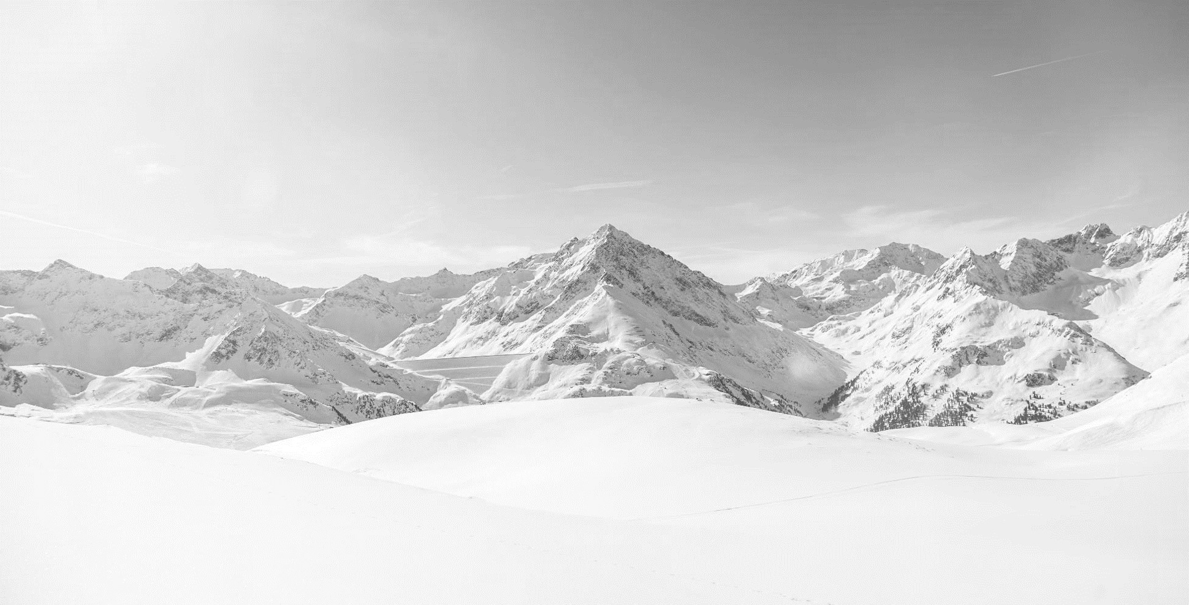


Slide 5


Slide 6
1 Listen to me in silence, O coastlands;
let the peoples renew their strength;
let them approach, then let them speak;
let us together draw near for judgment.
2 Who stirred up one from the east
whom victory meets at every step?
He gives up nations before him,
so that he tramples kings underfoot;
he makes them like dust with his sword,
like driven stubble with his bow.
3 He pursues them and passes on safely,
by paths his feet have not trod.
4 Who has performed and done this,
calling the generations from the beginning?
I, the LORD, the first,
and with the last; I am he.
5 The coastlands have seen and are afraid;
the ends of the earth tremble;
they have drawn near and come.
6 Everyone helps his neighbor
and says to his brother, “Be strong!”
7 The craftsman strengthens the goldsmith,
and he who smooths with the hammer him who strikes the anvil,
saying of the soldering, “It is good”;
and they strengthen it with nails so that it cannot be moved.
(Isaiah 41:1-7 ESV)

Slide 7
8 But you, Israel, my servant,
Jacob, whom I have chosen,
the offspring of Abraham, my friend;
9 you whom I took from the ends of the earth,
and called from its farthest corners,
saying to you, “You are my servant,
I have chosen you and not cast you off”;
10 fear not, for I am with you;
be not dismayed, for I am your God;
I will strengthen you, I will help you,
I will uphold you with my righteous right hand.
11 Behold, all who are incensed against you
shall be put to shame and confounded;
those who strive against you
shall be as nothing and shall perish.
12 You shall seek those who contend with you,
but you shall not find them;
those who war against you
shall be as nothing at all.
13 For I, the LORD your God,
hold your right hand;
it is I who say to you, “Fear not,
I am the one who helps you.”
14 Fear not, you worm Jacob,
you men of Israel!
I am the one who helps you, declares the LORD;
your Redeemer is the Holy One of Israel.
15 Behold, I make of you a threshing sledge,
new, sharp, and having teeth;
you shall thresh the mountains and crush them,
and you shall make the hills like chaff;
16 you shall winnow them, and the wind shall carry them away,
and the tempest shall scatter them.
And you shall rejoice in the LORD;
in the Holy One of Israel you shall glory.
(Isaiah 41:8-16 ESV)

Slide 8
17 When the poor and needy seek water,
and there is none,
and their tongue is parched with thirst,
I the LORD will answer them;
I the God of Israel will not forsake them.
18 I will open rivers on the bare heights,
and fountains in the midst of the valleys.
I will make the wilderness a pool of water,
and the dry land springs of water.
19 I will put in the wilderness the cedar,
the acacia, the myrtle, and the olive.
I will set in the desert the cypress,
the plane and the pine together,
20 that they may see and know,
may consider and understand together,
that the hand of the LORD has done this,
the Holy One of Israel has created it.
(Isaiah 41:17-20, ESV)

Slide 9
Main Point
These verses describe God’s activity in redeeming His people
Those who belong to Him will find redemption
The purpose of this is that God’s people will know Him as their God

Slide 10
Application Points
The Only Redeemer
  This text has shown us the reality of God
  If God does not exist, then the worry that comes…is of little concern
  If God does exist then such fear is a very logical thing
  To be holy is to be different, separate, other
  We know God does exist
  The prophetic statement has been delivered and paid in the person of Jesus Christ
  We also acknowledge we live in a world where there is incredible doubt
  We see this all the time with different ideologies, sexuality, or even gender

Slide 11
Application Points
The Only Redeemer (2)
  Humanity is not so different than the time of Isaiah
  Just as it was for the people in the past…they created gods for themselves…creating a whole reality for themselves
  This is the default position
  Has this been successful?
  Instead, we see an increase of violence and oppression
  The things God promised to save us from are the things which many people seem to want to run into
  They make false claims about reality in the process
  How can we overcome the constant barrage?
  How do we withstand the constant pressure to bend the knee?

Slide 12
Application Points
The Only Redeemer (3)
  The answer has been mentioned already
  By God we can withstand the subjectivism of our day
  We can know and understand reality because it has been created by this incredible God
  It is not our own strength which his capable of withstanding, but the power of God in us
  He has not only promised this, but has delivered His promise in full through Christ
  Christ is the perfect one
  It leads to life, it leads to redemption, it leads to goodness, it leads to total truth over all of reality
  God has given to the poor and needy that which is necessary for life
  The life He has given through Christ is one which encompasses all things

Slide 13
Application Points
The Only Redeemer (4)
  We were once in the wilderness
  He has fulfilled His promise to provide for a people like us
  He has become our Redeemer, He has become our Sustainer
  Be encouraged to not fall sway to the darkness of the world
  Turn toward the Light of Christ, and know that all the questions will be given answers, all the hardships will be given meaning, all your life will be given purpose in Him
  There is no other redemption apart from God
  He is our only Redemeer.

Slide 14
Application Points
The Gospel of Christ
  Origins
    Where we began
  Fall
    What went wrong
  Redemption
    How it is fixed
  Glorification
    Where it at leads

