Slide 1
Isaiah 42:10-43:7
Through Water and Flame

Slide 2



Slide 3


Slide 4

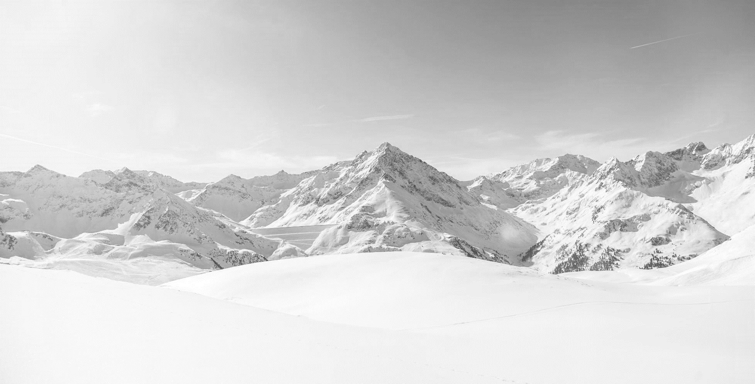

Slide 5


Slide 6
10 Sing to the LORD a new song,
his praise from the end of the earth,
you who go down to the sea, and all that fills it,
the coastlands and their inhabitants.
11 Let the desert and its cities lift up their voice,
the villages that Kedar inhabits;
let the habitants of Sela sing for joy,
let them shout from the top of the mountains.
12 Let them give glory to the LORD,
and declare his praise in the coastlands.
13 The LORD goes out like a mighty man,
like a man of war he stirs up his zeal;
he cries out, he shouts aloud,
he shows himself mighty against his foes.
14 For a long time I have held my peace;
I have kept still and restrained myself;
now I will cry out like a woman in labor;
I will gasp and pant.
15 I will lay waste mountains and hills,
and dry up all their vegetation;
I will turn the rivers into islands,
and dry up the pools.
16 And I will lead the blind
in a way that they do not know,
in paths that they have not known
I will guide them.
I will turn the darkness before them into light,
the rough places into level ground.
These are the things I do,
and I do not forsake them.
17 They are turned back and utterly put to shame,
who trust in carved idols,
who say to metal images,
“You are our gods.”
(Isaiah 42:10-17, ESV)

Slide 7
18 Hear, you deaf,
and look, you blind, that you may see!
19 Who is blind but my servant,
or deaf as my messenger whom I send?
Who is blind as my dedicated one,
or blind as the servant of the LORD?
20 He sees many things, but does not observe them;
his ears are open, but he does not hear.
21 The LORD was pleased, for his righteousness’ sake,
to magnify his law and make it glorious.
22 But this is a people plundered and looted;
they are all of them trapped in holes
and hidden in prisons;
they have become plunder with none to rescue,
spoil with none to say, “Restore!”
23 Who among you will give ear to this,
will attend and listen for the time to come?
24 Who gave up Jacob to the looter,
and Israel to the plunderers?
Was it not the LORD, against whom we have sinned,
in whose ways they would not walk,
and whose law they would not obey?
25 So he poured on him the heat of his anger
and the might of battle;
it set him on fire all around, but he did not understand;
(Isaiah 42:18-25, ESV)

Slide 8
1 But now thus says the LORD,
he who created you, O Jacob,
he who formed you, O Israel:
“Fear not, for I have redeemed you;
I have called you by name, you are mine.
2 When you pass through the waters, I will be with you;
and through the rivers, they shall not overwhelm you;
when you walk through fire you shall not be burned,
and the flame shall not consume you.
3 For I am the LORD your God,
the Holy One of Israel, your Savior.
I give Egypt as your ransom,
Cush and Seba in exchange for you.
4 Because you are precious in my eyes,
and honored, and I love you,
I give men in return for you,
peoples in exchange for your life.
5 Fear not, for I am with you;
I will bring your offspring from the east,
and from the west I will gather you.
6 I will say to the north, Give up,
and to the south, Do not withhold;
bring my sons from afar
and my daughters from the end of the earth,
7 everyone who is called by my name,
whom I created for my glory,
whom I formed and made.”
(Isaiah 43:1-7, ESV)

Slide 9
Main Point
These verses describe a hymn of rejoicing over what God is about to do, a challenge, and the plan for restoration
While the Jewish people were the failed servant
Those within the Jewish community, the whole world, will be redeemed by God’s grace for His glory

Slide 10
Application Points
Through water and flame
  The devastation has generally come through their own faithlessness
  We are reminded of the failure to follow God and the consequences of such decisions
  The world is a dark place
  It is easy to see how it happens here and now
  There have been popular teachers and preachers in our time who preach a health and wealth gospel
  There is this kind of Santa Claus God who think about you above all else
  It is no surprise, then, that so many end up leaving the faith
  “How could God who loves me and wants to give me all that I desire do such a thing?”

Slide 11
Application Points
Through water and flame (2)
  The real question is whether the belief in God desiring only to give you what you want is true
  Though we may experience the water, and the flame, they will not win the day
  There is an expectation that things will not go right
  We live in a fallen world where terrible things occur
  What is guaranteed is not whatever we want
  What is guaranteed is that the darkness will not have the last laugh
  In the end the waters will recede, the flame will be quenched, and you will rise up on the final day

Slide 12
Application Points
Through water and flame (3)
  The answer is found throughout Isaiah
  One of the reasons for His supremacy is that He is the Living God
  This great and powerful God is the One Isaiah now describes
  He has called His people, shaped them, formed them, and loves them
  This is the great God we worship today
  His Spirit given to us so we could experience this very Person and His love for us
  This God has a personal relationship with His people
  Nothing can stop God from His people
  We are not deserving of any of this
  They were horrors
  We too were horrors in our own sin

Slide 13
Application Points
Through water and flame (4)
  God has done something marvelous
  We have every reason to not fear because He is with us
  The waters will rise on us
  The flame will surround us
  All creation will give up those who belong Him, and nothing no nation, no king, no power, not even death, will be able to keep those who are called by His Name
  What do we do should we face water and flame?
  We persevere through faith
  We know our God will lead us through water and flame into His glory

Slide 14
Application Points
The Gospel of Christ
  Origins
    Where we began
  Fall
    What went wrong
  Redemption
    How it is fixed
  Glorification
    Where it at leads

