Slide 1

to
South Gate Alliance
1436 James McKevitt Road SW
Southgatealliance.net

Slide 2
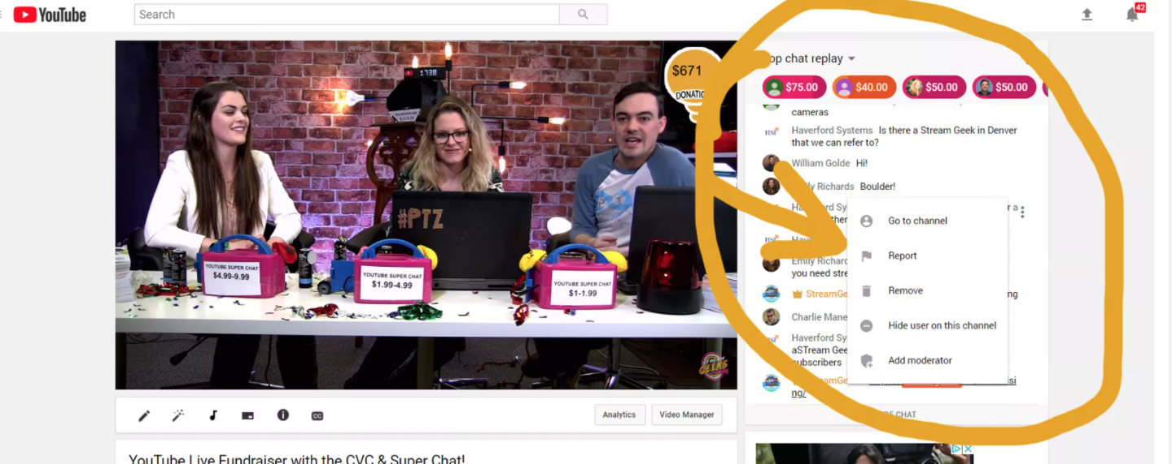
Live Chat now available on Sundays from 10:40 am – 11:40am

Slide 3
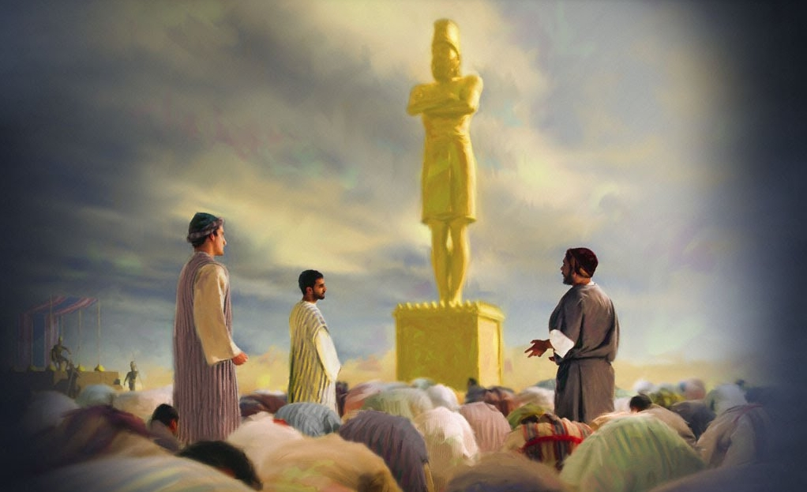
Taking a Stand for God!

Slide 4
Psalm 86:1-13
¹ Hear me, Lord, and answer me, for I am poor and needy. ² Guard my life, for I’m faithful to you; save your servant who trusts in you. You are my God;
³ have mercy on me, Lord, for I call to you all day long. ⁴ Bring joy to your servant, Lord, for I put my trust in you.
⁵ You, Lord, are forgiving and good, abounding in love to all who call to you. ⁶ Hear my prayer, Lord; listen to my cry for mercy. ⁷ When I’m in distress, I call to you, because you answer me.

Slide 5
Psalm 86:1-13
⁸ Among the gods there is none like you, Lord; no deeds can compare with yours. ⁹ All the nations you’ve made will come and worship before you, Lord; they’ll bring glory to your name. ¹⁰ For you are great and do marvelous deeds; you alone are God.
¹¹ Teach me your way, Lord, that I may rely on your faithfulness; give me an undivided heart, that I may fear your name. ¹² I will praise you, Lord my God, with all my heart; I will glorify your name forever. ¹³ For great is your love toward me; you’ve delivered me.

Slide 6

God, I worship you… You are…
Almighty God
Beautiful
Creator of the Universe
Deliverer
Eternal One
Emmanuel – God with us
Good, good Father
Holy
Healer
Immortal
Invisible
Jehovah Jireh (my provider)
King of Kings and Lord of Lords
Omniscient Omnipresent Omnipotent
Powerful
Prince of Peace
Protector
Redeemer
Rock
Savior
Sanctifier
Truth
Psalm 86:15:“But you, Lord, are a compassionate and gracious God,
slow to anger, abounding in love and faithfulness.”

Slide 7
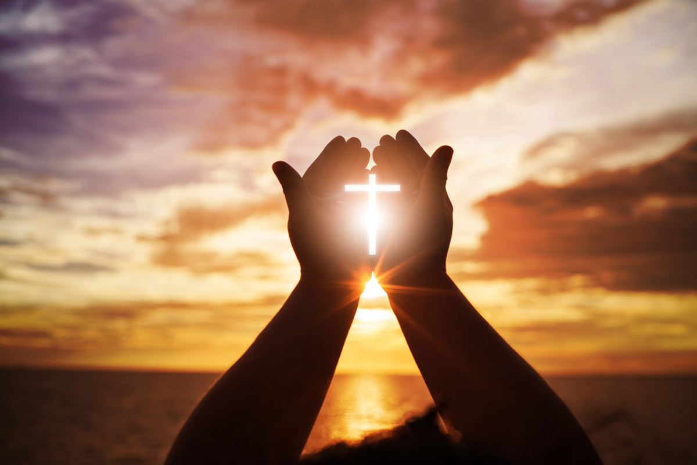
God, I need prayer for…

Slide 8
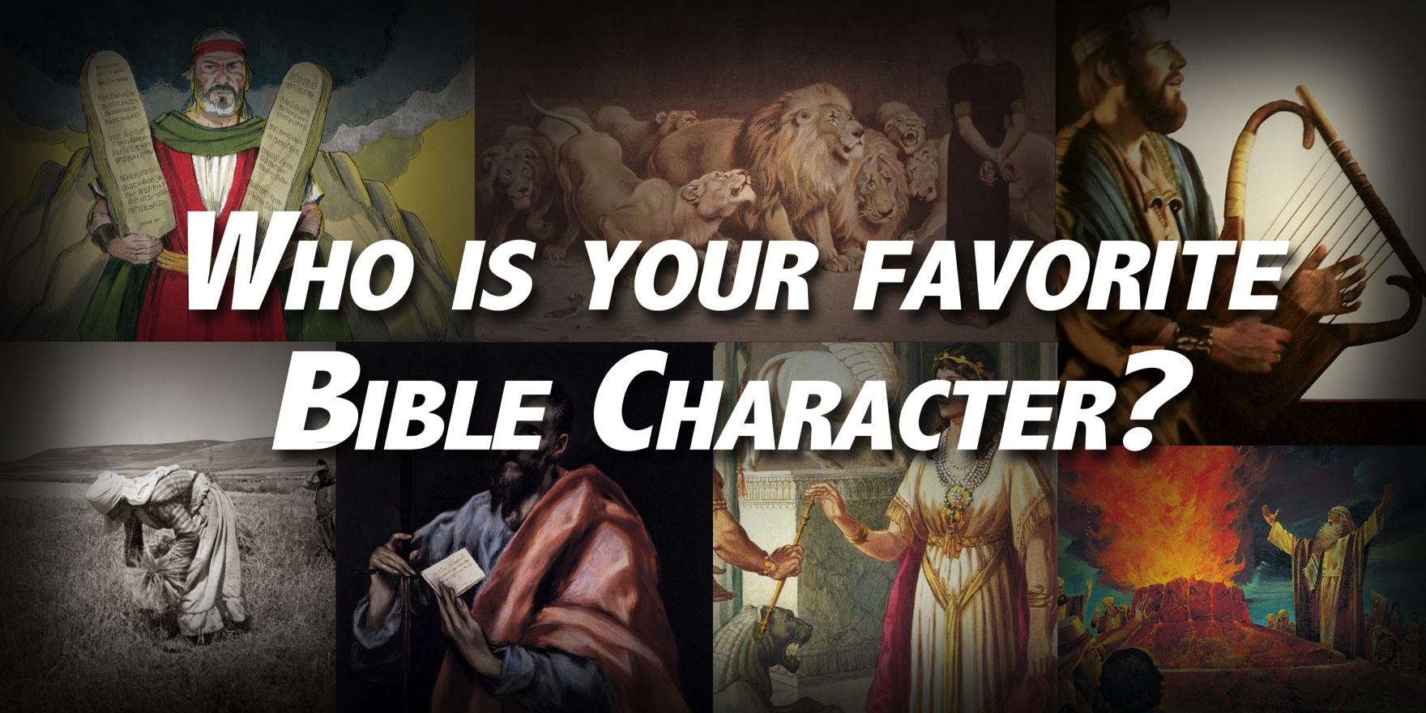

Slide 9
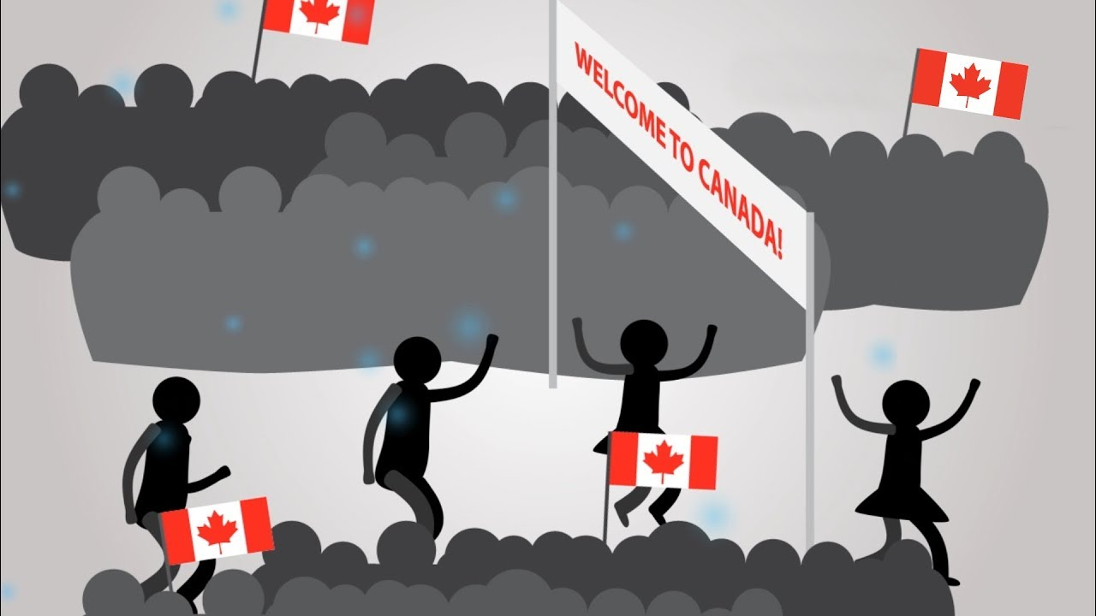

Slide 10
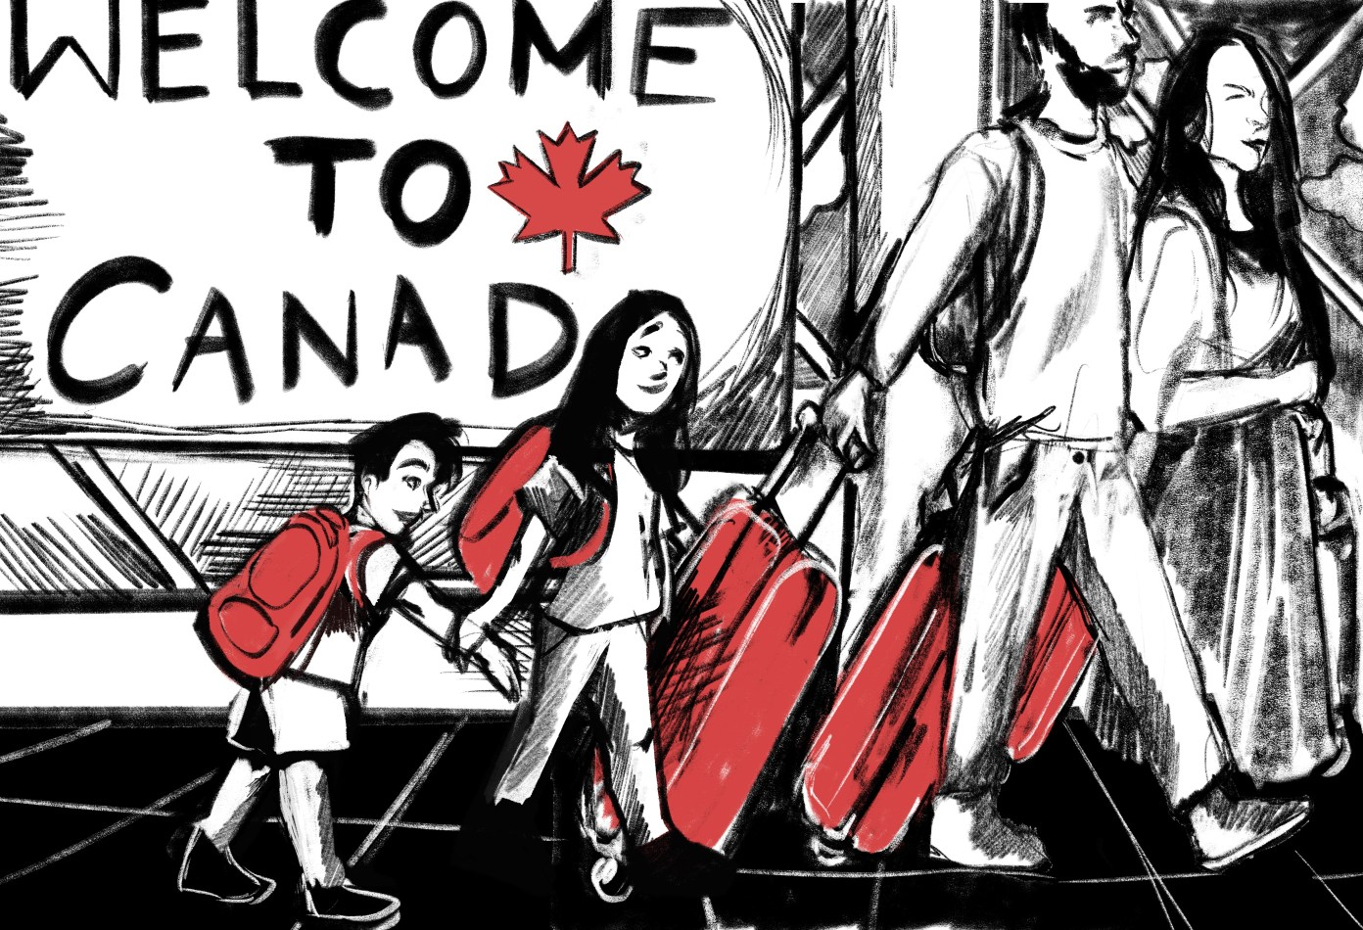

Slide 11
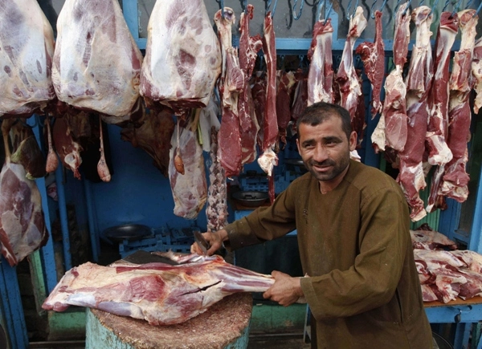
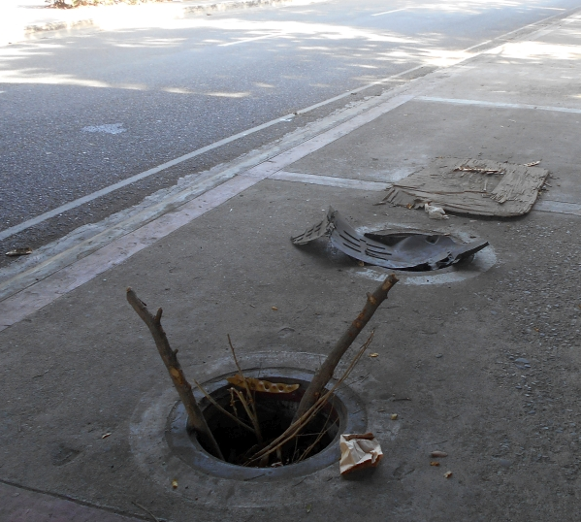
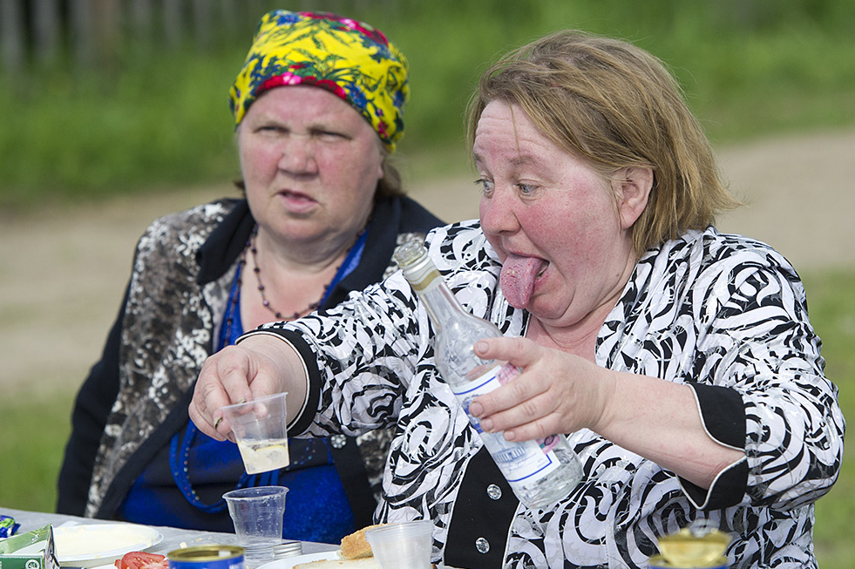
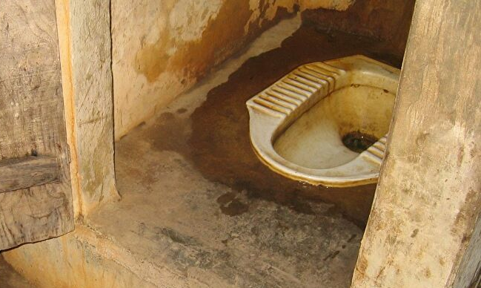

Slide 12
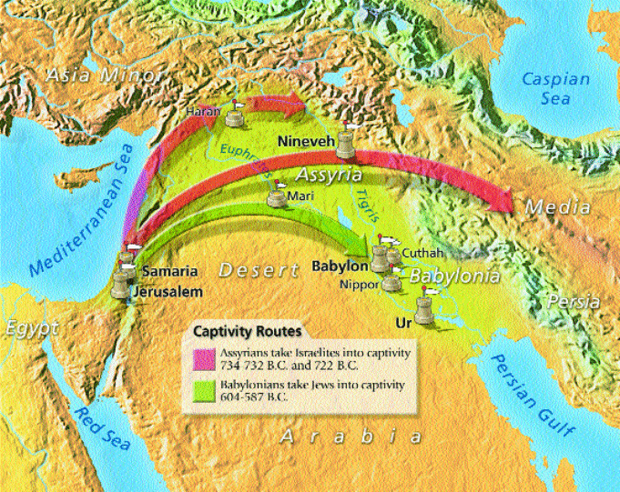

Slide 13



Slide 14

Don’t just try to blend in; STAND OUT!
1.1 Stand out in the way you treat your body

Slide 15
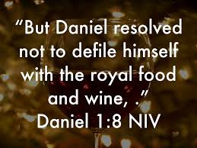
Don’t just try to blend in; STAND OUT!
1.1 Stand out in the way you treat your body
Some battles are won before you ever fight them.
Never underestimate the potential of one resolution
to change your life.

Slide 16

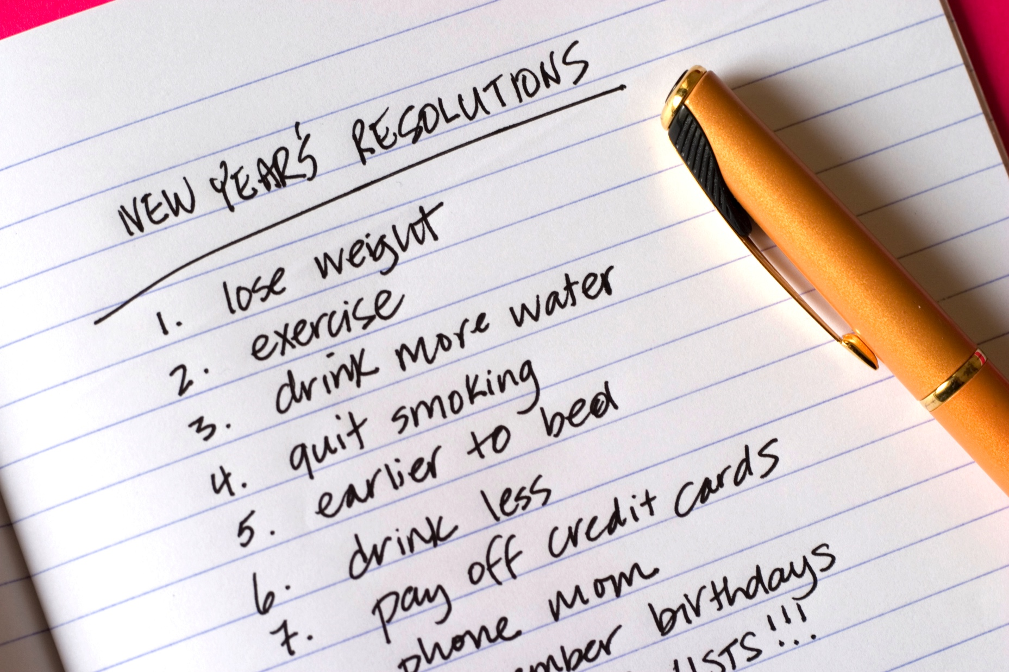

Slide 17
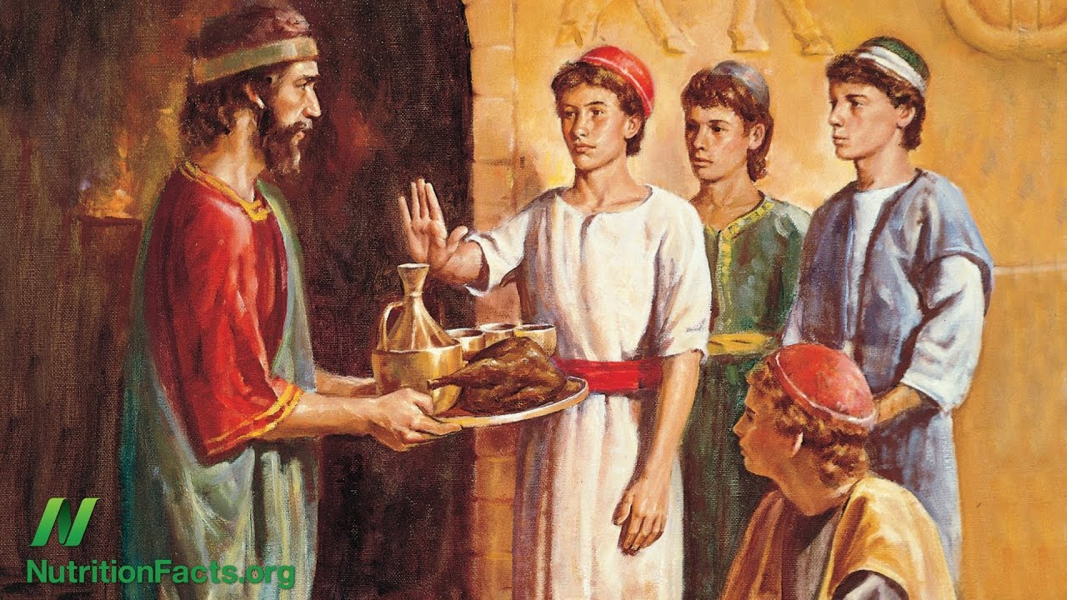

Slide 18

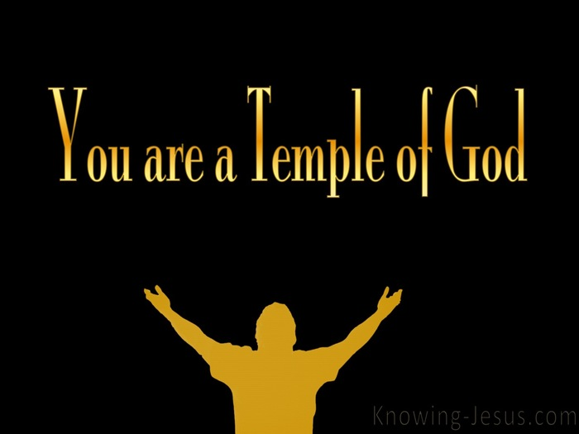

Slide 19


Don’t just try to blend in; STAND OUT!
1.2 Stand out in the way you study

Slide 20
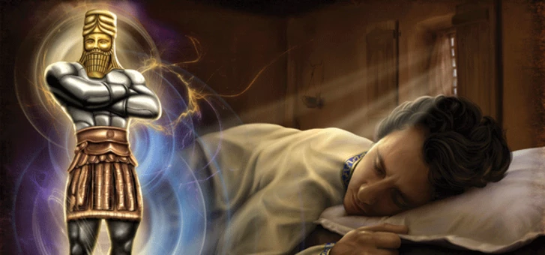
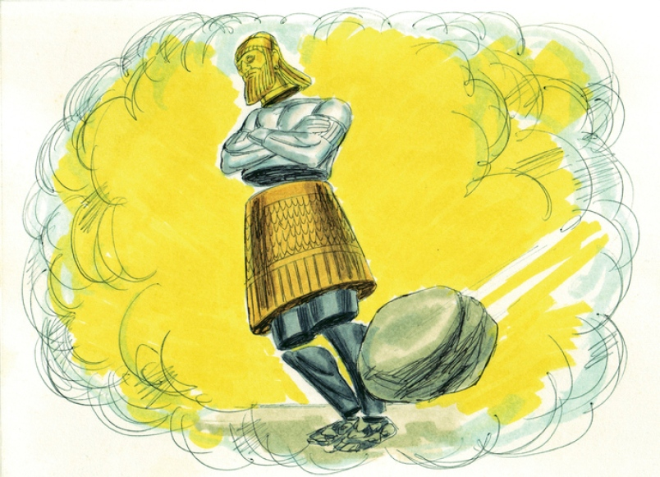
Don’t just try to blend in; STAND OUT!
1.3 Stand out in the way you pray!

Slide 21
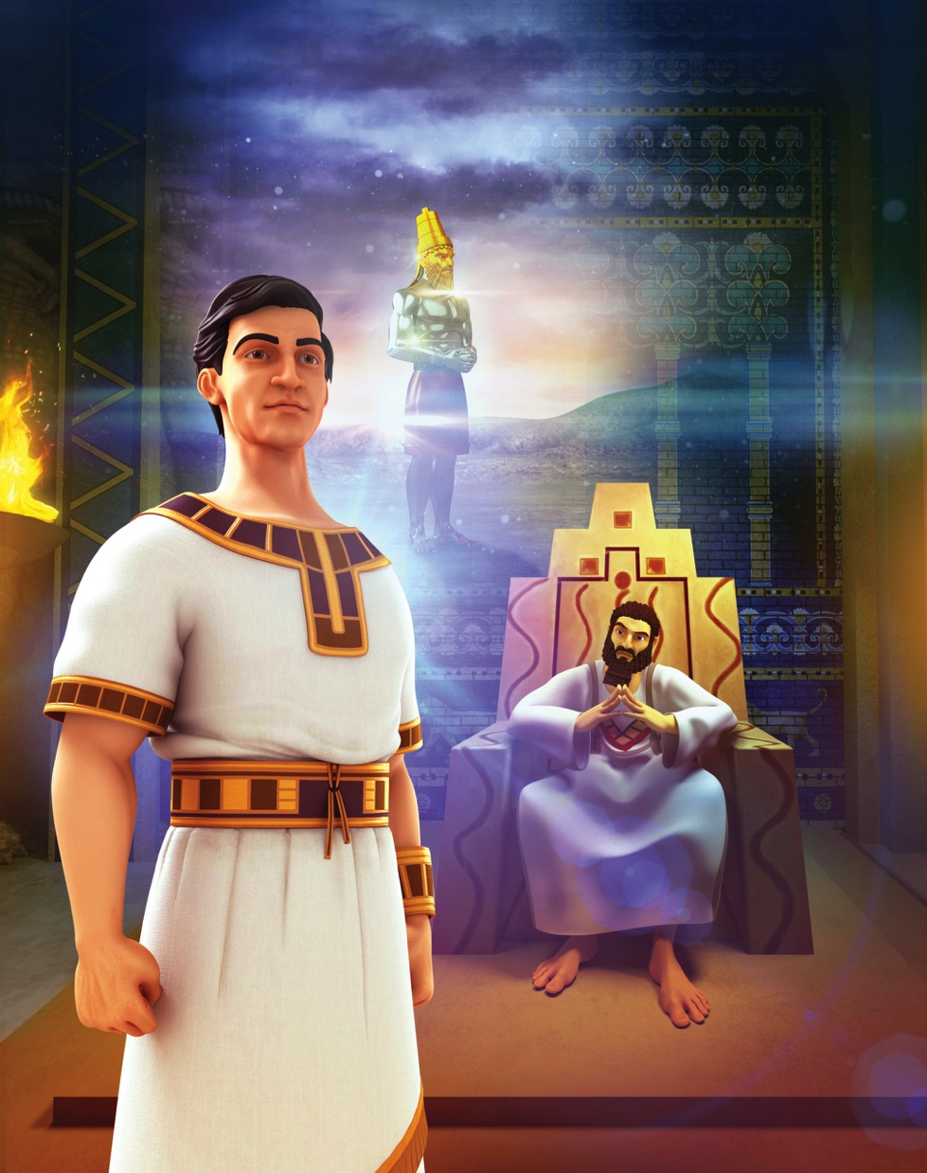
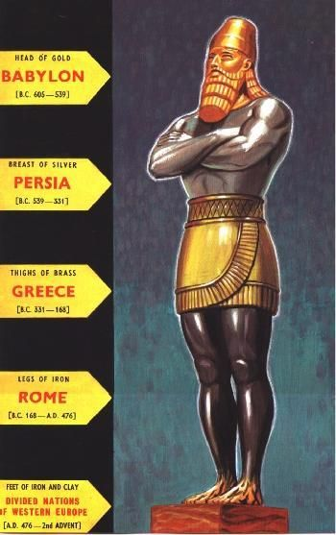
Don’t just try to blend in; STAND OUT!
1.3 Stand out in the way you pray!
“The king asked: are you able to tell me what I saw in my dream and interpret it? Daniel replied, “No wise man, enchanter, magician or diviner can explain to the king the mystery he’s asked about, but there’s a God in heaven who reveals mysteries.”
(2:26-27).

Slide 22
Don’t just try to blend in; STAND OUT!
1.3 Stand out in the way you pray!
The king said to Daniel, “Surely your God is the God of gods and the Lord of kings and a revealer of mysteries, for you were able to reveal this mystery. ⁴⁸ Then the king placed Daniel in a high position and lavished many gifts on him. He made him ruler over the entire province of Babylon and placed him in charge of all its wise men. Daniel 2:47-48
God honors those who honor him with their bodies, with their minds, and with their prayerful dependence on Him.

Slide 23
2. When the world bows down to idols, STAND UP!
Just because everybody else is doing something doesn’t make it right!
Just because something is legal doesn’t make it right.

Slide 24
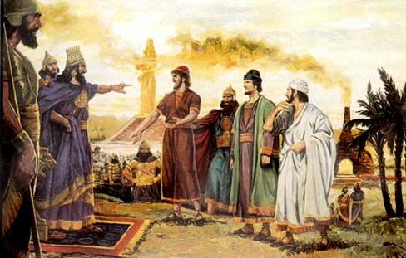
2. When the world bows down to idols, STAND UP!
3:15: “Then what god will be able to rescue you from my hand?”
“King Nebuchadnezzar, we don’t need to defend ourselves before you in this matter. ¹⁷ If we’re thrown into the blazing furnace, the God we serve is able to save us from it, and he will rescue us from your hand. ¹⁸ But even if he doesn’t, we want you to know, O king, that we won’t serve your gods or worship the image of gold you’ve set up.”
Daniel 3:6, 16-18

Slide 25
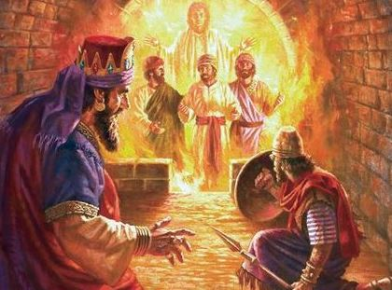
2. When the world bows down to idols, STAND UP!
“Wasn’t it three men that we tied up and threw into the fire? Look! I see four men walking around in the fire, unbound and unharmed, and the fourth looks like a son of the gods.” (3:25)

Slide 26
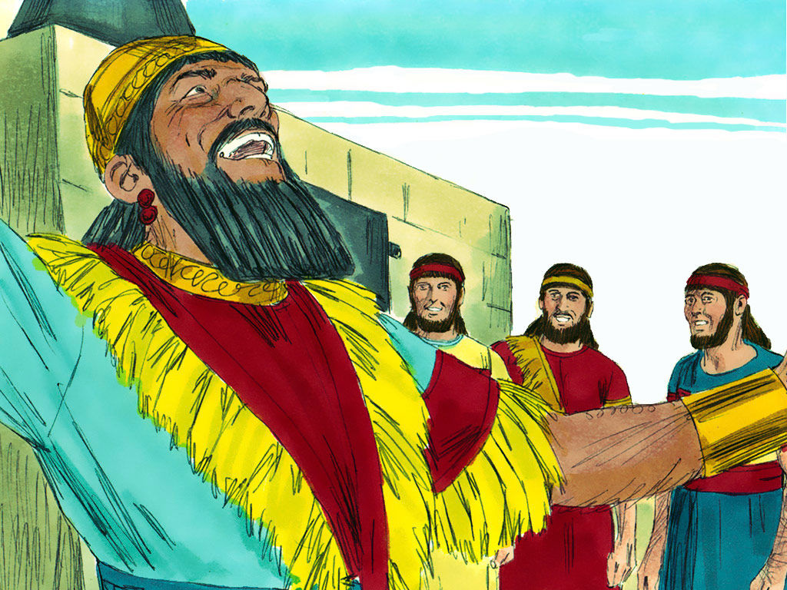
2. When the world bows down to idols, STAND UP!
“They trusted in him and defied the king’s command and were willing to give up their lives rather than serve or worship any god except their own.” (3:28)
God honored those who honored Him!

Slide 27
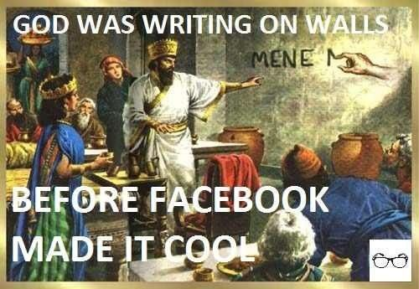
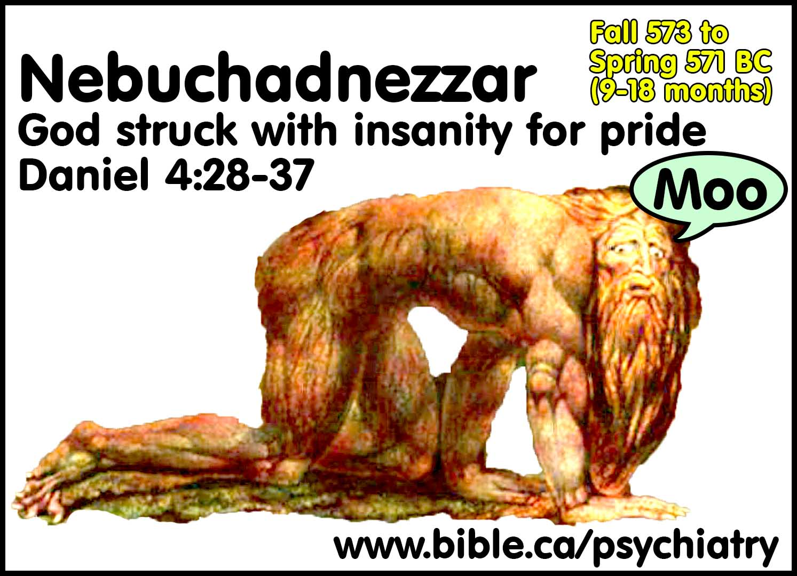
3. When the world pushes you down, STAND FIRM!
Daniel 4
Daniel 5

Slide 28
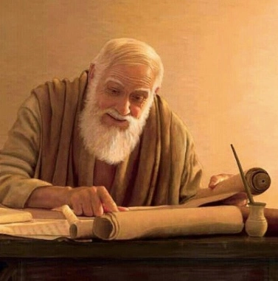
3. When the world pushes you down, STAND FIRM!
At this, the administrators and the satraps tried to find grounds for charges against Daniel in his conduct of government affairs, but they were unable to do so. They could find no corruption in him, because he was trustworthy and neither corrupt nor negligent. Daniel 6:4

Slide 29
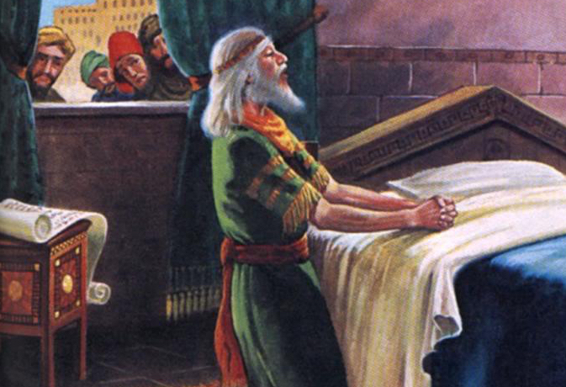
3. When the world pushes you down, STAND FIRM!

Slide 30
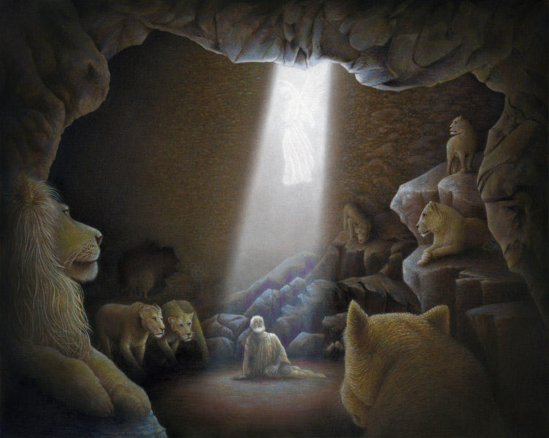
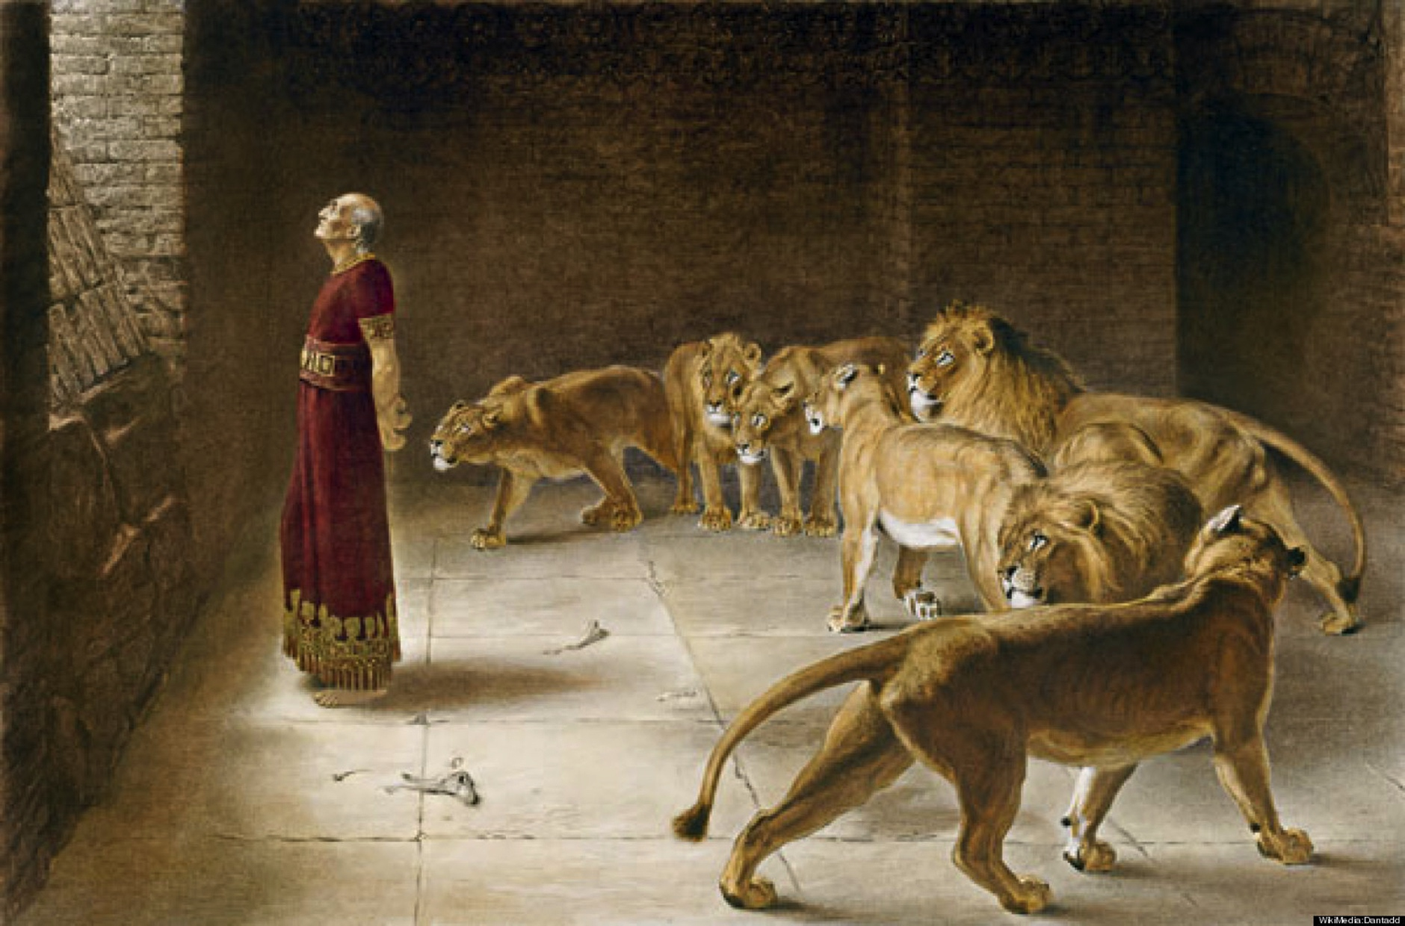
3. When the world pushes you down, STAND FIRM!
God didn’t save Daniel
from this trial;
God saved Daniel
through this trial.

Slide 31
3. When the world pushes you down, STAND FIRM!
²⁵ Then King Darius wrote to all the nations and peoples of every language in all the earth:
“May you prosper greatly! ²⁶ “I issue a decree that in every part of my kingdom people must fear and reverence the God of Daniel. “For He is the living God and He endures forever; His kingdom won’t be destroyed, His dominion will never end. ²⁷ He rescues and he saves; He performs signs and wonders in the heavens and on the earth. He’s rescued Daniel from the power of the lions.” ²⁸ So Daniel prospered during the reign of Darius and the reign of Cyrus the Persian. Daniel 6:25-28

Slide 32
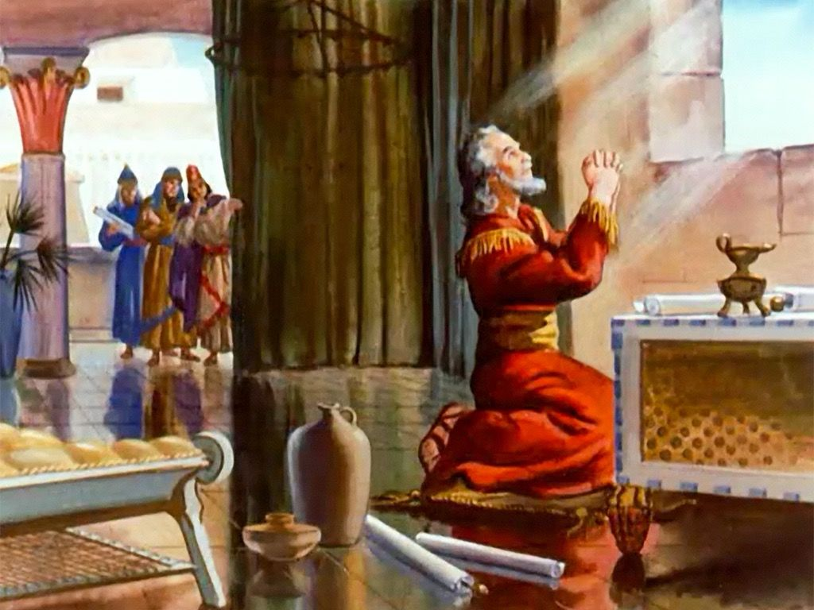
3. When the world pushes you down, STAND FIRM!
¹⁷ “Now, our God, hear the prayers and petitions of your servant. For your sake, Lord, look with favor on your desolate sanctuary. ¹⁸ Give ear, our God, and hear; open your eyes and see the desolation of the city that bears your Name. We don’t make requests of you because we’re righteous, but because of your great mercy. ¹⁹ Lord, listen! Lord, forgive! Lord, hear and act! For your sake, my God, don’t delay, because your city and your people bear your Name.” (9:17-19)

Slide 33
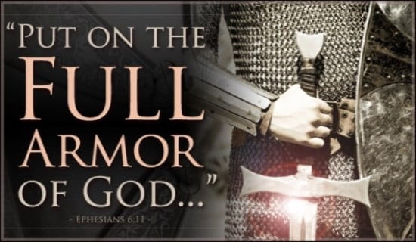
3. When the world pushes you down, STAND FIRM!
1 Corinthians 16:13: “Be on your guard; stand firm in the faith; be men of courage; be strong.”
Ephesians 6:11: "Put on the full armor of God, so that you will be able to stand firm against the schemes of the devil."

Slide 34
Conclusion
Stand out!
Stand up!
Stand Firm!
If you want a great testimony like Daniel had, you’ll need to make it through some tests with God’s help.

Slide 35
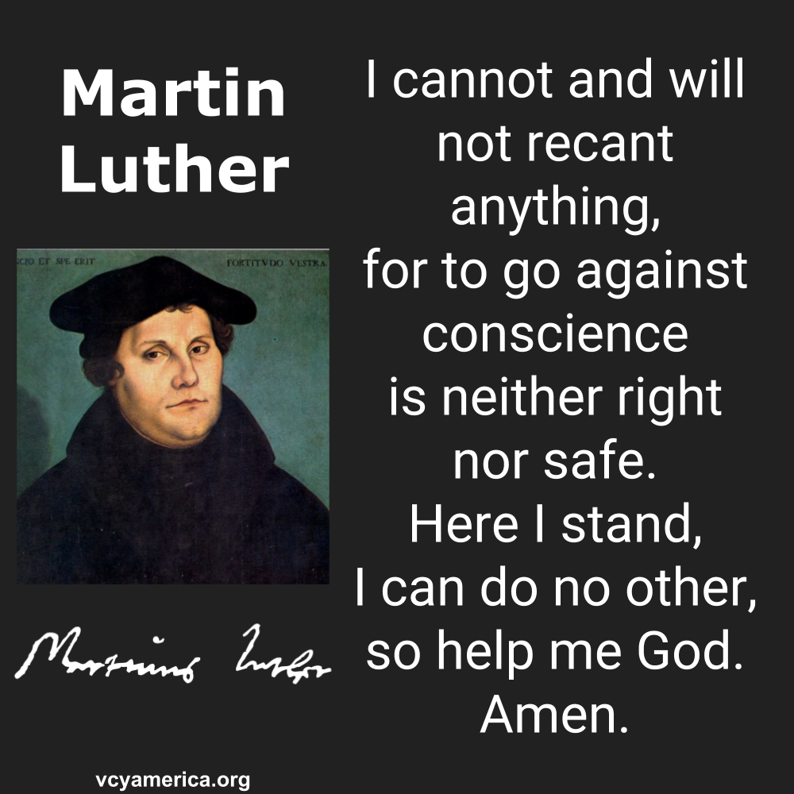
Conclusion

Slide 36
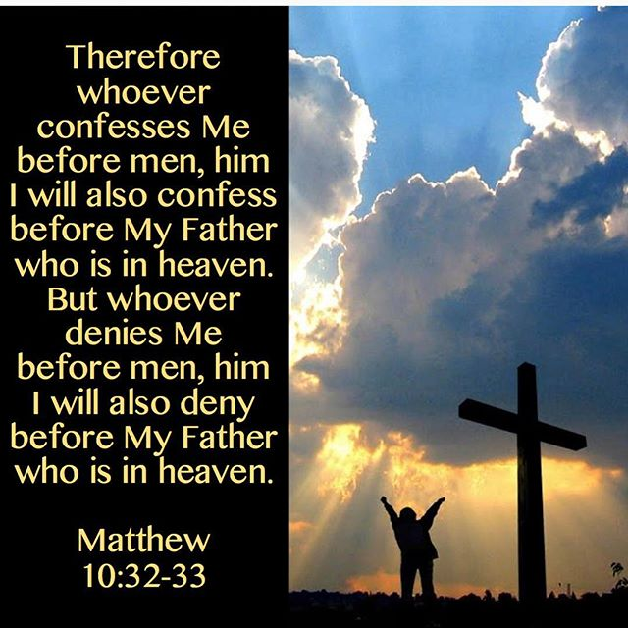
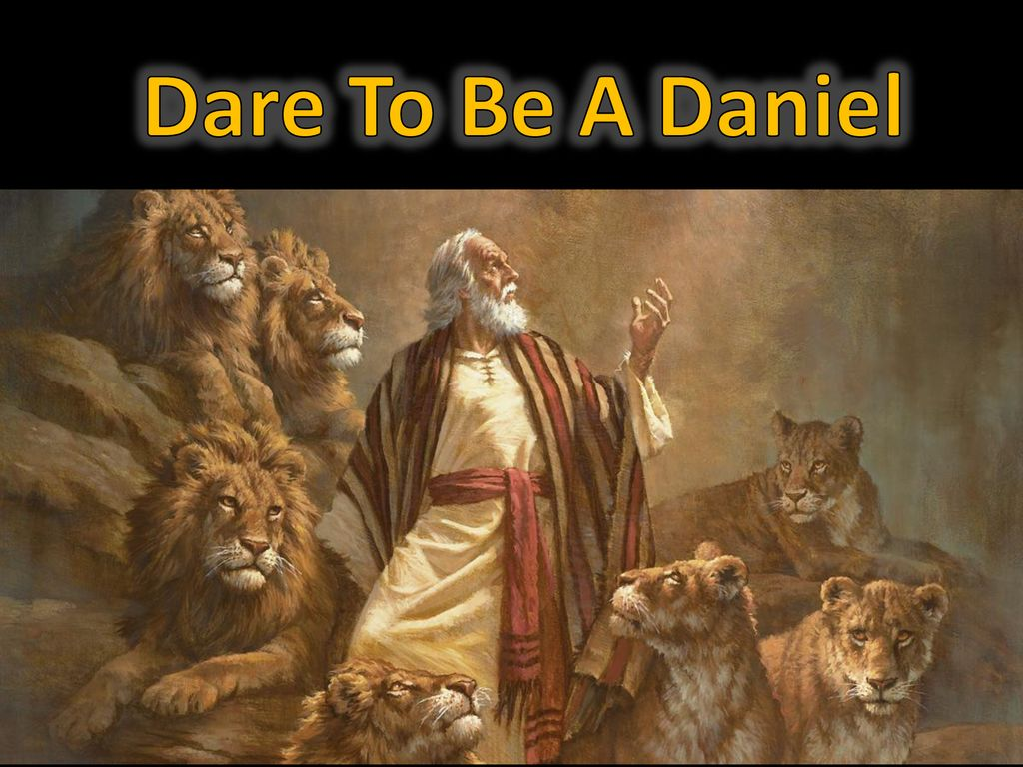
Conclusion

Slide 37
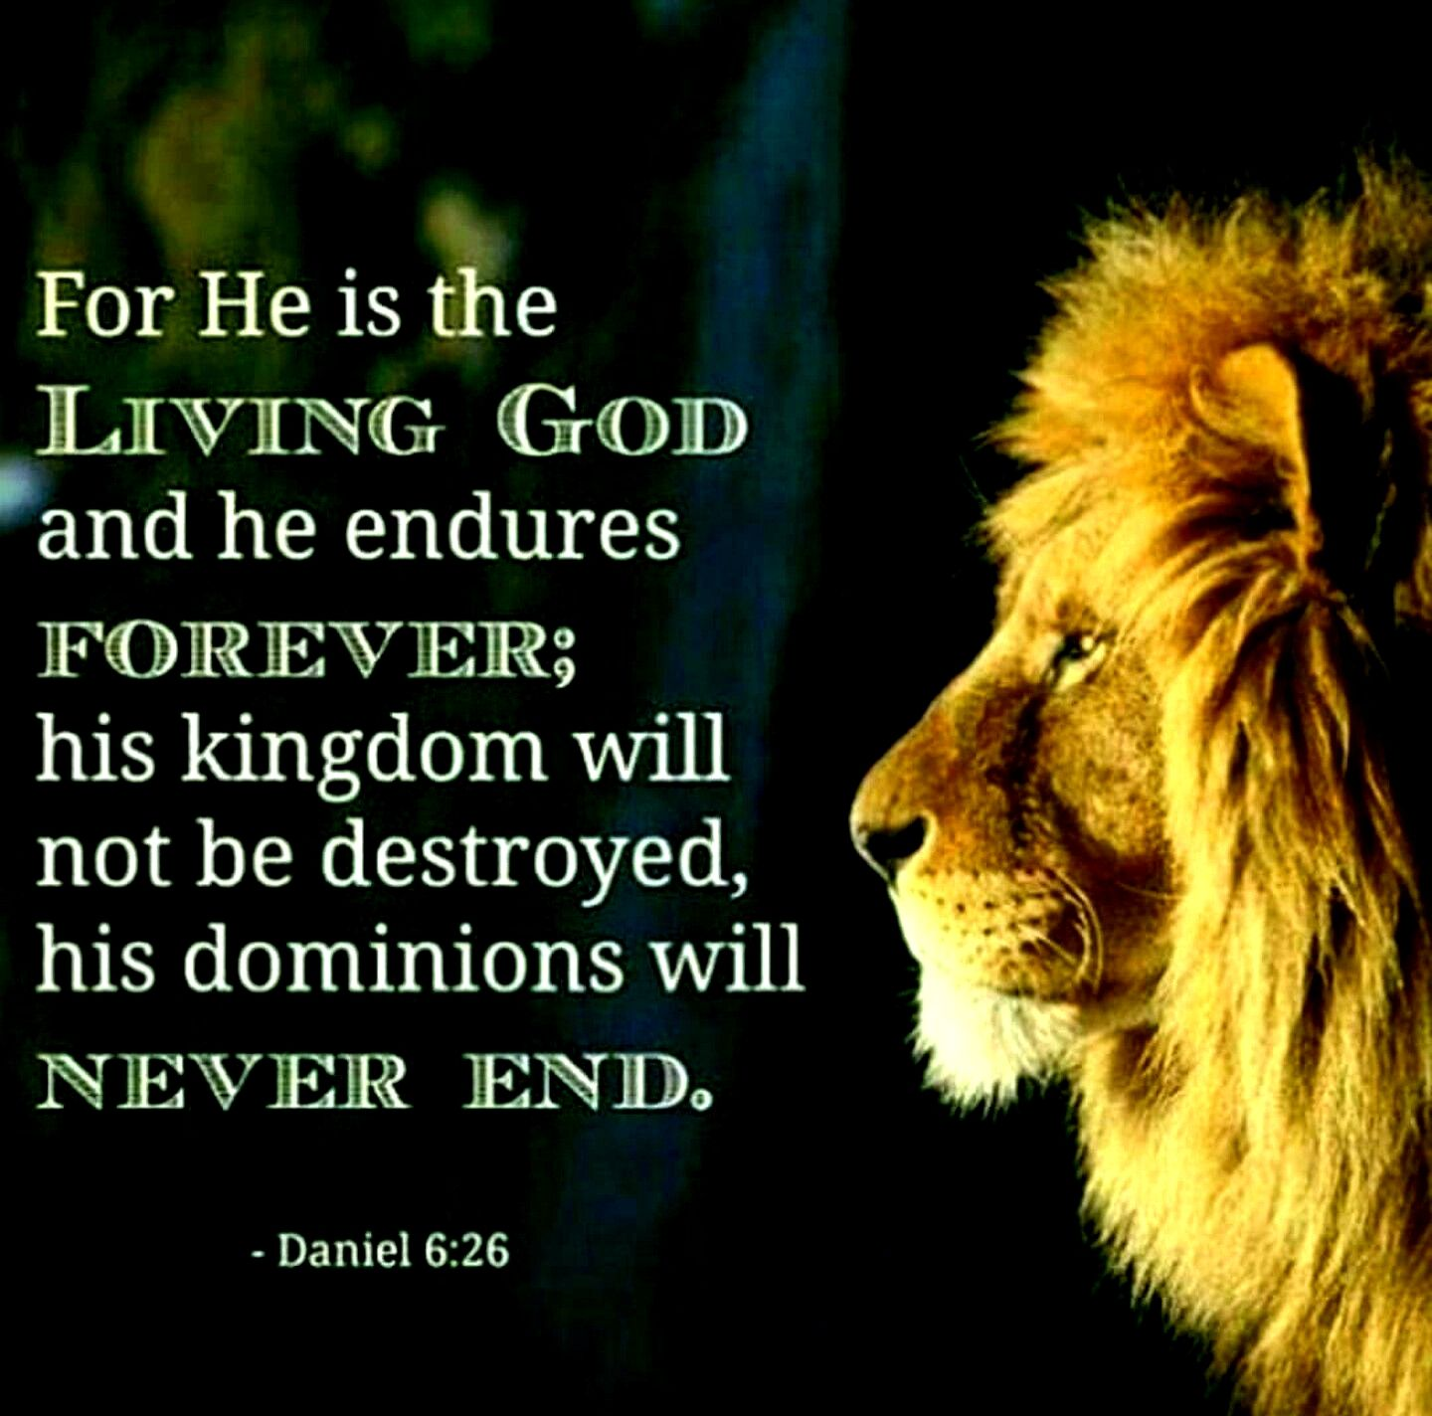
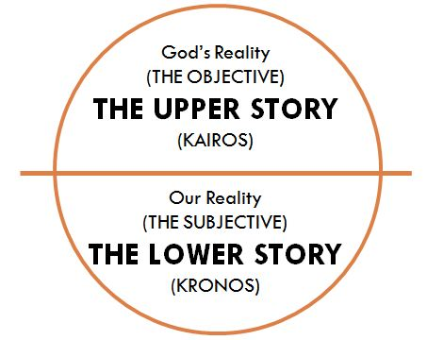
Conclusion

Slide 38

There will be a Zoom connect right after the service.
If you don’t have a link, send an email to wilbertgaw@gmail.com

Slide 39
Benediction
May you experience the protection, peace and strength of God our heavenly Father as He enables you to stand firm in your faith. If God is for us, who can be against us?
May you know the love of Jesus that transforms us.
May you follow the leading of the Holy Spirit who guides us.
May the God of all hope soon crush Satan under your feet!

Slide 40

FOR JOINING US!

