Slide 1

Snapshots of Jesus
On a forgiving cross.

Slide 2
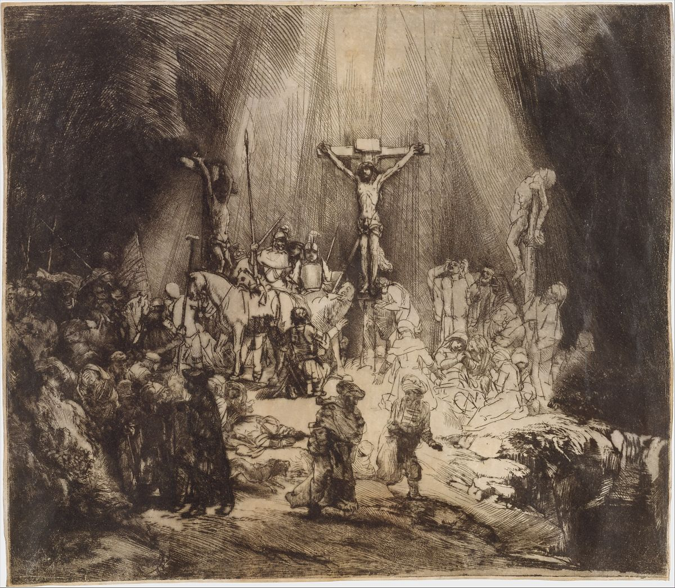
Rembrandt, 1653

Slide 3
Luke 23
32 Two others, who were criminals, were led away to be put to death with him. 33 And when they came to the place that is called The Skull, there they crucified him, and the criminals, one on his right and one on his left. Some

Slide 4
Luke 23
34 And Jesus said, “Father, forgive them, for they know not what they do.”

Slide 5
Luke 23
And they cast lots to divide his garments.
35 And the people stood by, watching, but the rulers scoffed at him, saying, “He saved others; let him save himself, if he is the Christ of God, his Chosen One!”
36 The soldiers also mocked him, coming up and offering him sour wine 37 and saying, “If you are the King of the Jews, save yourself!” 38 There was also an inscription over him, “This is the King of the Jews.”
39 One of the criminals who were hanged railed at him, saying, “Are you not the Christ? Save yourself and us!”

Slide 6
Luke 23
40 But the other rebuked him, saying, “Do you not fear God, since you are under the same sentence of condemnation? 41 And we indeed justly, for we are receiving the due reward of our deeds; but this man has done nothing wrong.” 42 And he said, “Jesus, remember me when you come into your kingdom.” 43 And he said to him, “Truly, I say to you, today you will be with me in paradise.”

Slide 7
Jesus meets the least likely people in the least likely places and he offers them forgiveness.

Slide 8
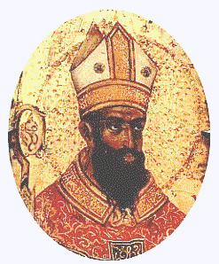
Augustine

Slide 9
Augustine
“Lord, make me a Christian but not yet”

Slide 10
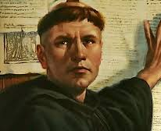
Martin Luther

Slide 11
Martin Luther
“I did not love, yes, I hated the righteous God who punishes sinners…”

Slide 12
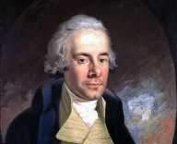
John Newton

Slide 13
John Newton
"I sinned with a high hand and I made it my study to tempt and seduce others."

Slide 14

Anne Lamott

Slide 15
Anne Lamott
“Sitting there, standing with them to sing, sometimes so shaky and sick that I felt like I might tip over, I felt bigger than myself, like I was being taken care of, tricked into coming back to life."

Slide 16
Jesus once and for all reveals the most accurate picture of God’s heart for broken and wounded humanity.

Slide 17
Hebrews 1:3 (NLT) The Son radiates God’s own glory and expresses the very character of God

Slide 18
Jesus’s forgiveness on the cross reveals…
That forgiveness is not and cannot be earned.

Slide 19
Jesus’s forgiveness on the cross reveals…
That forgiveness is not and cannot be earned.
That no one is beyond the love of God.

Slide 20
Jesus’s forgiveness on the cross reveals…
That forgiveness is not and cannot be earned.
That no one is beyond the love of God.
What exactly is the heart of God for broken humans.

Slide 21
Snapshots of Jesus
On a forgiving cross.

