Slide 1



Slide 2

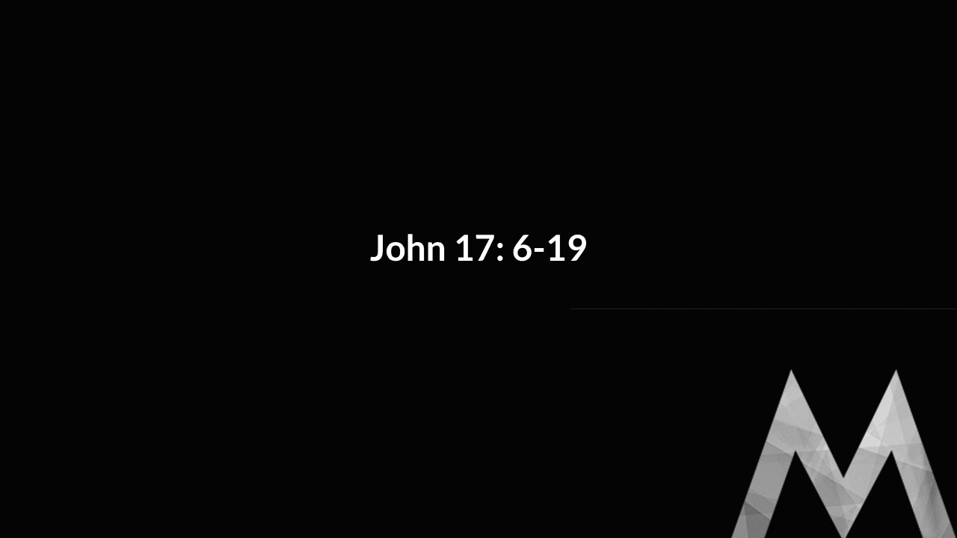
What do our prayers reveal about us?

Slide 3

John 17: Listening to Jesus Pray

Slide 4


And I will do whatever you ask in my name, so that the Son may bring glory to the Father. You may ask me for anything in my name, and I will do it.
John 14:13-14

Slide 5

John 17: 1-5

Slide 6
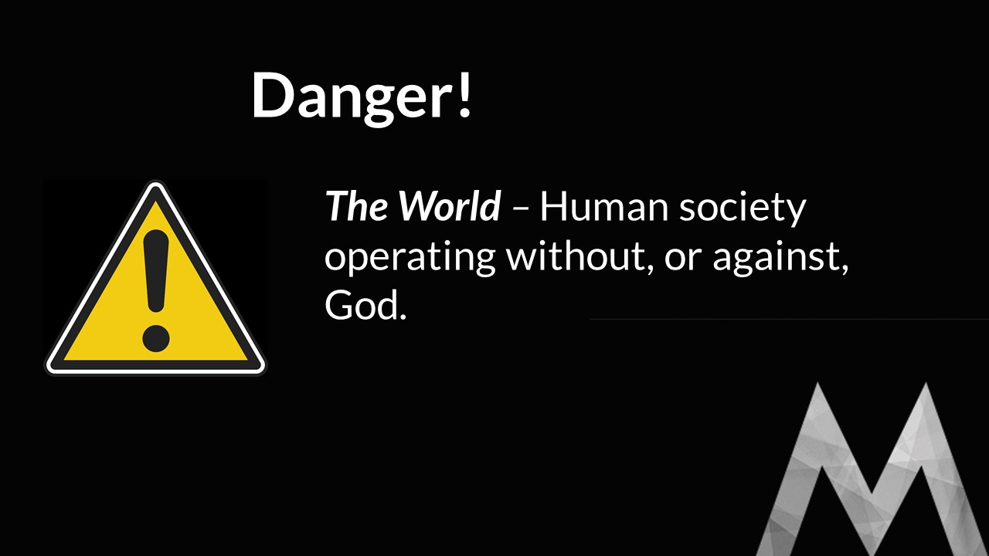
“Glorify your Son, that your Son may glorify you. “

Slide 7

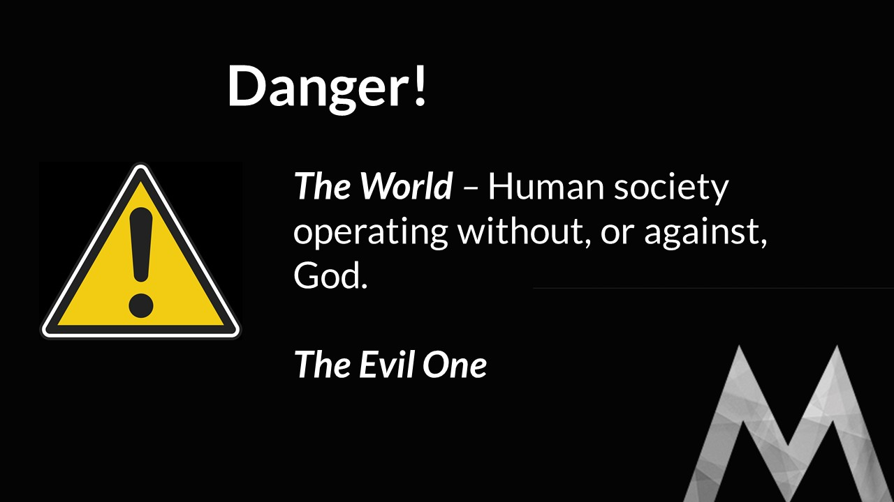
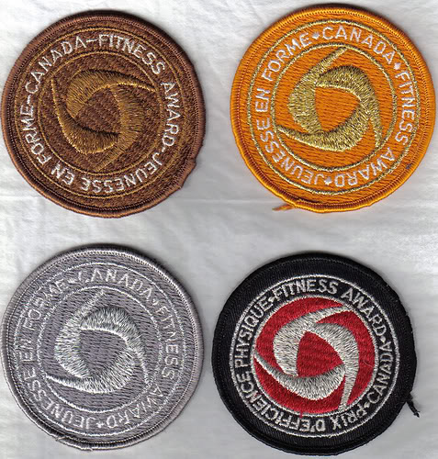

Slide 8

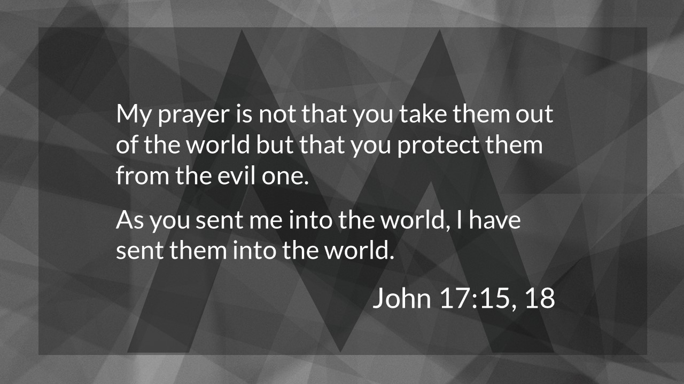
God’s Glory
Who God is
The Honour that’s due God because of who he is.

Slide 9
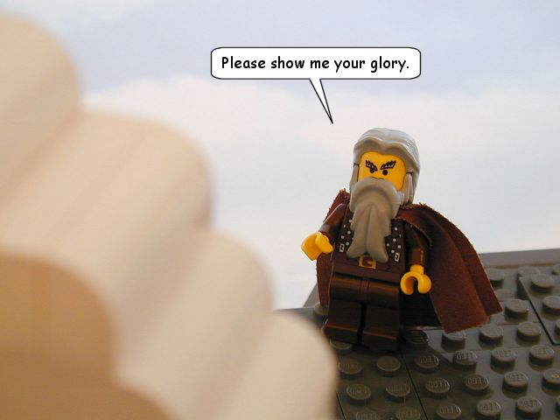
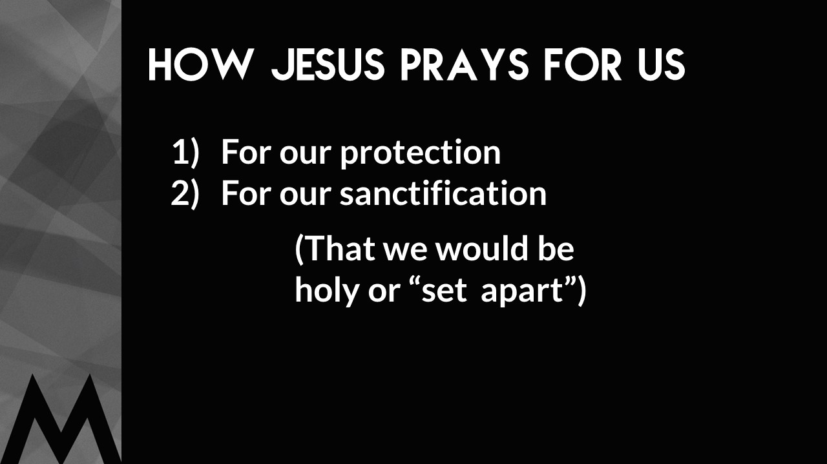

Slide 10
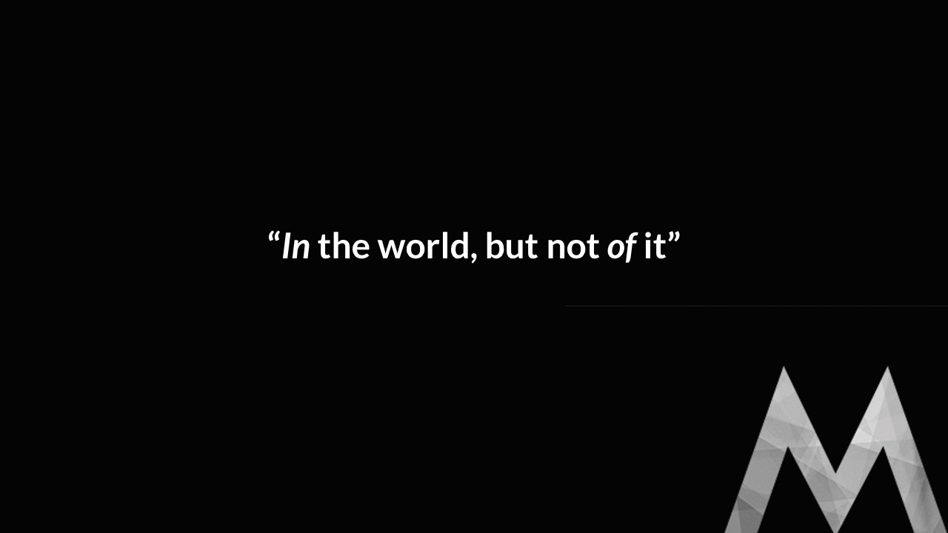
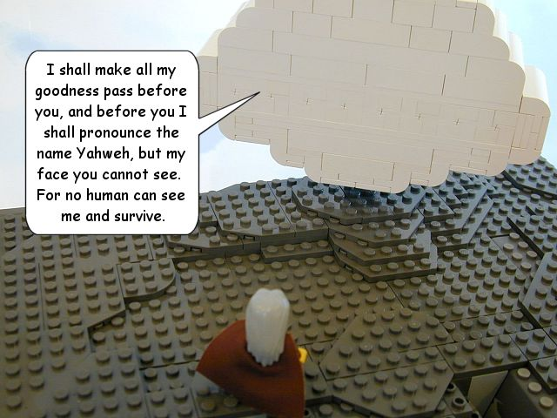

Slide 11
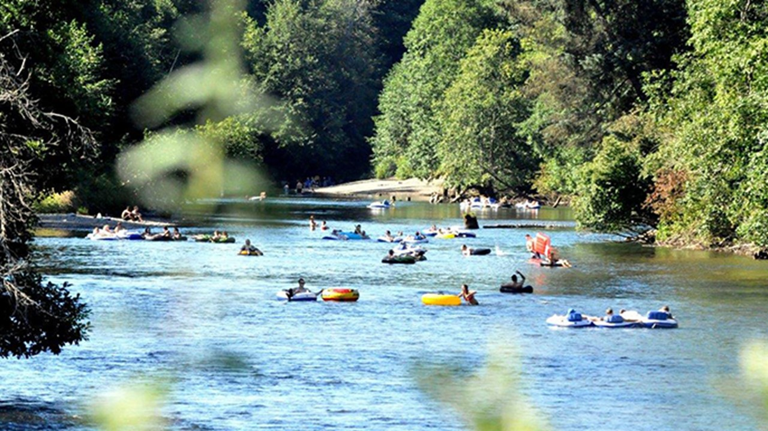
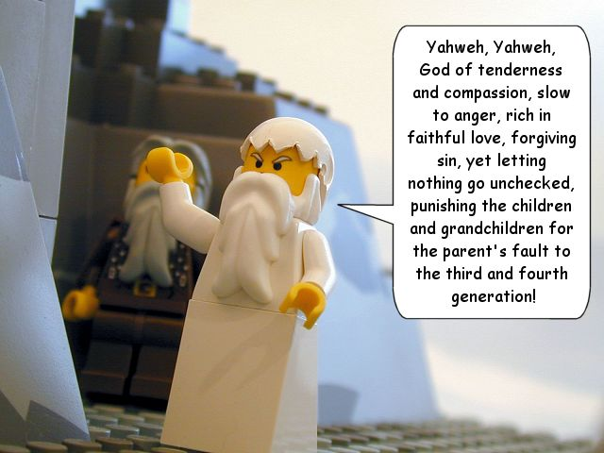

Slide 12

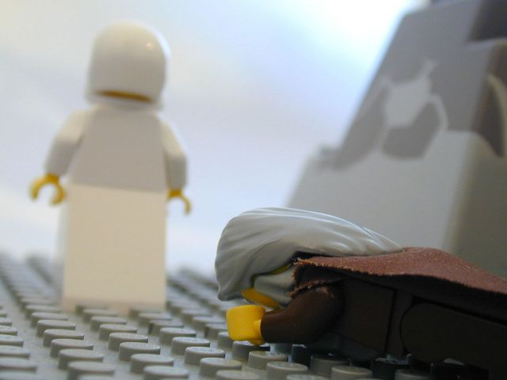

Slide 13
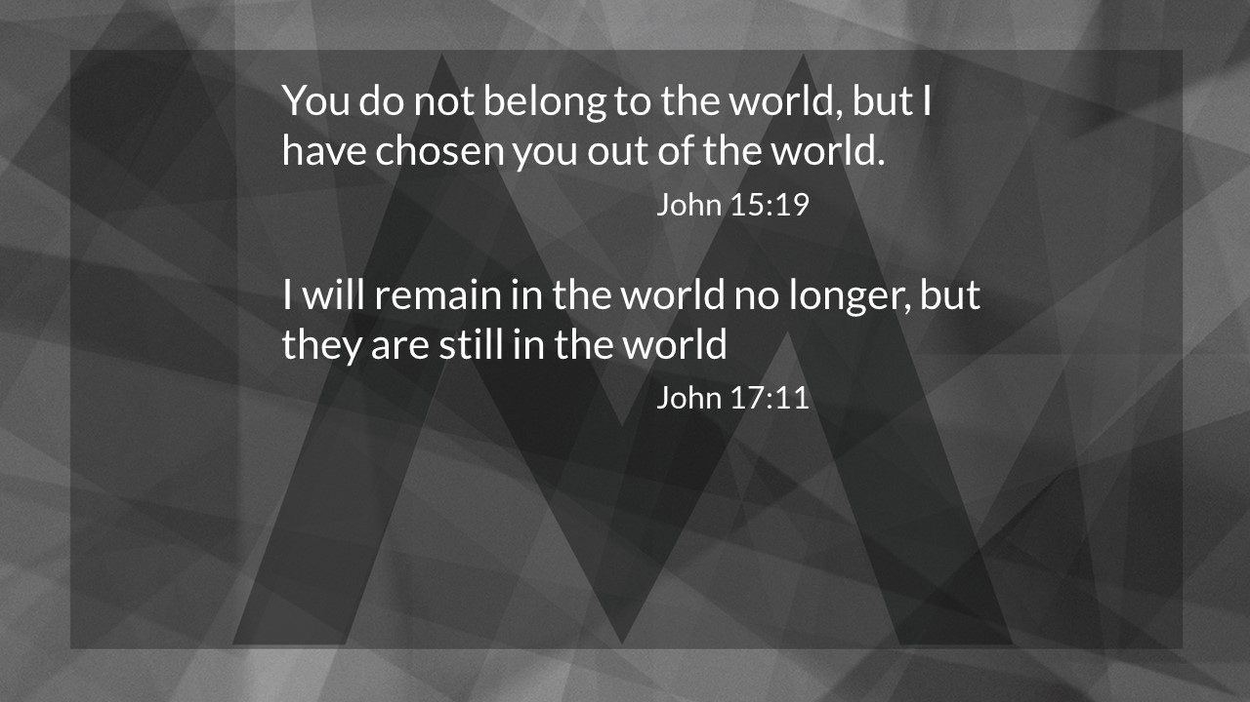
God’s Glory
Who God is
The Honour that’s due God because of who he is.

Slide 14
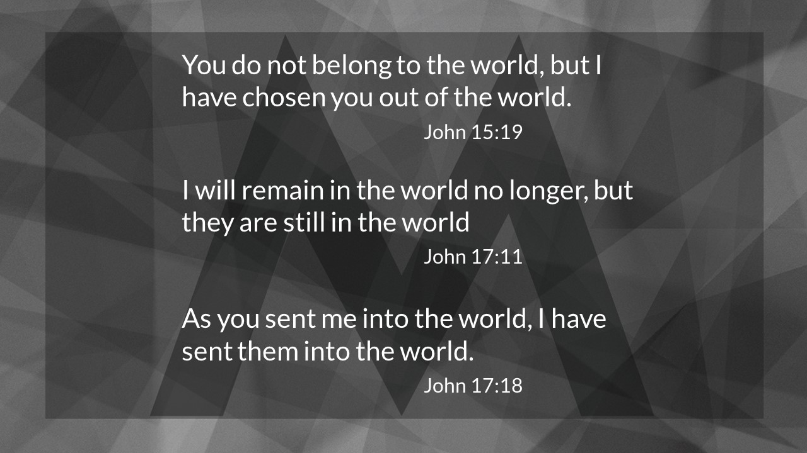
“Jesus heart’s desire is to have the world know the heart of the father, and the heart of the father is this – self-emptying love that gives eternal life away to those who don’t deserve it.
Darrell Johnson

Slide 15
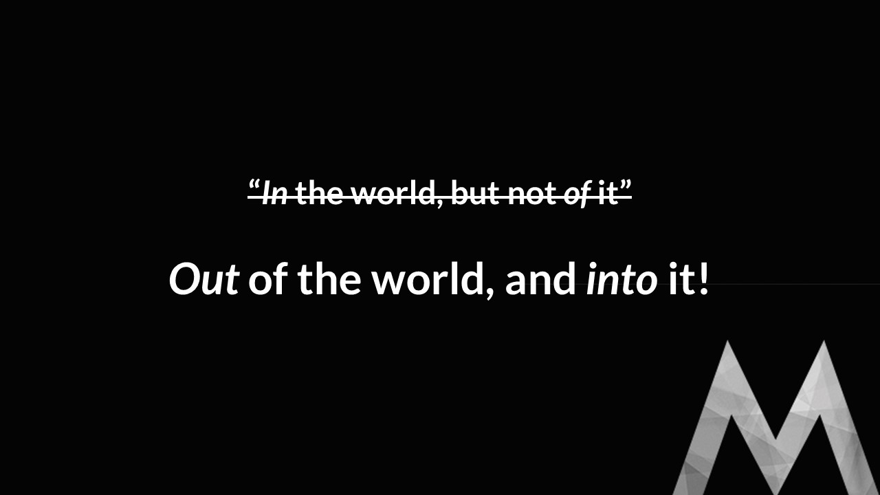
And they sang a new song: “You are worthy to take the scroll and to open its seals because you were slain, and with your blood you purchased men for God from every tribe and language and people and nation.”
“Worthy is the Lamb, who was slain, to receive power and wealth and wisdom and strength and honor and glory and praise!”
Revelation 5:9,12

Slide 16

Jesus Reveals God’s Glory.
what Are we supposed to do?

Slide 17

Jesus Reveals God’s Glory.
what Are we supposed to do?
Nothing!

Slide 18
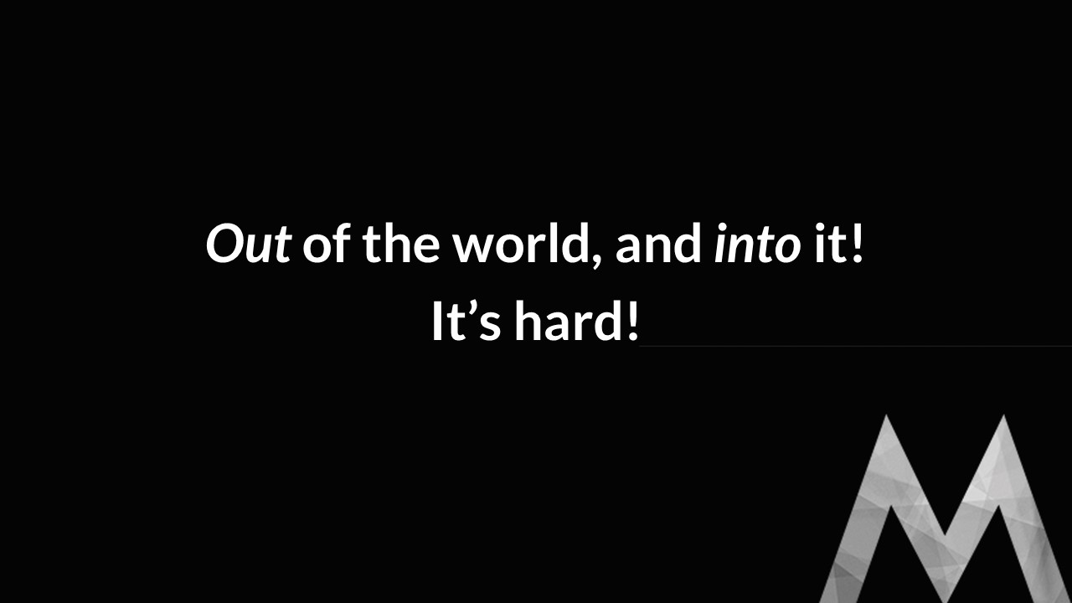
Jesus Reveals God’s Glory.
what Are we supposed to do?
Nothing!
Give God the Glory he is due.

Slide 19

Consumer: A person who acquires goods and services for his or her own personal needs.

Slide 20

Jesus Reveals God’s Glory.
what Are we supposed to do?
Nothing!
Give God the Glory he is due.

Slide 21

Jesus Reveals God’s Glory.
what Are we supposed to do?
Nothing!
Give God the Glory he is due.
Get to know Jesus.

Slide 22
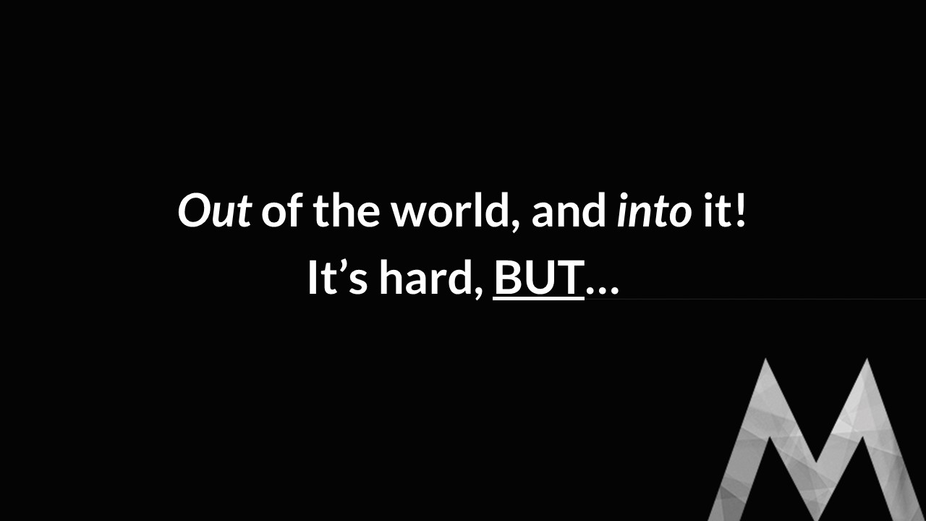
Now this is eternal life:

Slide 23
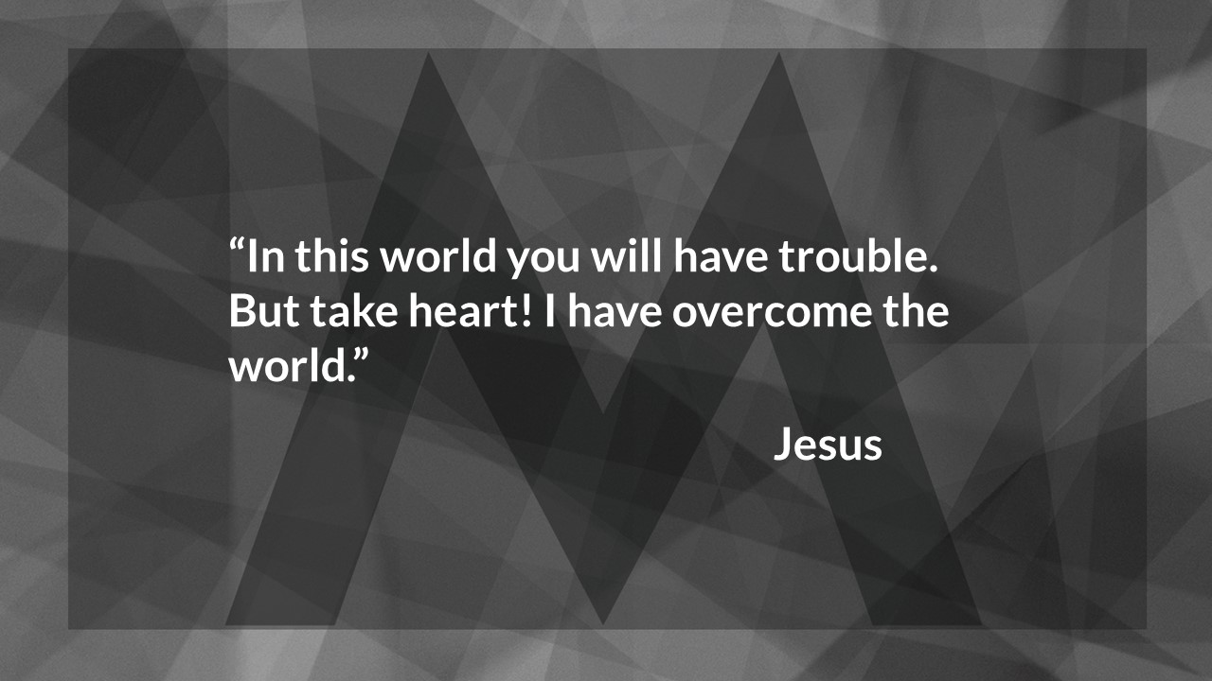
Now this is eternal life: that they may know you, the only true God, and Jesus Christ, whom you have sent.
John 17:3

Slide 24
What is more, I consider everything a loss compared to the surpassing greatness of knowing Christ Jesus my Lord, for whose sake I have lost all things. I consider them rubbish, that I may gain Christ …
Philippians 3:8

