Slide 1



Slide 2
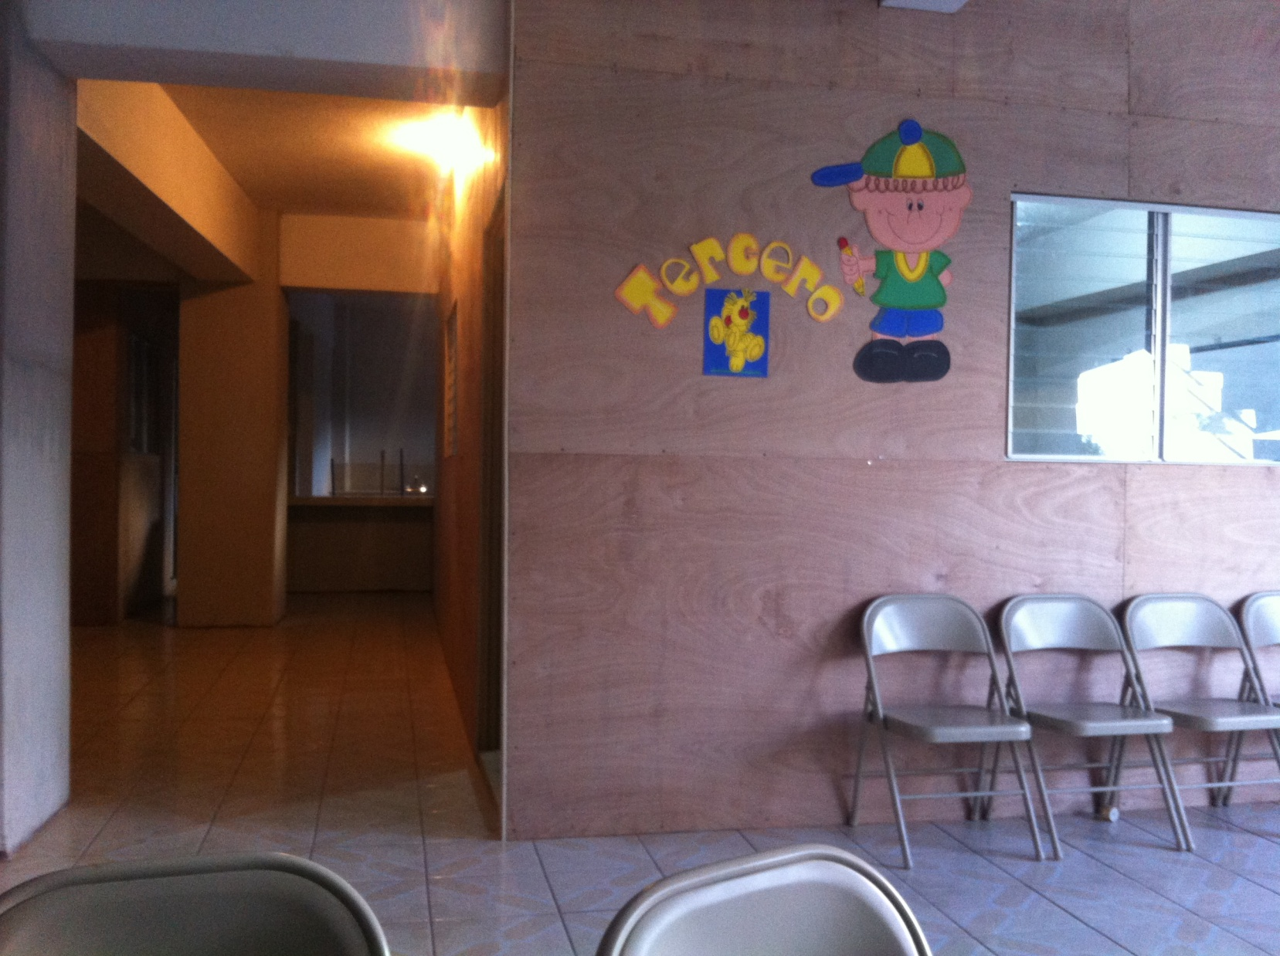

Slide 3
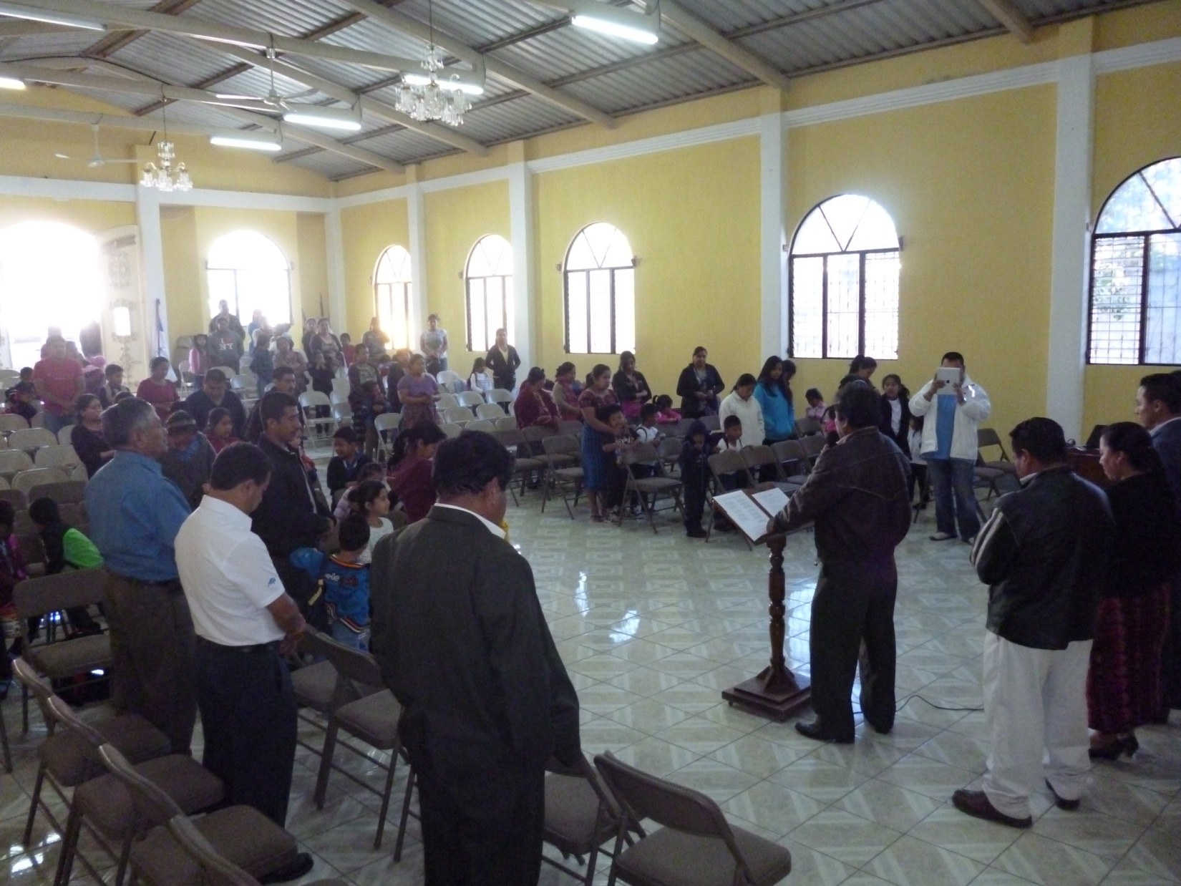

Slide 4
relevant (rĕl′ə-vənt)
adj. meaningful or purposeful in current society or culture

Slide 5

is church
relevant?

Slide 6


Slide 7
is the church
relevant?

Slide 8
Peter’s writing is saturated with Old Testament Imagery.
See: Isaiah 8, 28, 43, Psalm 118, Hosea 2

Slide 9
The church is relevant because it is tied to Jesus. And Jesus is at the heart of what God is up to in the world.

Slide 10

… [you are] fellow citizens with God’s people and members of God’s household, built on the foundation of the apostles and prophets, with Christ Jesus himself as the chief cornerstone. In him the whole building is joined together and rises to become a holy temple in the Lord. And in him you too are being built together to become a dwelling in which God lives by his Spirit
Ephesians 2:19-22

Slide 11

Some people find refuge Jesus...

Slide 12
...and others trip over him

Slide 13
God dignifies the church by...
Making us the new temple in which he dwells

Slide 14
God dignifies the church by...
Making us the new temple in which he dwells
Ordaining us as his priests.

Slide 15
God dignifies the church by...
Making us the new temple in which he dwells
Ordaining us as his priests
Setting us apart as a chosen people and a holy nation.

Slide 16
the bottom line
Jesus still divides.

Slide 17
the bottom line
Jesus still divides.
Get used to being irrelevant. For now.

Slide 18
They did not receive the things promised; they only saw them and welcomed them from a distance. And they admitted that they were aliens and strangers on earth. People who say such things show that they are looking for a country of their own. If they had been thinking of the country they had left, they would have had opportunity to return. Instead, they were longing for a better country—a heavenly one. Therefore God is not ashamed to be called their God, for he has prepared a city for them
Hebrews 11:13-16

Slide 19
is church
relevant?

