Slide 1
We were made to Thrive!
THRIVE in FIJI - 2018
Presented by: Michael and Denise Reilly
SEEDS INTERNATIONAL

Slide 2
Our Mission & Vision
To develop relationships with schools in Fiji
allowing us to proclaim the gospel by
distribution of Seedlings books, sharing
the love of Jesus Christ in presentations and
presence.
To provide opportunities for Muir Lake Alliance
Church family to serve, bless and be blessed by
being a part of Seeds International in Fiji.
Developing partnership and relationship with
Seeds, Cornerstone Church and Scripture Union Fiji

Slide 3
Project Fiji – Goals Review
2017 = Team of 5 adults to join us
going to Fiji in late March
2018 = Team of youth and young adults to
experience cross cultural missions
and join our Fiji team in mission.
2019 = Multi-generational team of children,
youth, adults and seniors to experience
short term cross cultural missions.

Slide 4
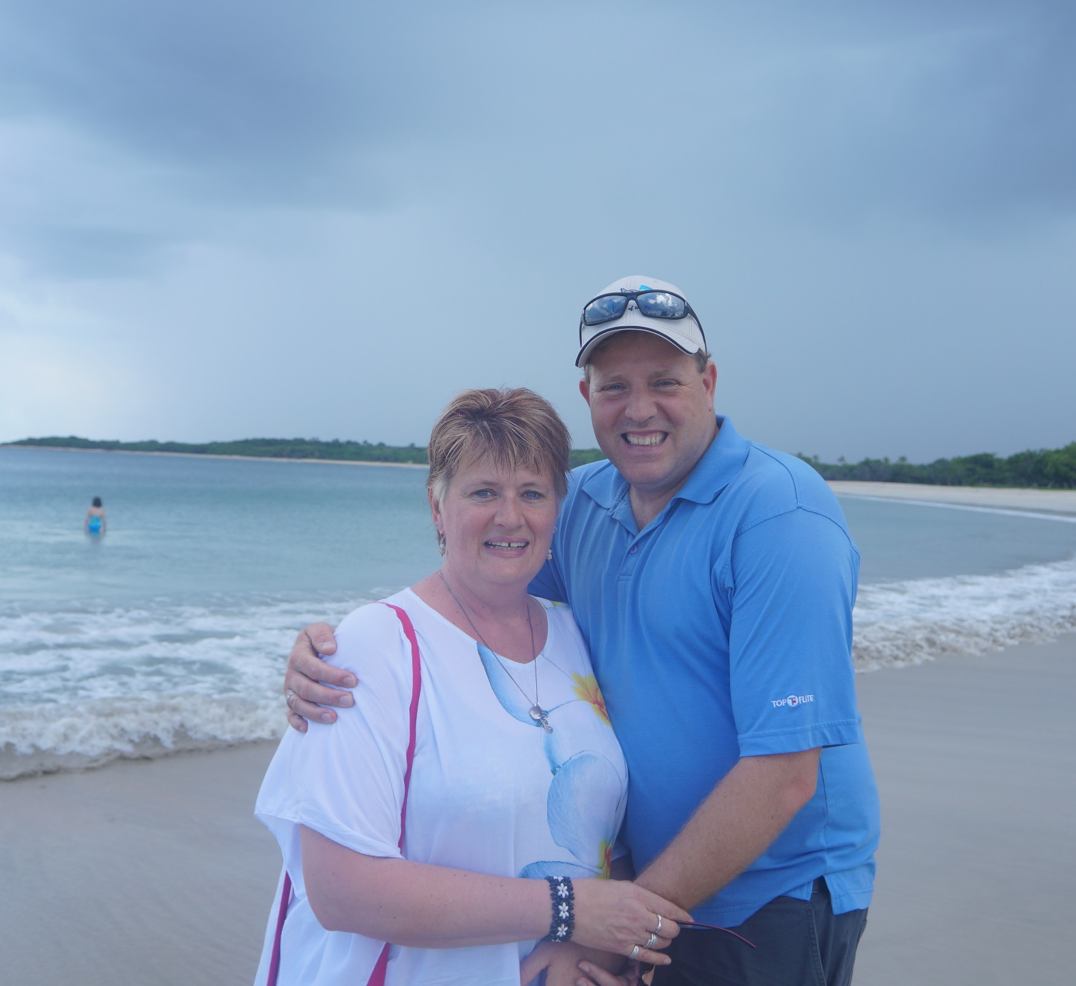
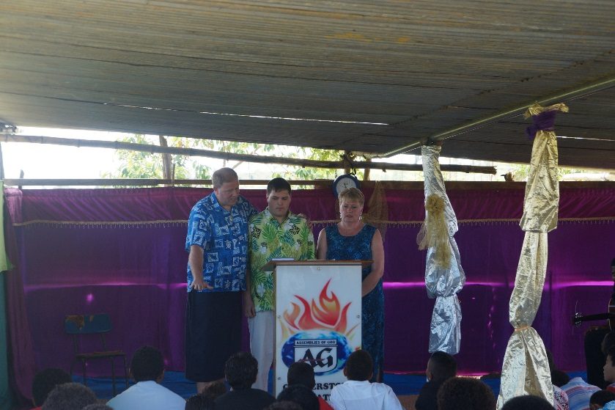
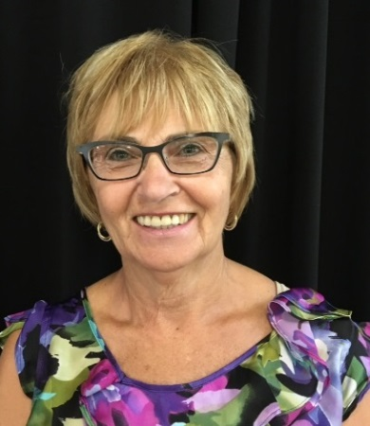
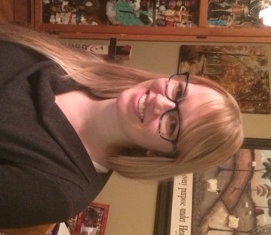
Michael and Denise – FIJI 2015
Tyson joins us
– FIJI 2016
Lorraine and Sabrina – FIJI 2017

Slide 5
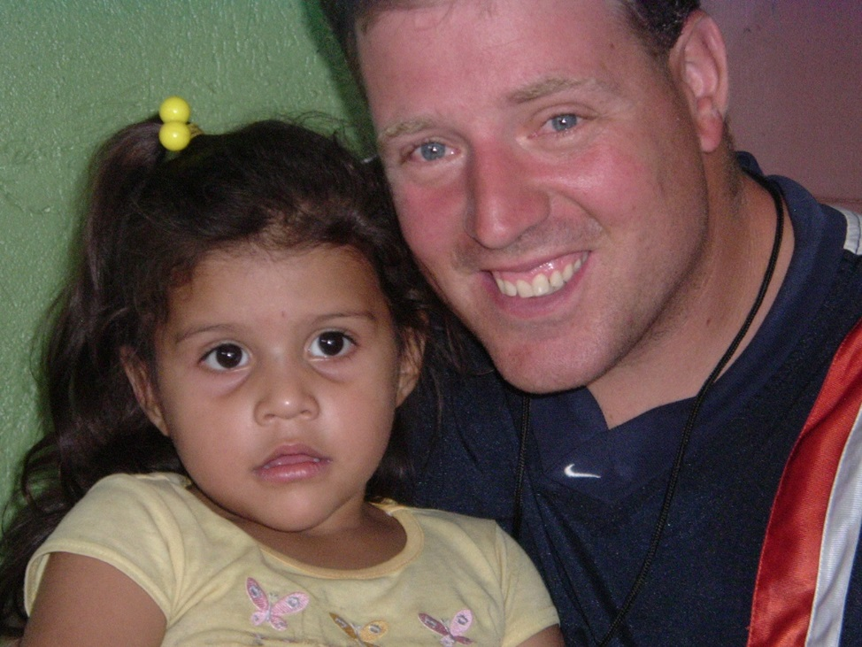
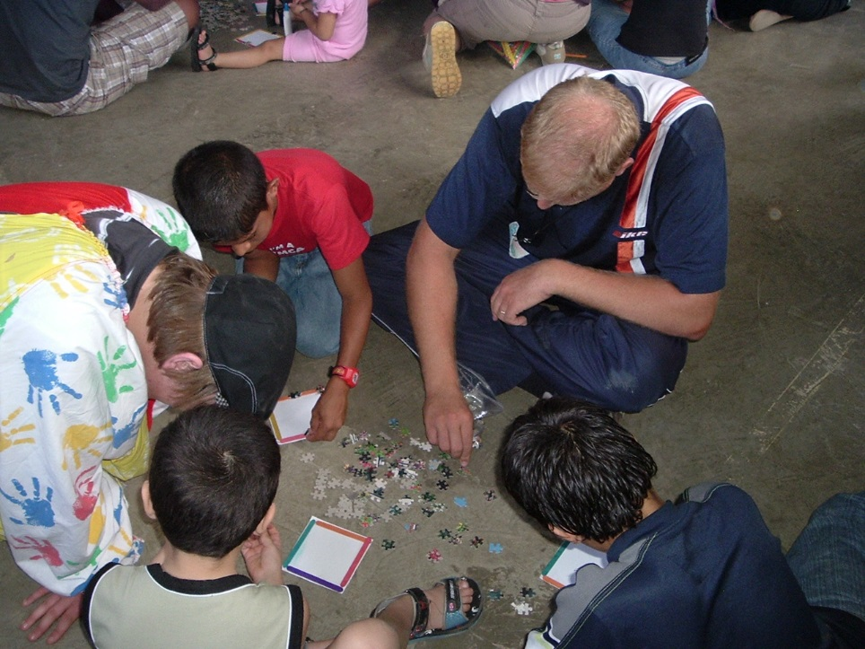
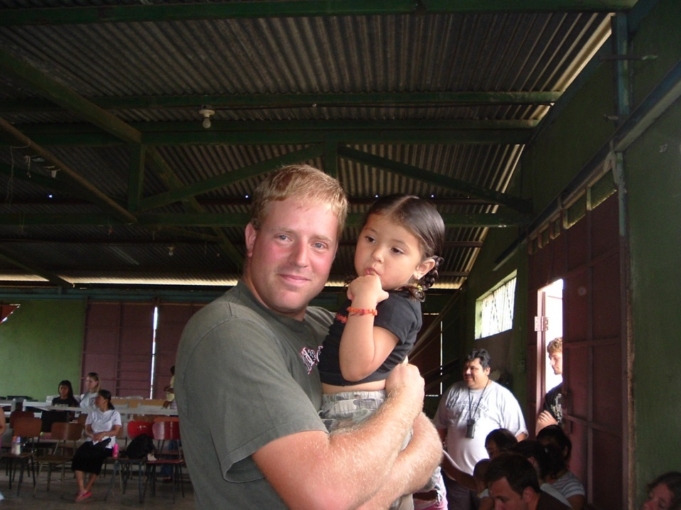
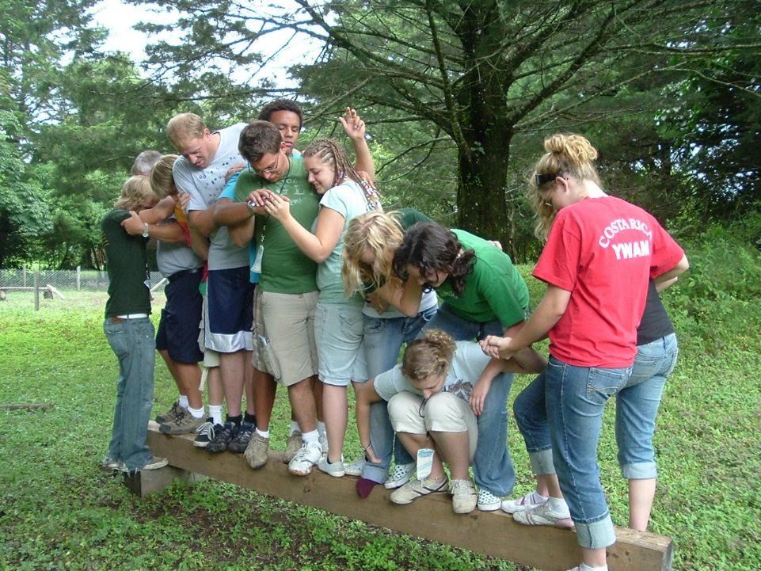
How God called us:
Costa Rica

Slide 6
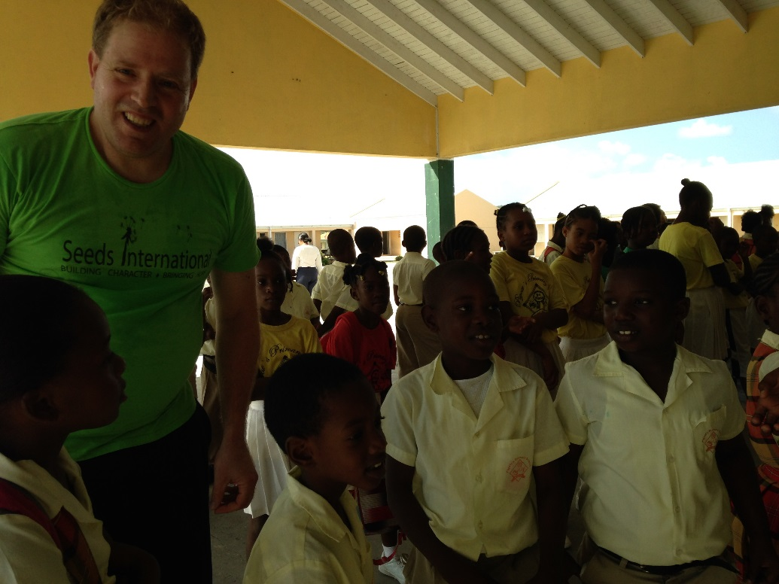
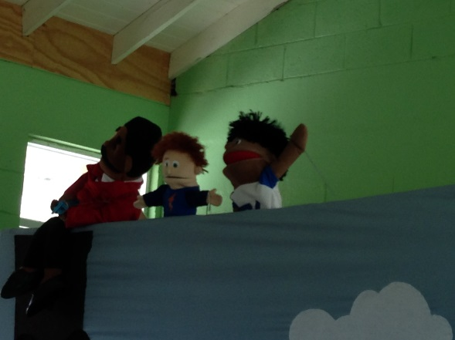
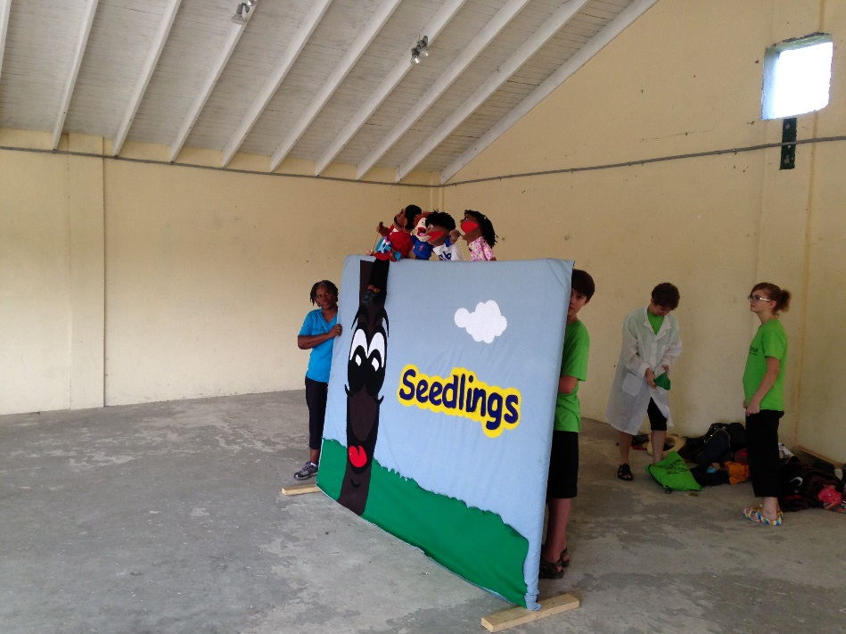
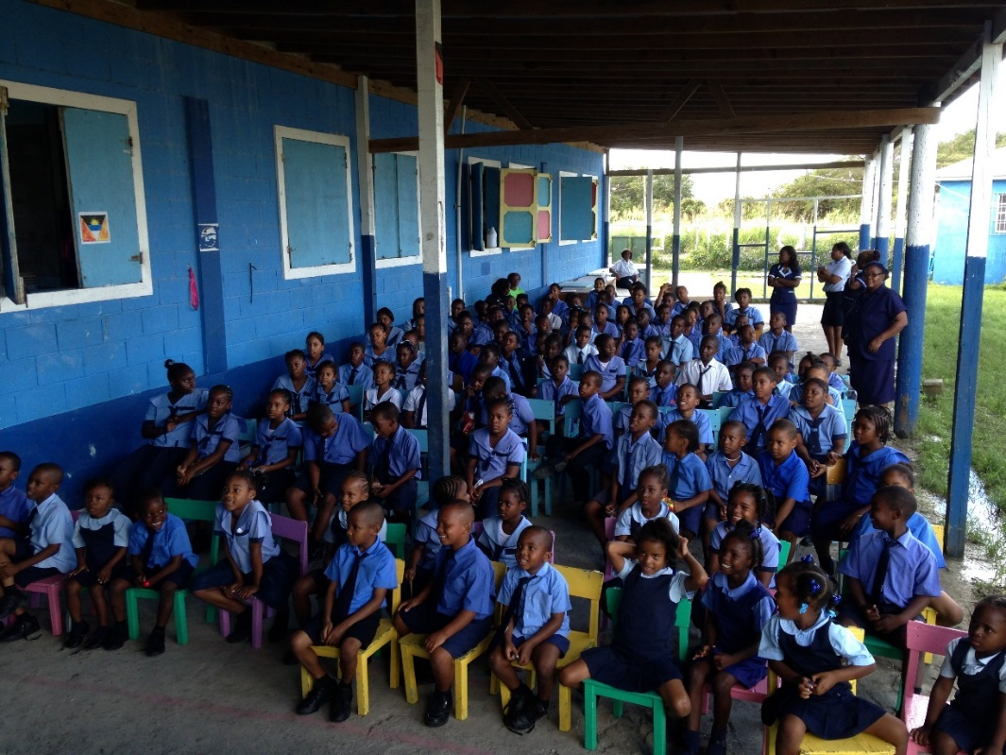
Antigua

Slide 7
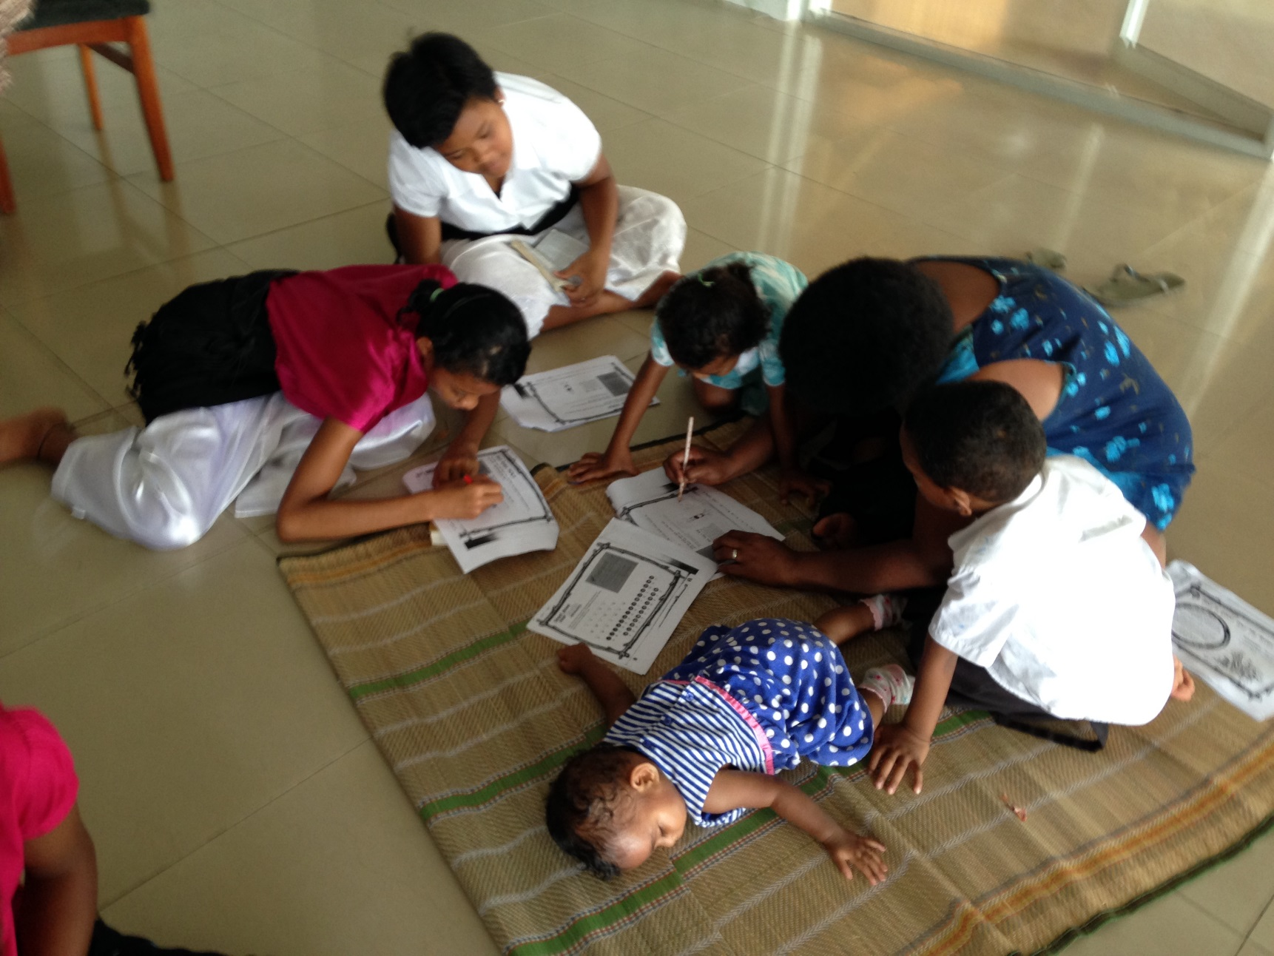
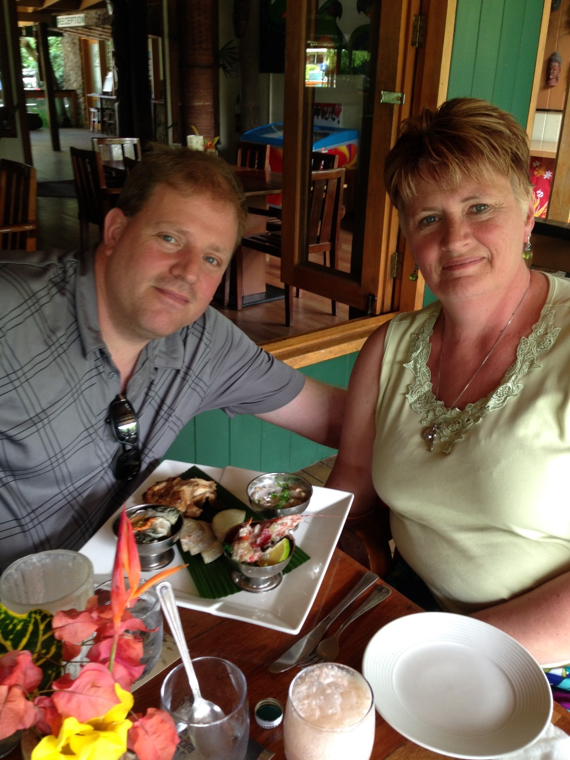
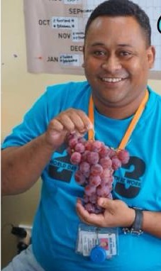
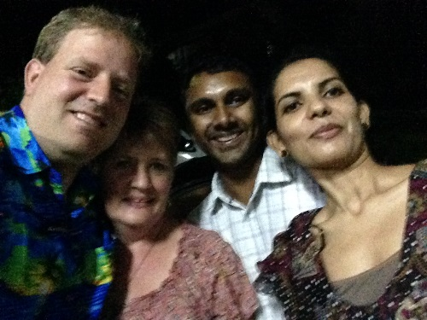
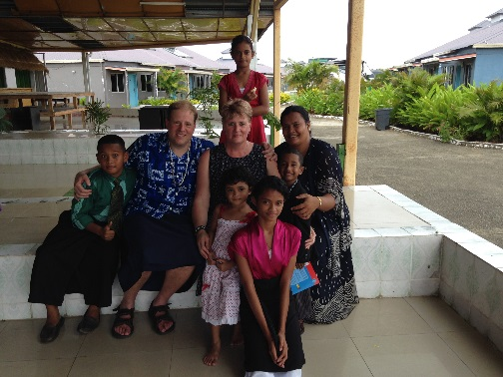
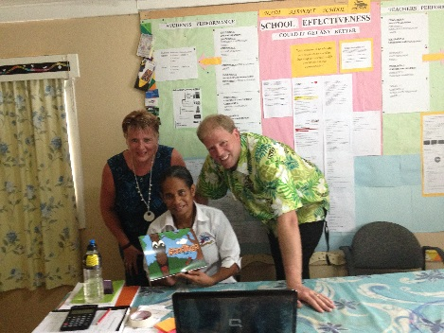
Fiji Contacts - 2015
Fiji

Slide 8
Is GOD Calling you to:
1) Encounter His heart
2) Expand your perspective
3) Become more grateful
4) Discover your spiritual family
5) Build lasting friendships
6) Overcome your fears
7) Grow the kingdom of Jesus

Slide 9
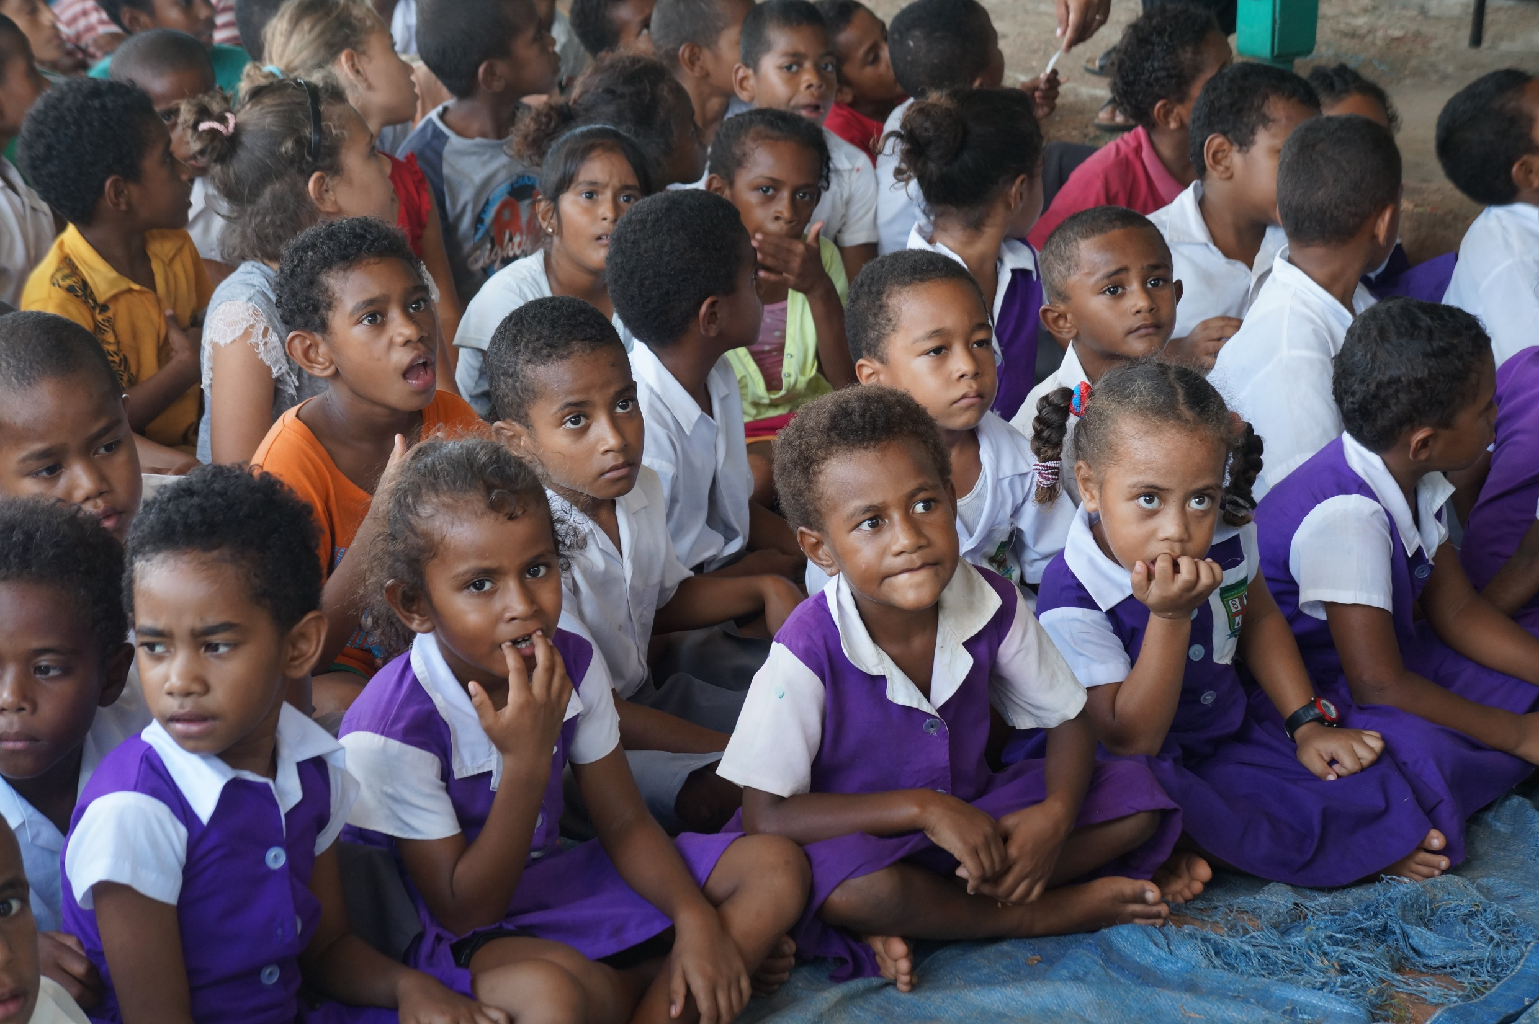
You will encounter God’s heart
Psalm 69:32
“The poor will see and be glad – you who seek God, may your hearts live.”

Slide 10
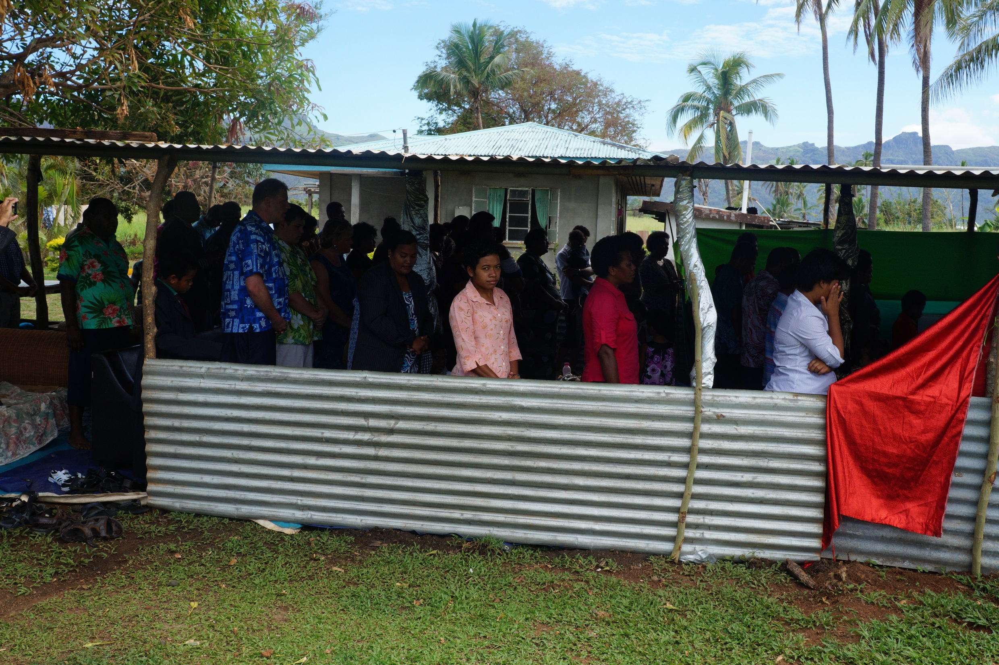
Galatians 3:26
“So in Christ Jesus you are all children of God through faith.”
You will expand your perspective

Slide 11
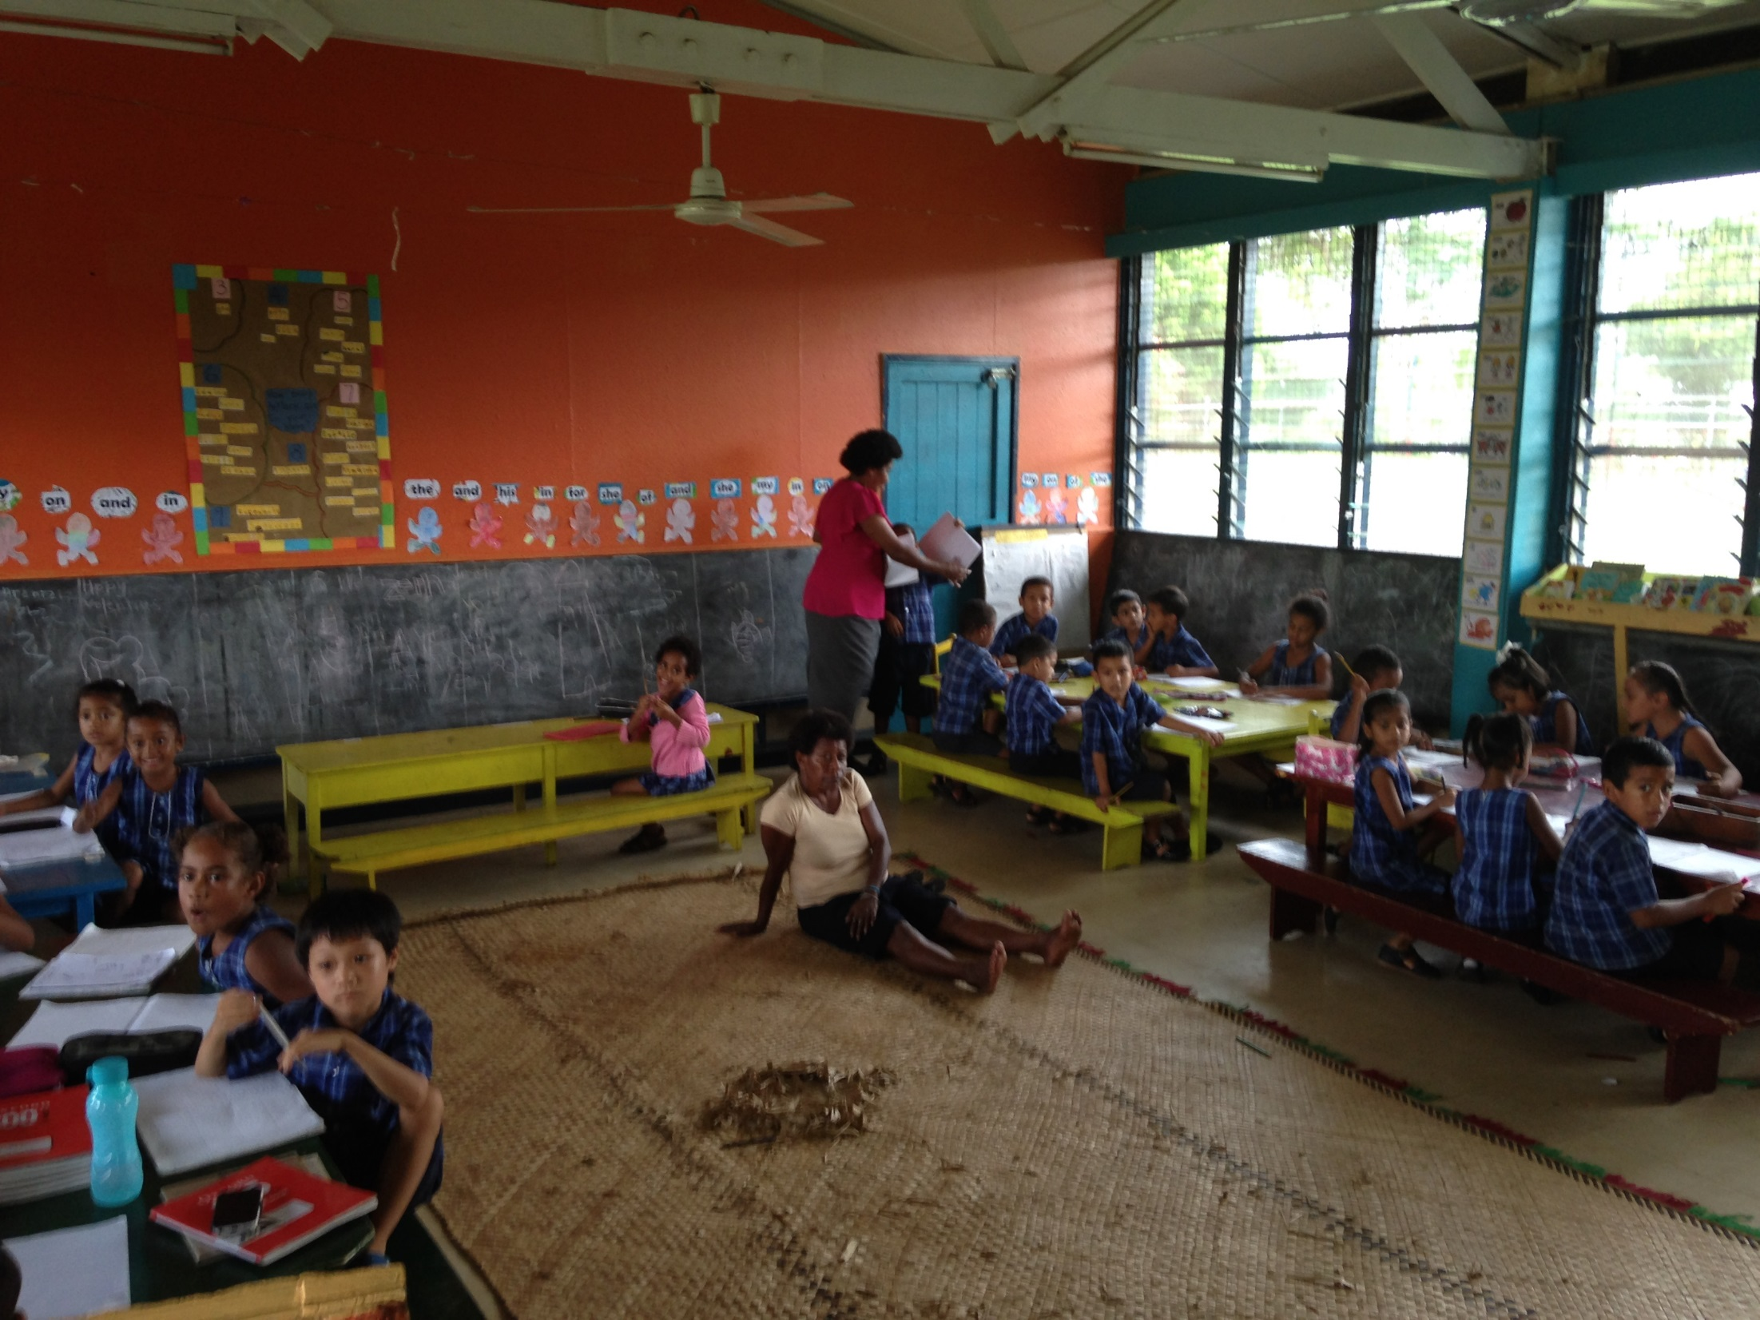
You will become more grateful
Psalm 128:2
“You will eat the fruit of your labour; blessing and prosperity will be yours.”

Slide 12
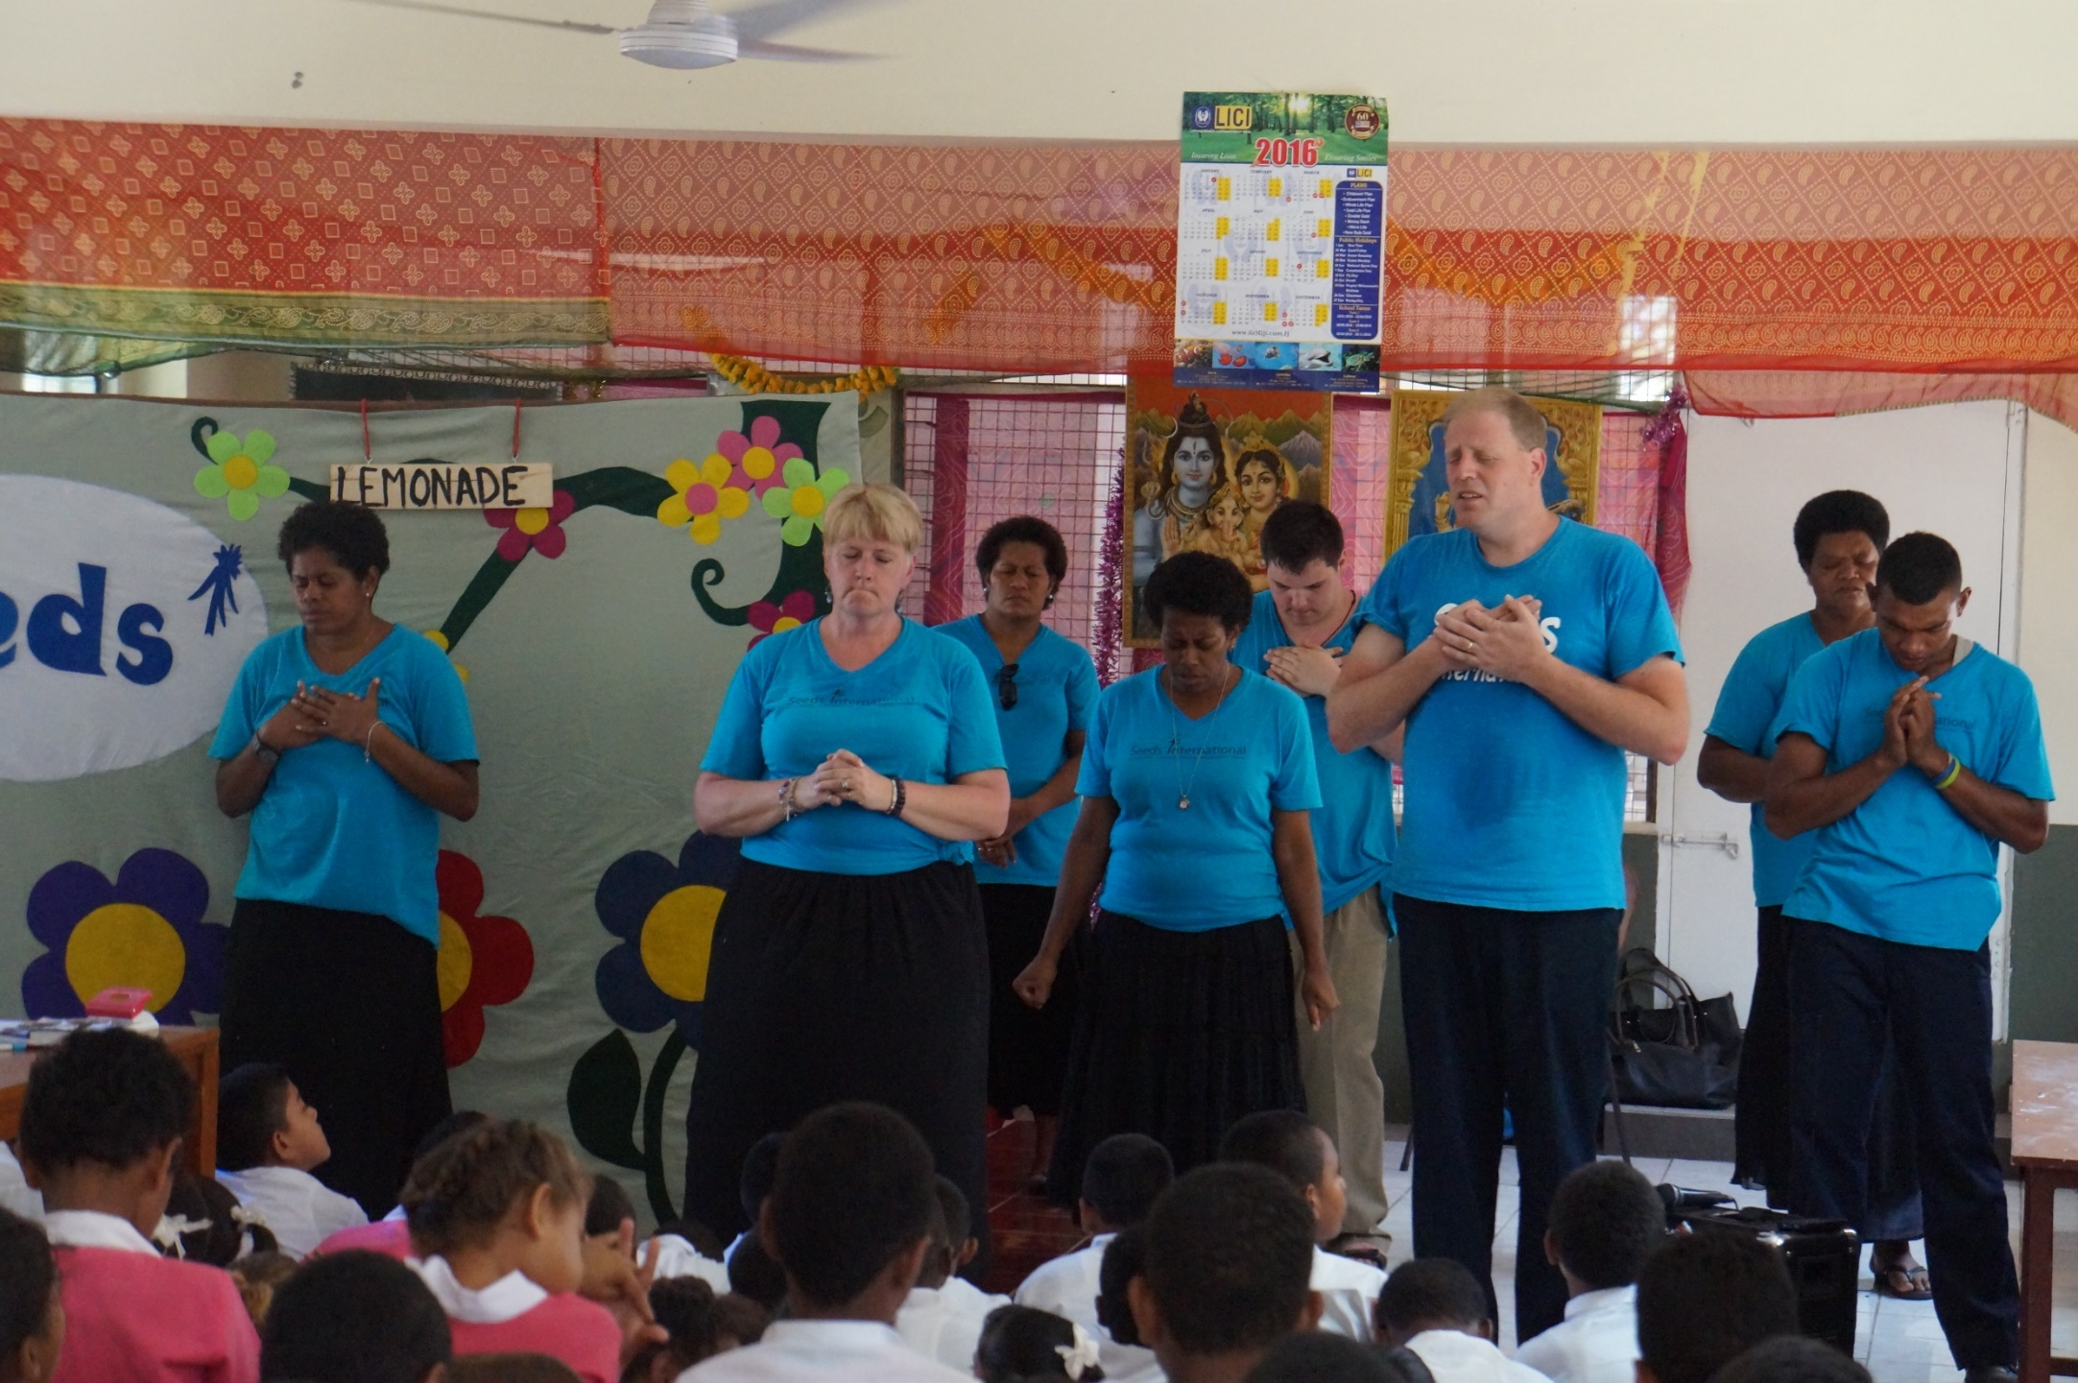
You will discover your spiritual family
1 Peter 2:5
“You also, like living stones, are being built into a spiritual house to be a holy priesthood, offering spiritual sacrifices acceptable to God through Jesus Christ.”

Slide 13
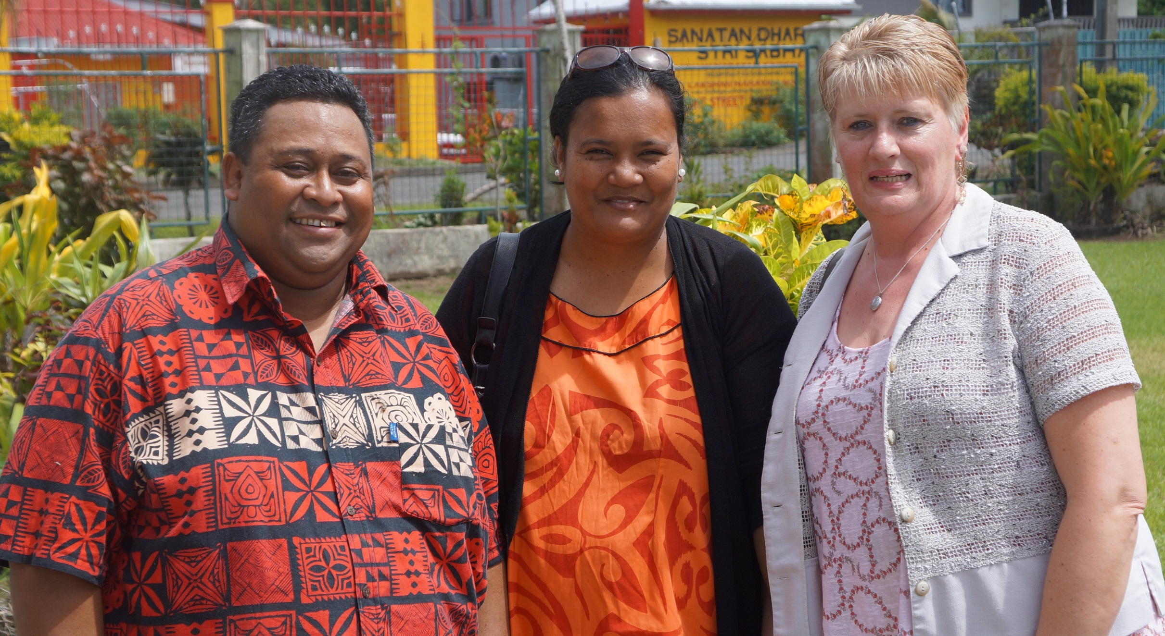
You will build lasting friendships
Psalm 96:7
“Ascribe to the Lord all you families of nations, ascribe to the Lord glory and strength.”

Slide 14

You will overcome your fears
Isaiah 41:10
“Do not fear, for I am with you; do not be dismayed for I am your God. I will strengthen you and help you; I will uphold you with my righteous right hand.”

Slide 15
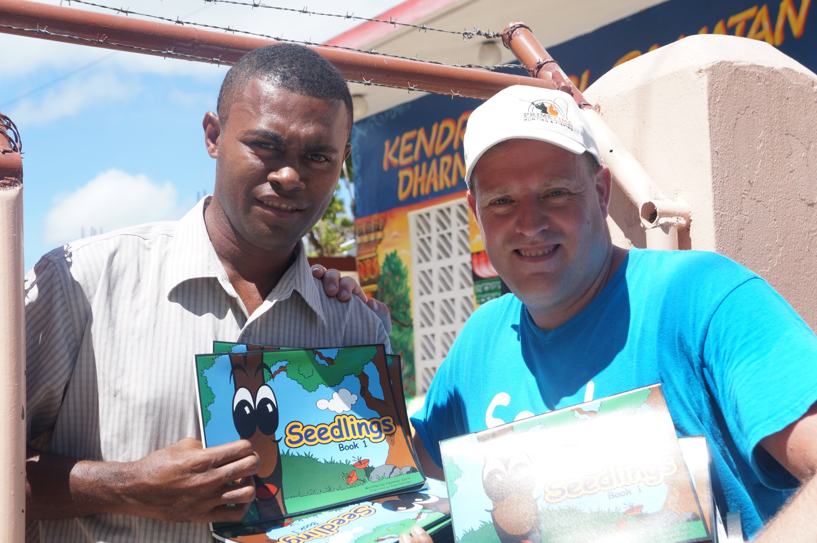
Luke 9:2
“And He sent them out to proclaim the Kingdom of God and to heal the sick.”
You will grow the kingdom of Jesus

Slide 16
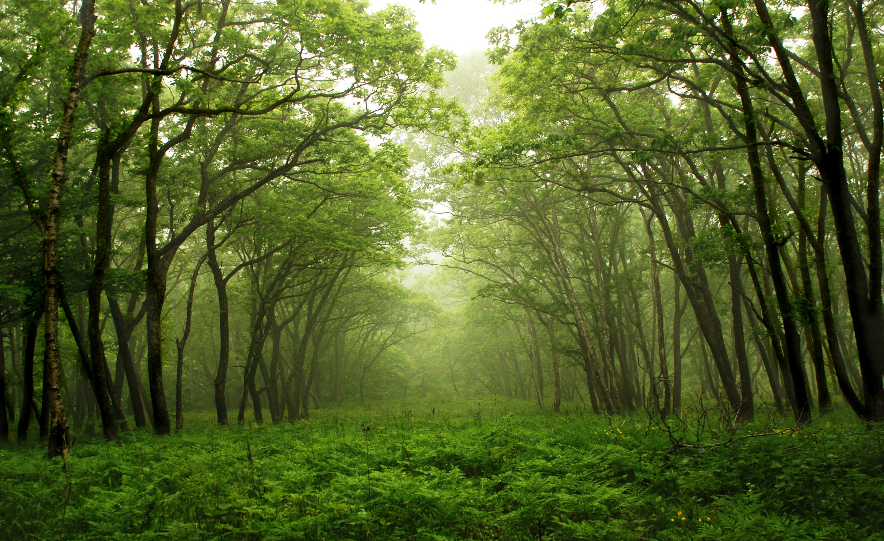
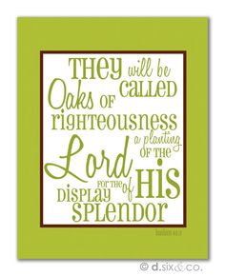
Isaiah 61:3

Slide 17
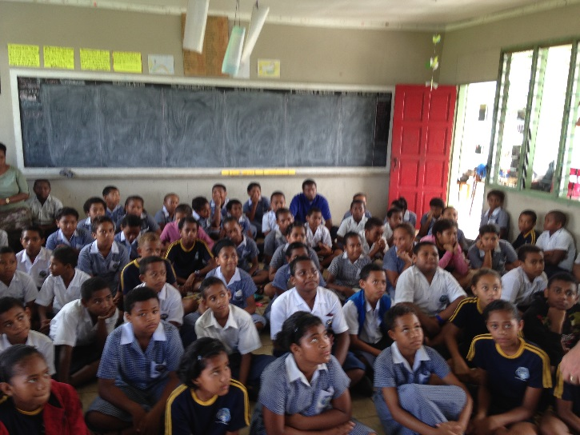
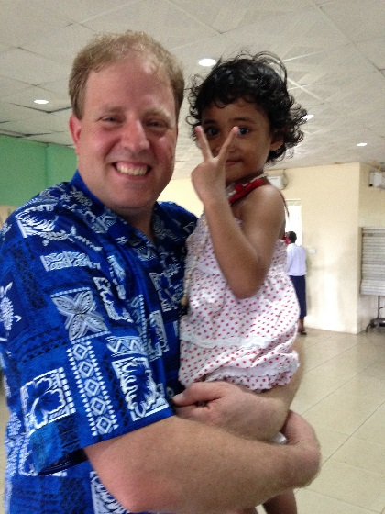

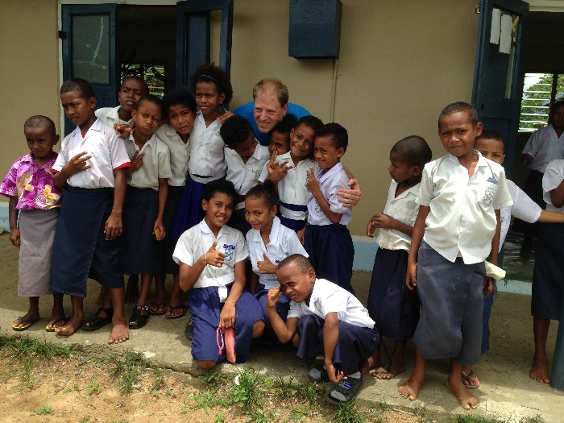
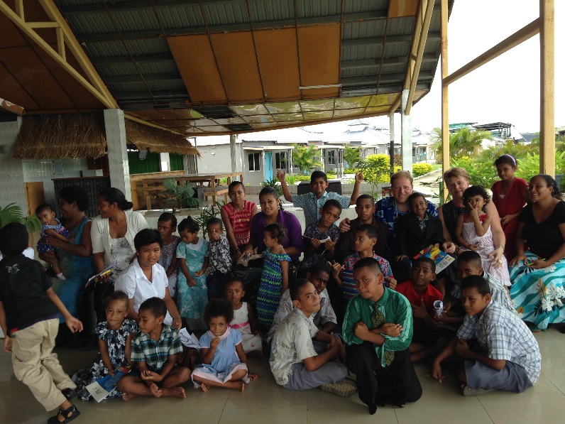

Slide 18

July 12th to 31st 2018
YOU Were Made To Thrive in Fiji:
See Michael or Denise
After the service
For details and a
Team Member
enrollment form!
Accepting applications
Until February 15 2018

