Slide 1
Indigenous Nations and Languages of Vancouver Island
Diocese of Islands & Inlets
94 Calls to Action Workshop
October 5, 2019

Slide 2
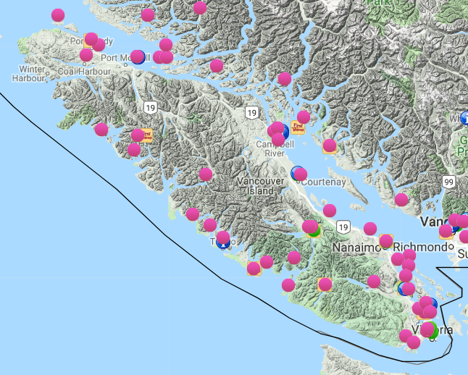
First Nations on Vancouver Island
maps.fpcc.ca

Slide 3
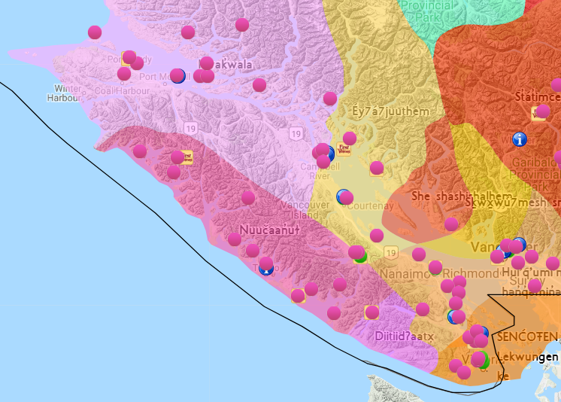
Language Families on Vancouver Island
maps.fpcc.ca

Slide 4
Language & Cultural Groups
Coast Salish
Nuu-chah-nulth (Nuučaaŉuɫ)
"all along the mountains"
Kwakwaka'wakw (Kʷakʷakəwakʷ)
(speakers of Kwak'wala or Kʷak'ʷala)

Slide 5
SENĆOŦEN & Lkwungen
HÍ,SW̱KE SIÁM. Hay'sxwq'a si'em'.
Thank you, respected one.

Slide 6
Pronunciation Tip
W̱ / xw sound
  HÍ,SW̱KE Hay'sxwq'a
  W̱SÁNEĆ
"I won't let anyone W̱ it out!"

Slide 7
Resources
First Peoples' Language Map of British Columbia: maps.fpcc.ca
FirstVoices online dictionaries: firstvoices.com
Native Land: native-land.ca
Indigenous Languages in Canada: What You Need to Know

Slide 8
Protocol
When is it OK for us as Settler Anglicans to use Indigenous languages?
Generally …
  naming Nations when acknowledging traditional territory
  greeting or thanking an Indigenous person who is present
Depends on the context!
Always defer if an Indigenous person is present.

Slide 9
Provenance
Is it OK to use Indigenous words and phrases learned off the internet?
  Better to develop relationships with Indigenous individuals and communities,
    learn from them directly
    use their language with their permission
    acknowledge who you learned from
  Speak 'from the heart', not just as a token.
  Internet resources are great for practice!

