Slide 1

How Shall We Understand the Calls?
Practice, Listening, Engaging, Responding

Slide 2
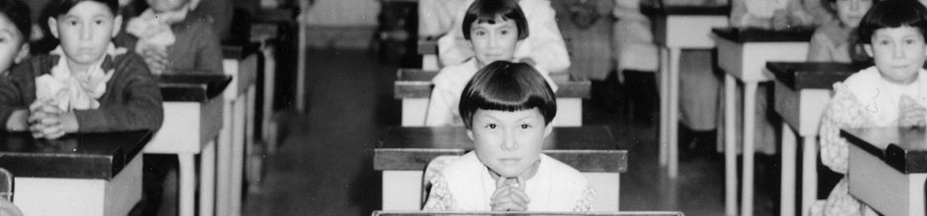
What was it?
Photo:trc.ca

Slide 3
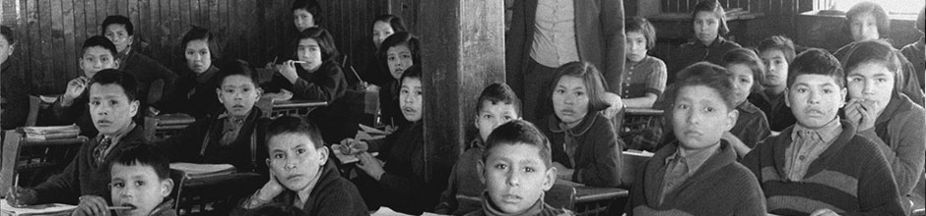
What did it hope to achieve?
Photo:trc.ca

Slide 4
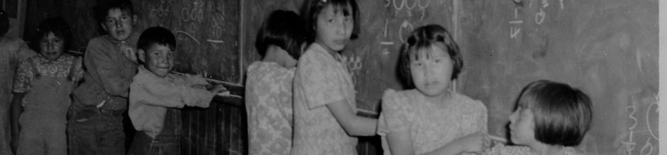
What did it accomplish?
Photo:trc.ca

Slide 5
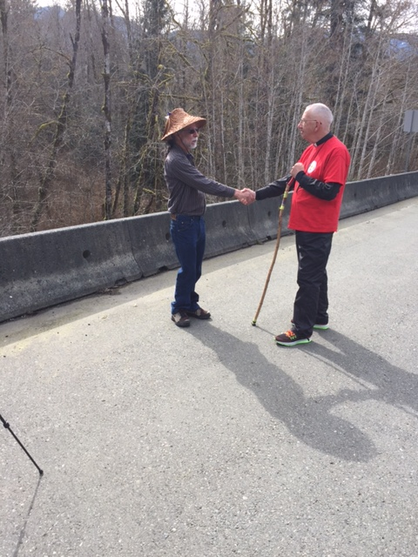
What is reconciliation?

Slide 6
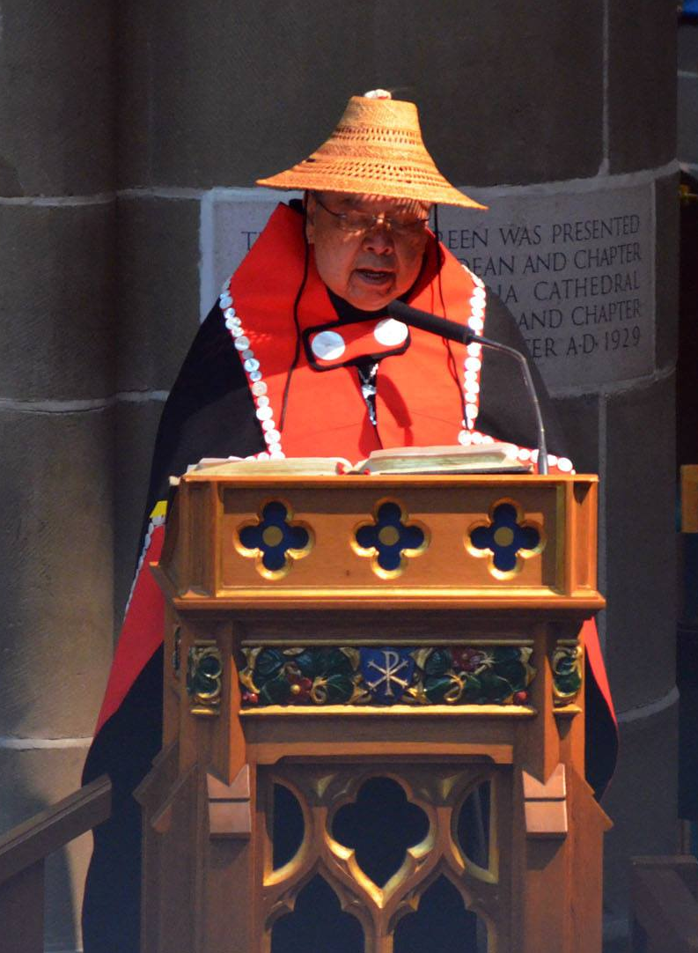
What does the Bible say about reconciliation?

Slide 7
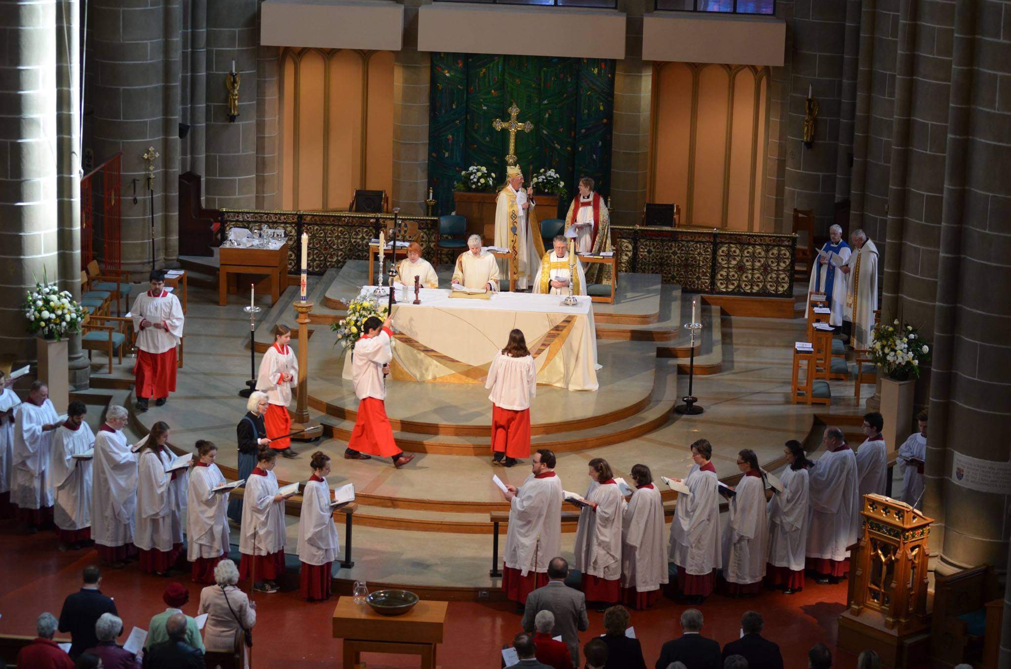
What does reconciliation look like in the Anglican church?

Slide 8
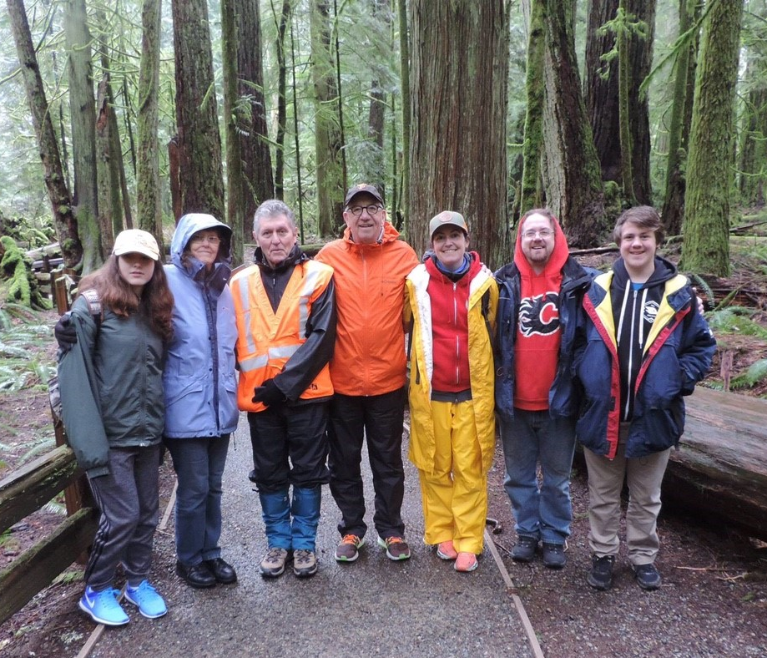
What does reconciliation mean to you?

Slide 9
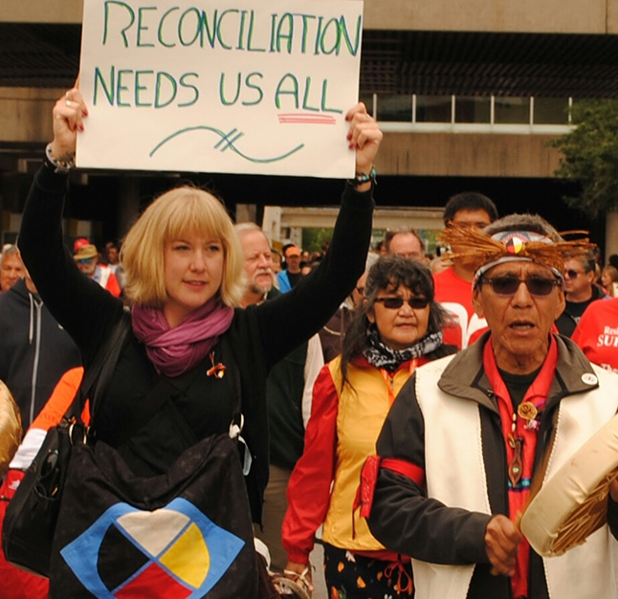
How can you be involved in reconciliation?

