Slide 1
MNCH PROGRAM
MOZAMBIQUE

Slide 2
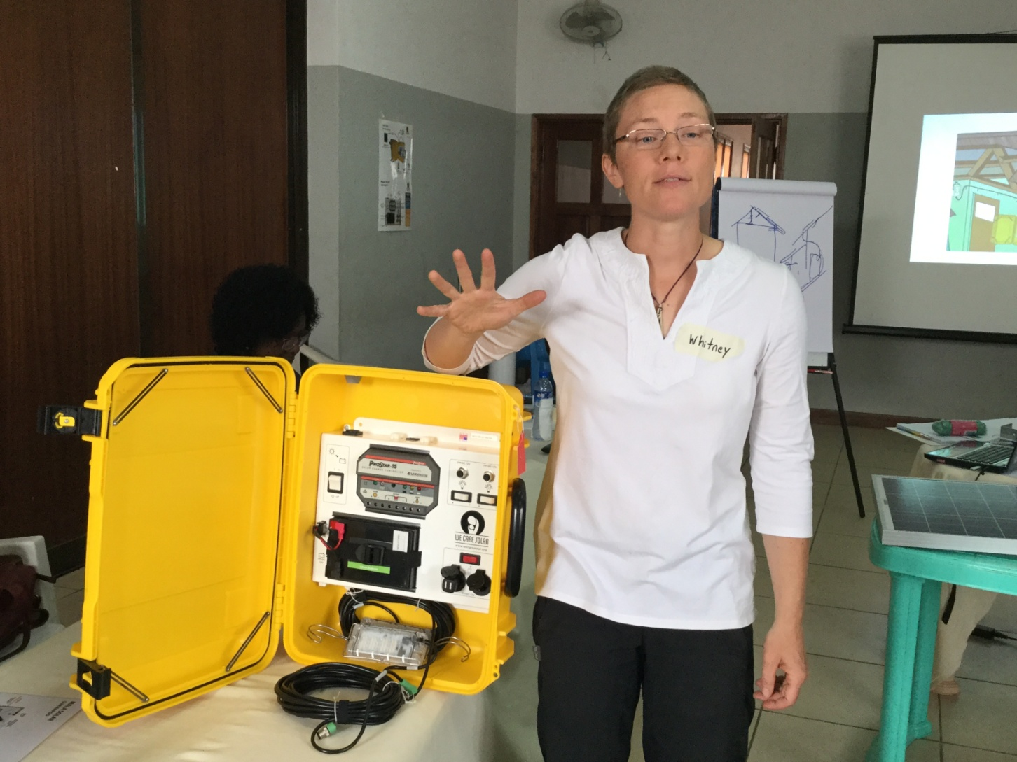
A SOLAR SUITCASE

Slide 3
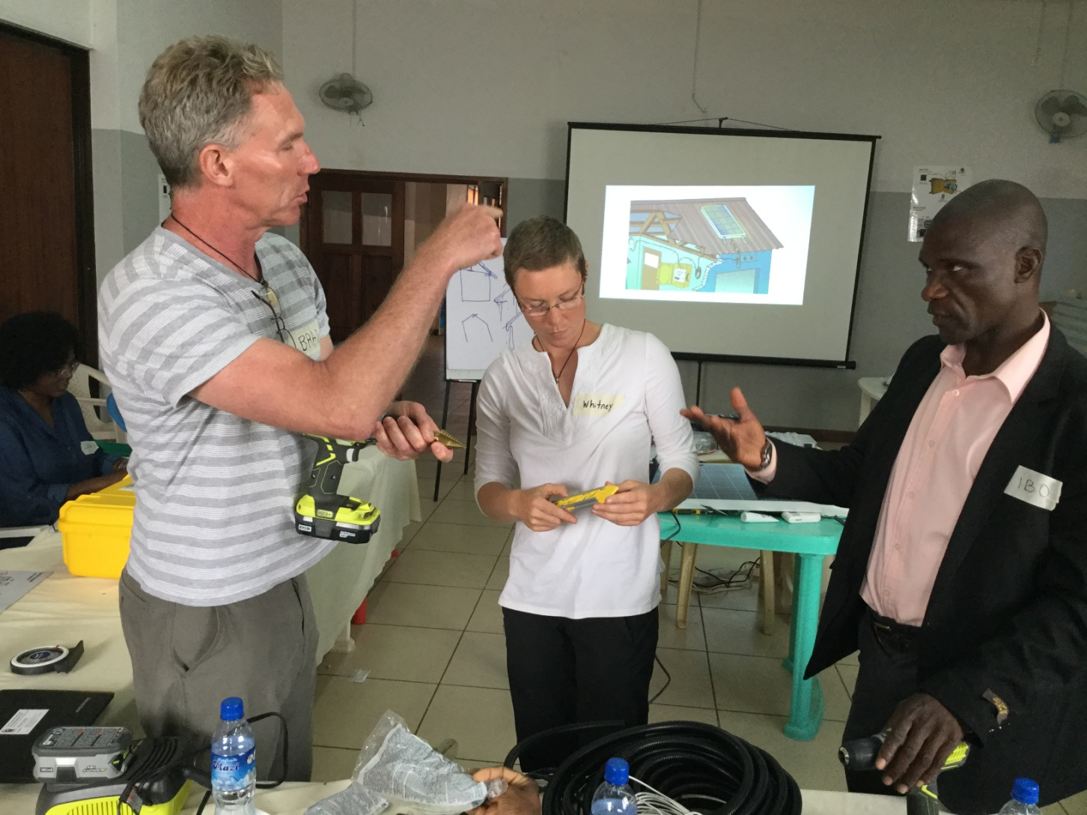
THE TRAINERS

Slide 4
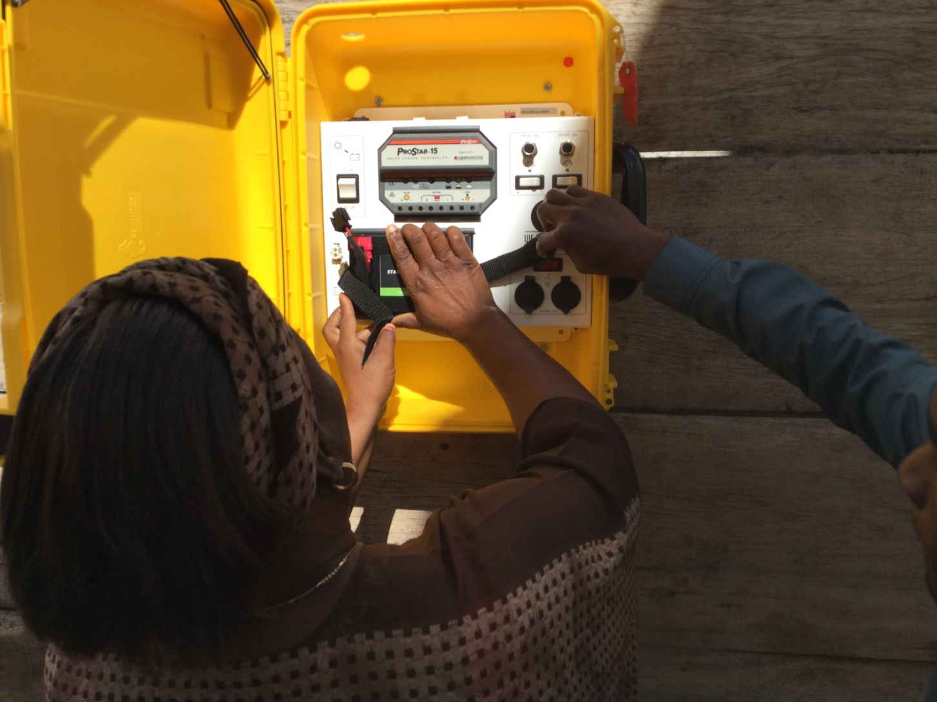
LEARNING HOW TO INSTALL THE SOLAR SUITCASES

Slide 5
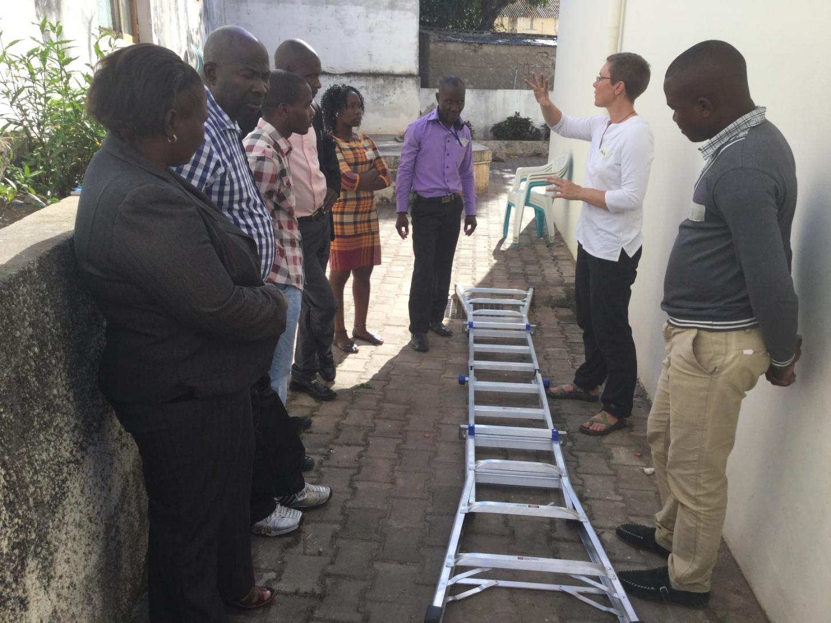
TRAINING

Slide 6
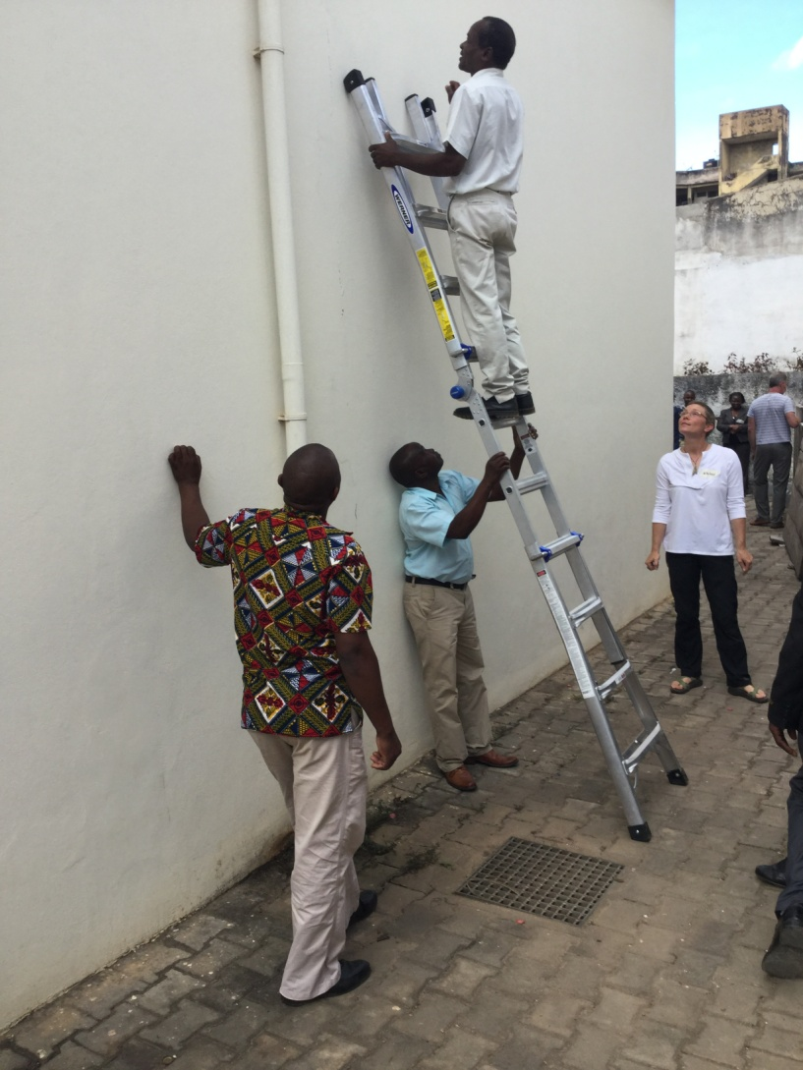
TRAINING

Slide 7
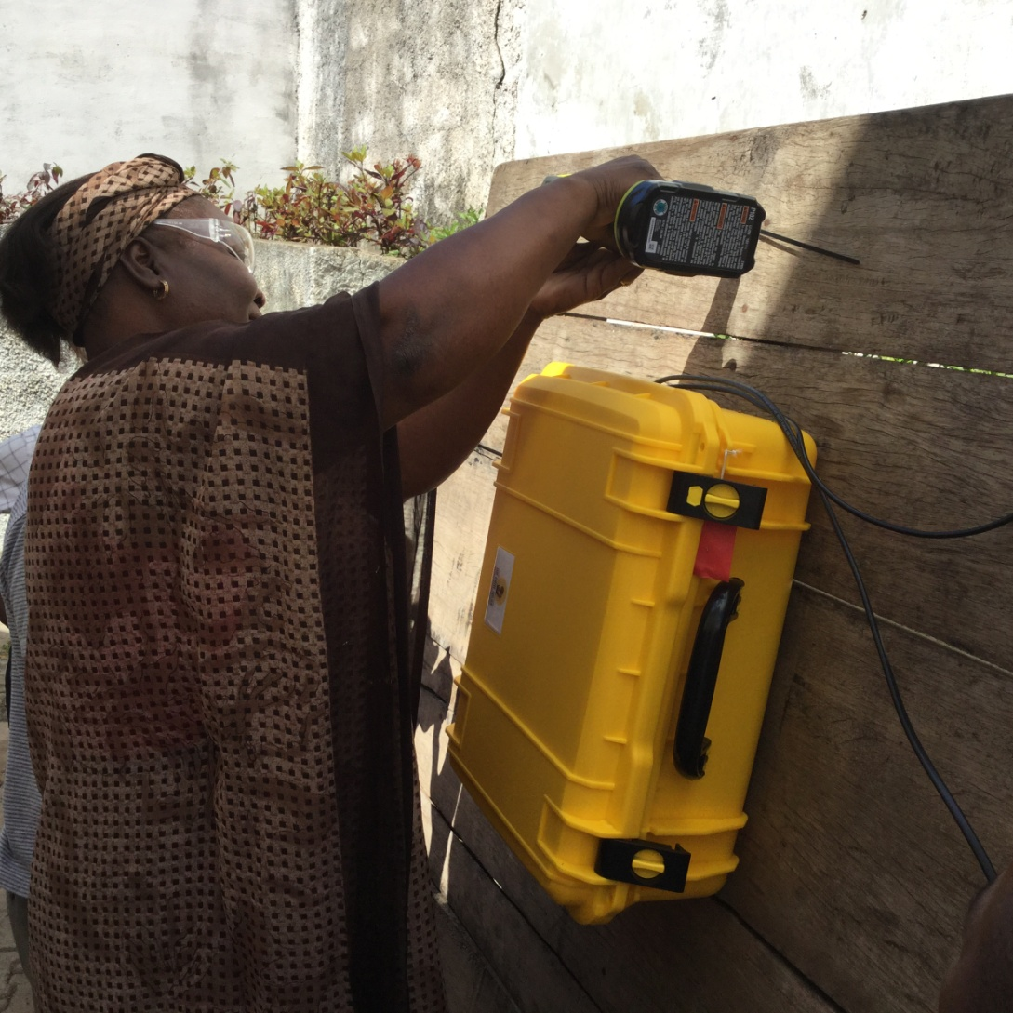
NURSE FLORINDA

Slide 8
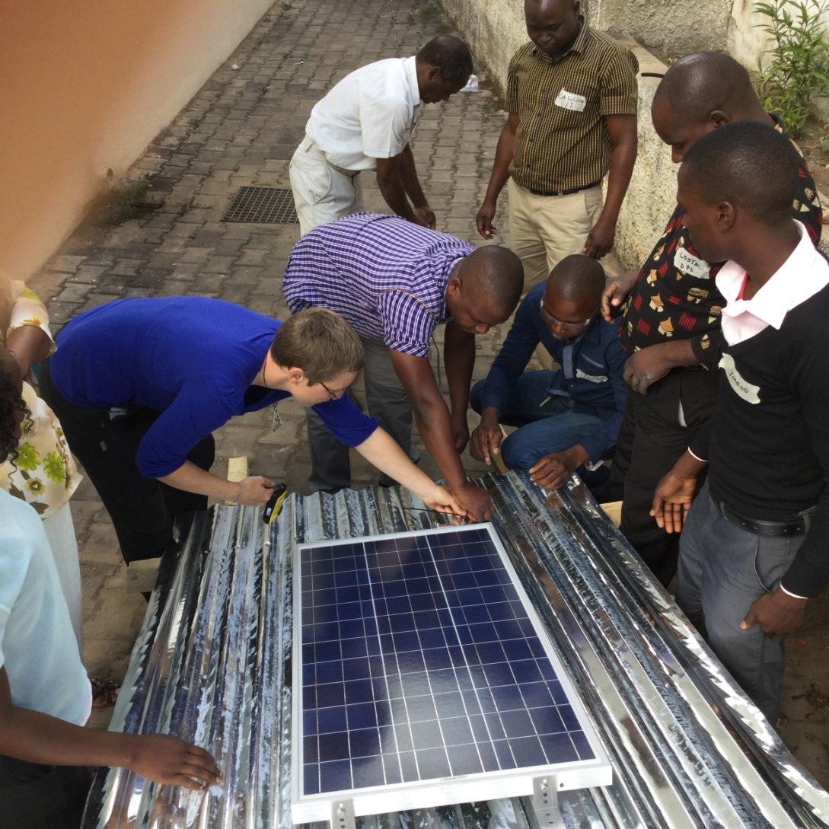
LEARNING HOW TO INSTALL THE SOLAR PANELS

Slide 9
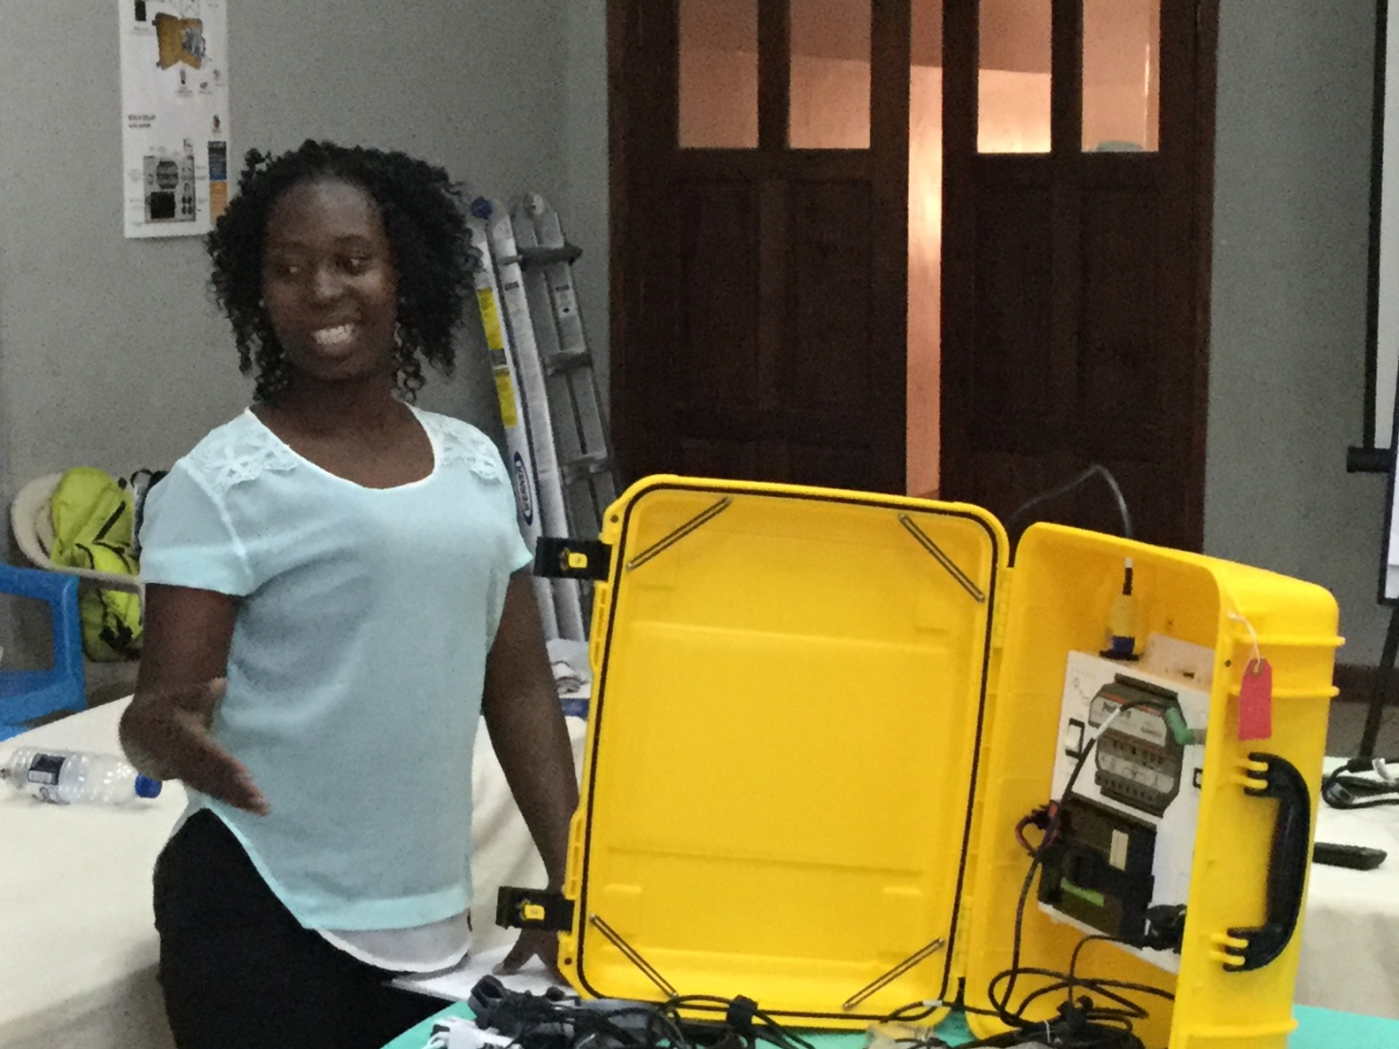
EVERYONE IS A TRAINER

Slide 10
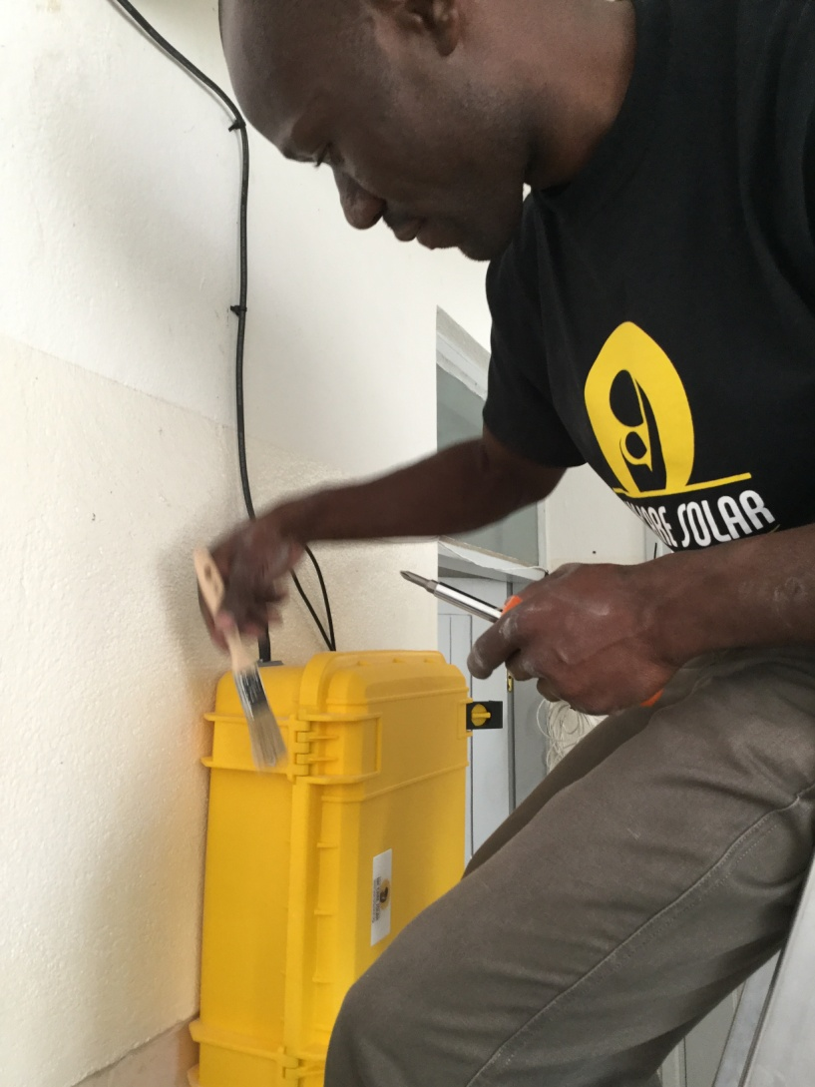
PRECISION

Slide 11
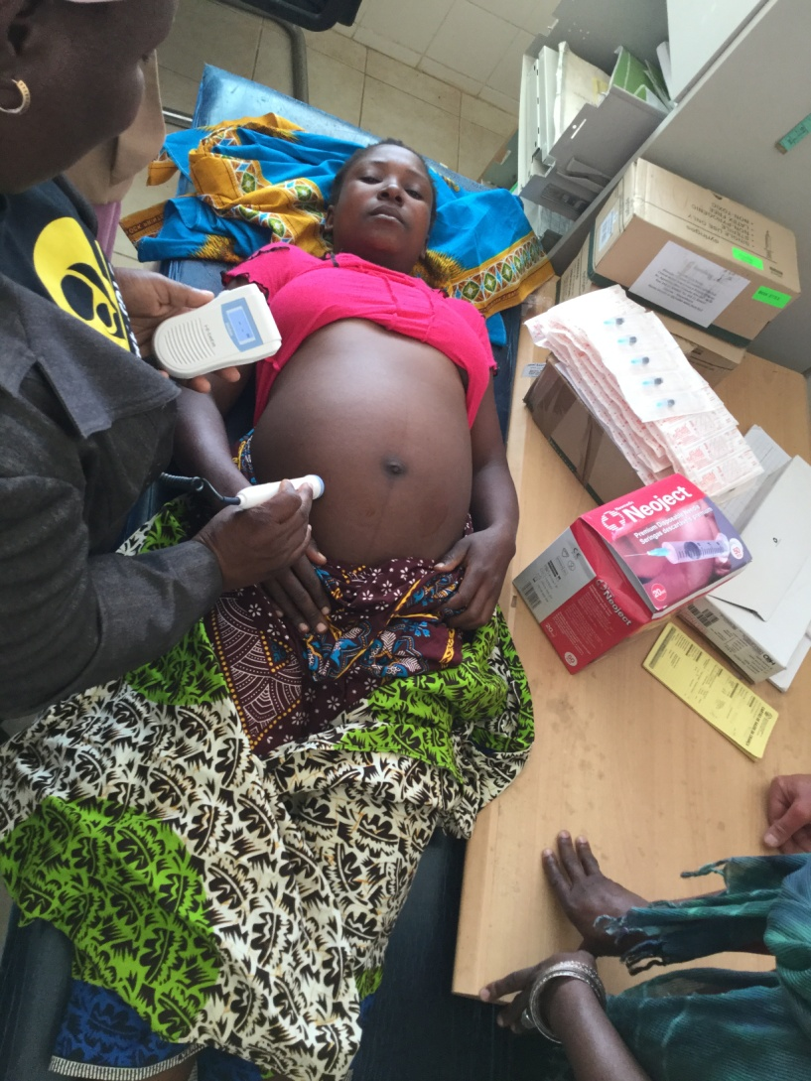
TRAINING THE NURSES

Slide 12
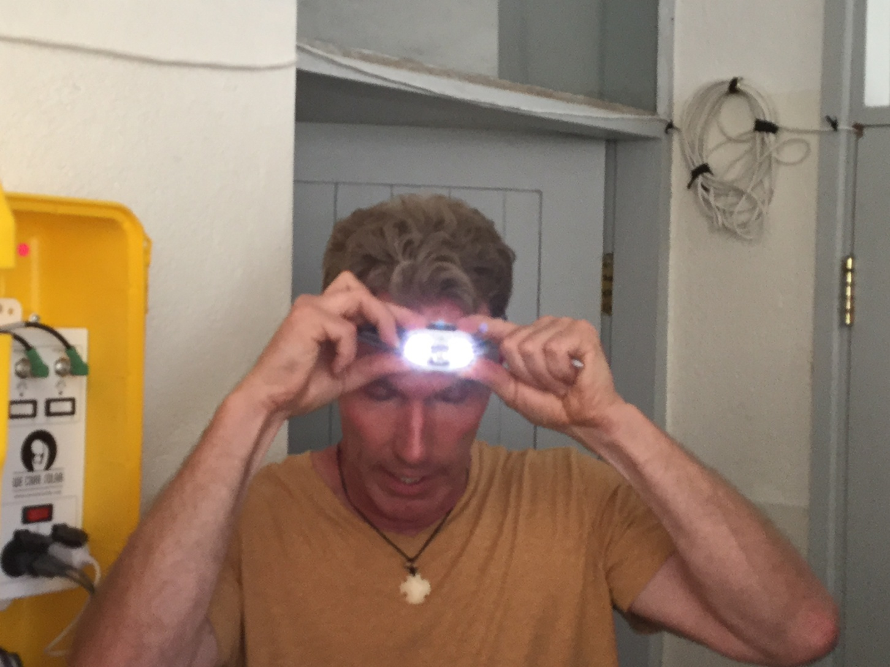
HEAD LIGHT

Slide 13
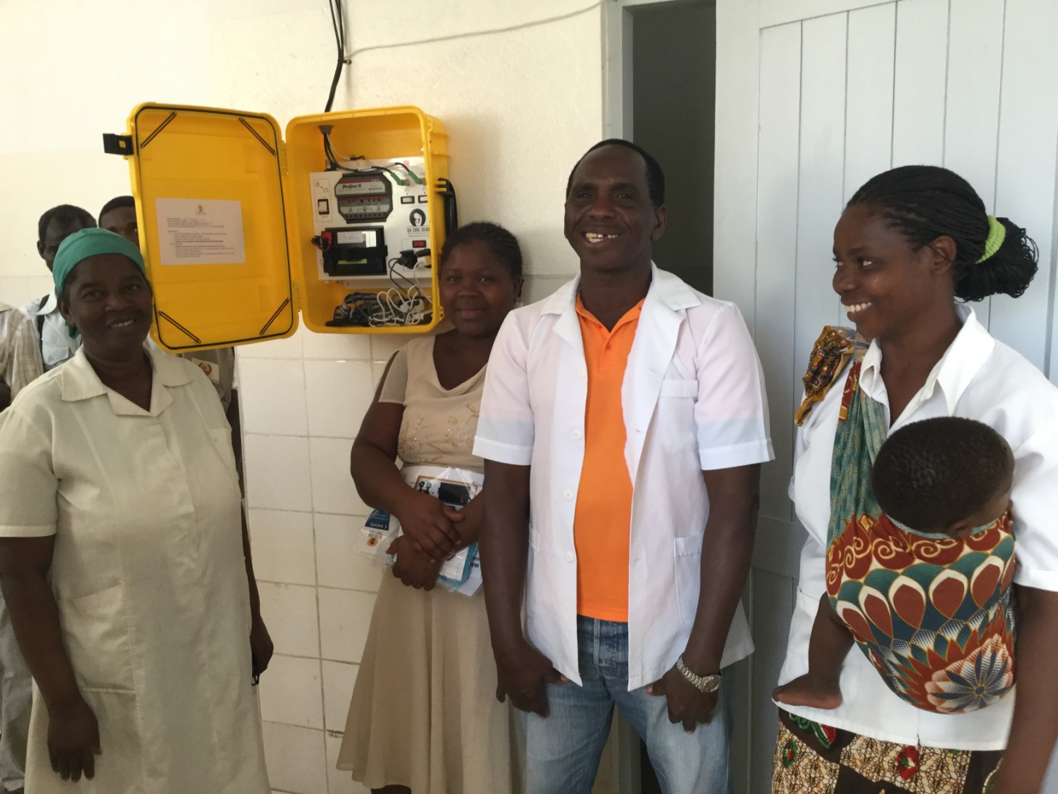
HAPPY STAFF

Slide 14
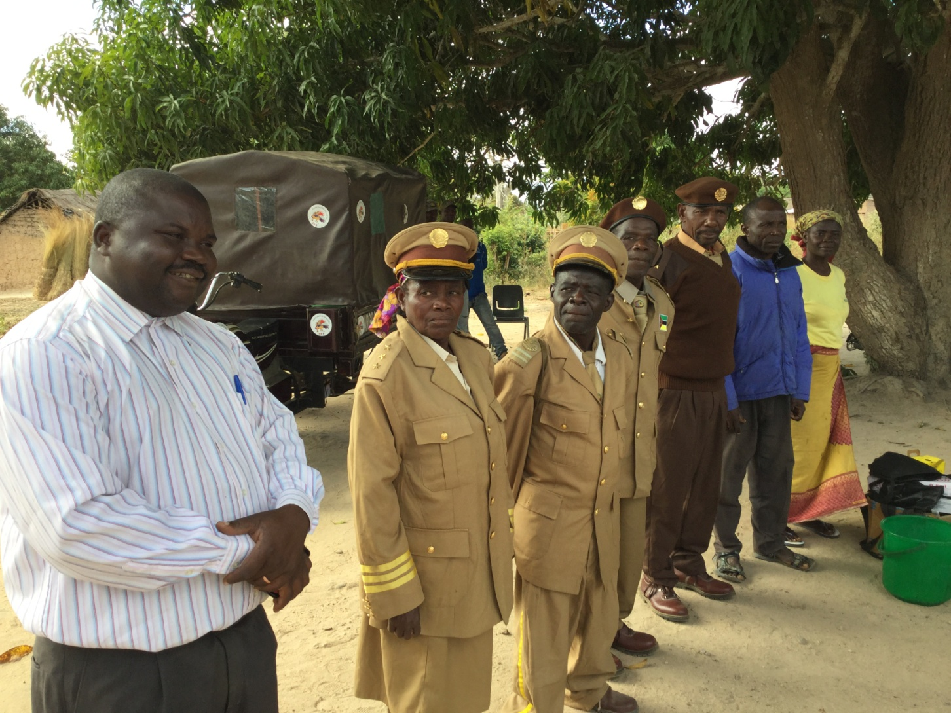
LOCAL AUTHORITIES

Slide 15
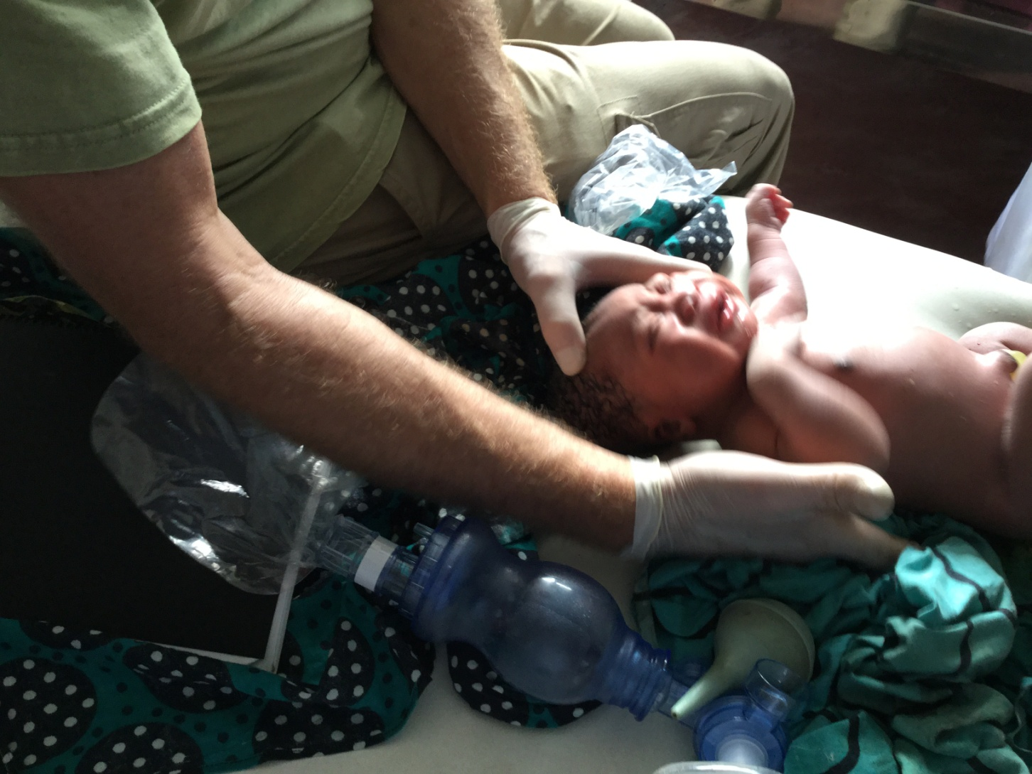
RESSUSCITATING A BABY

Slide 16
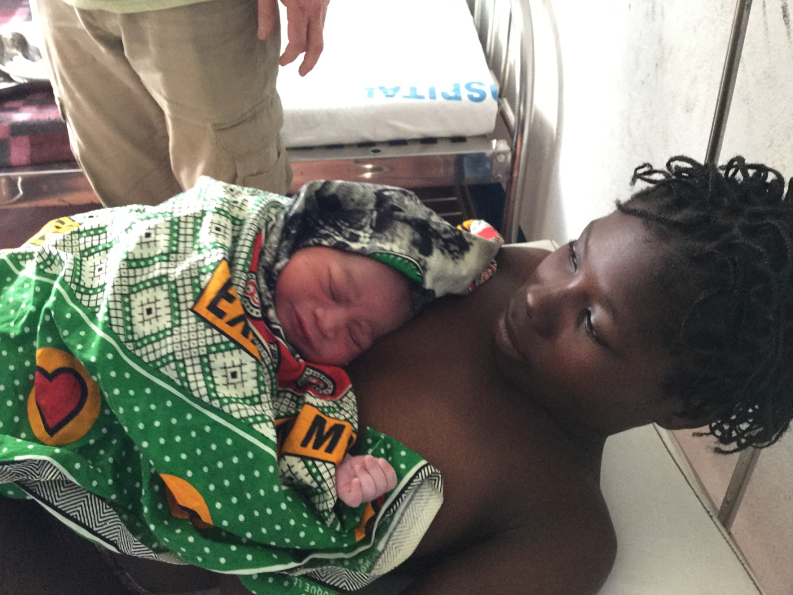
A HAPPY MOM

Slide 17
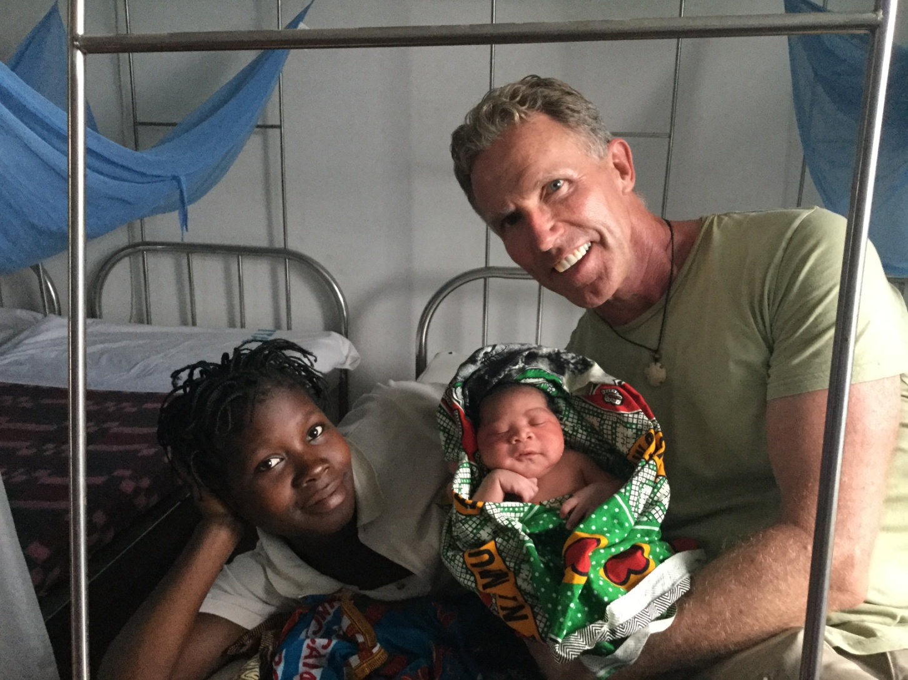
DR. HOLDEN, MOM & BABY BRAD

Slide 18
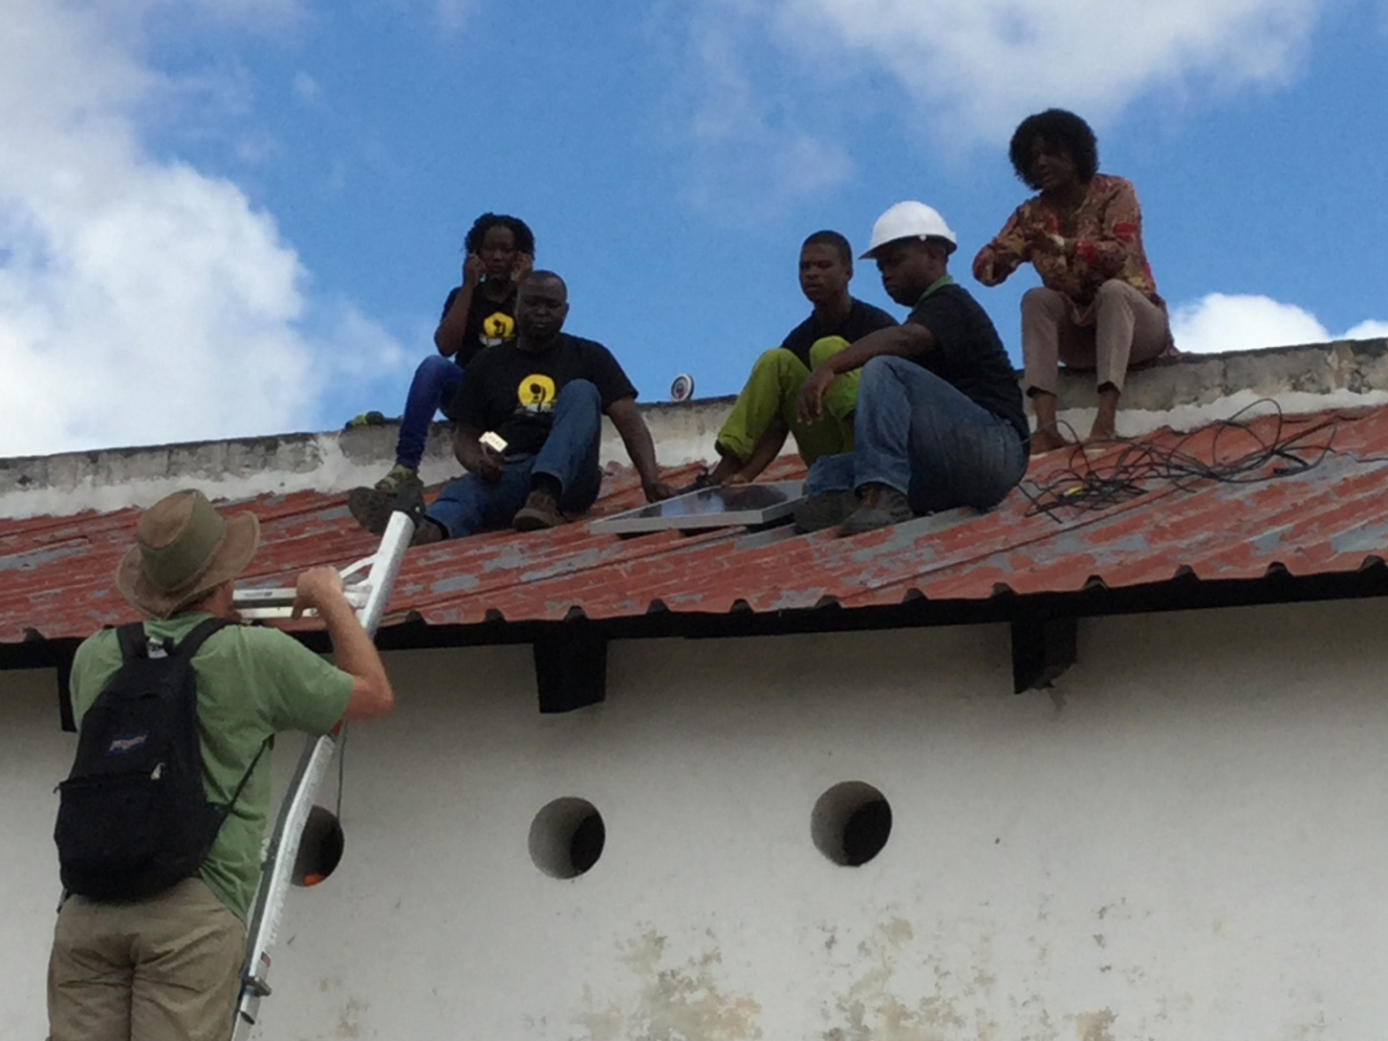
GET THE JOB DONE

Slide 19
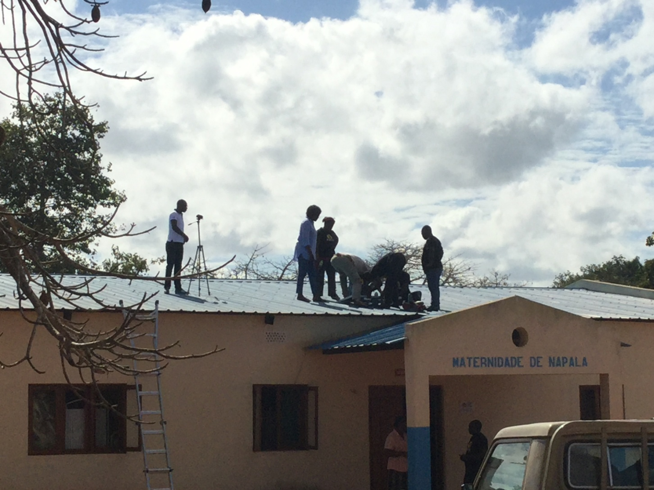
ASSESSING THE WEATHER

Slide 20
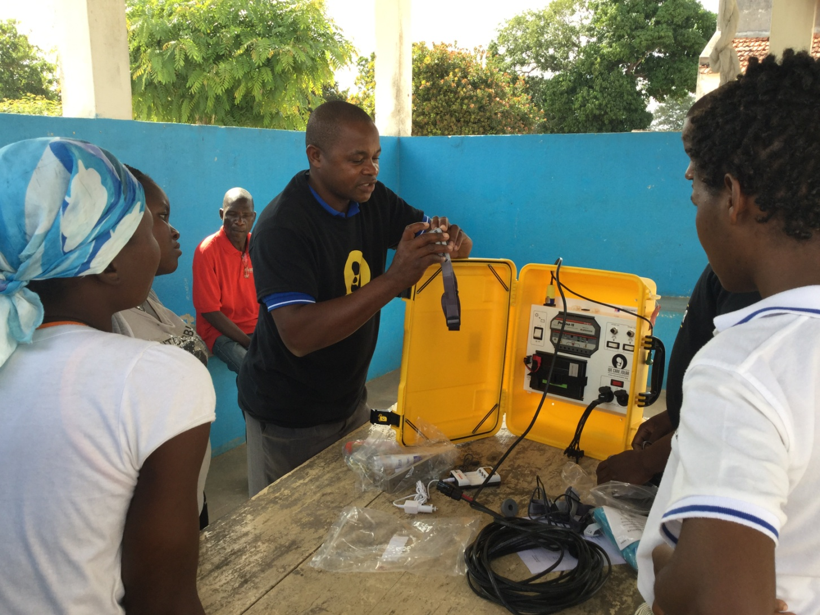
TRAINING ALL HEALTH STAFF

Slide 21
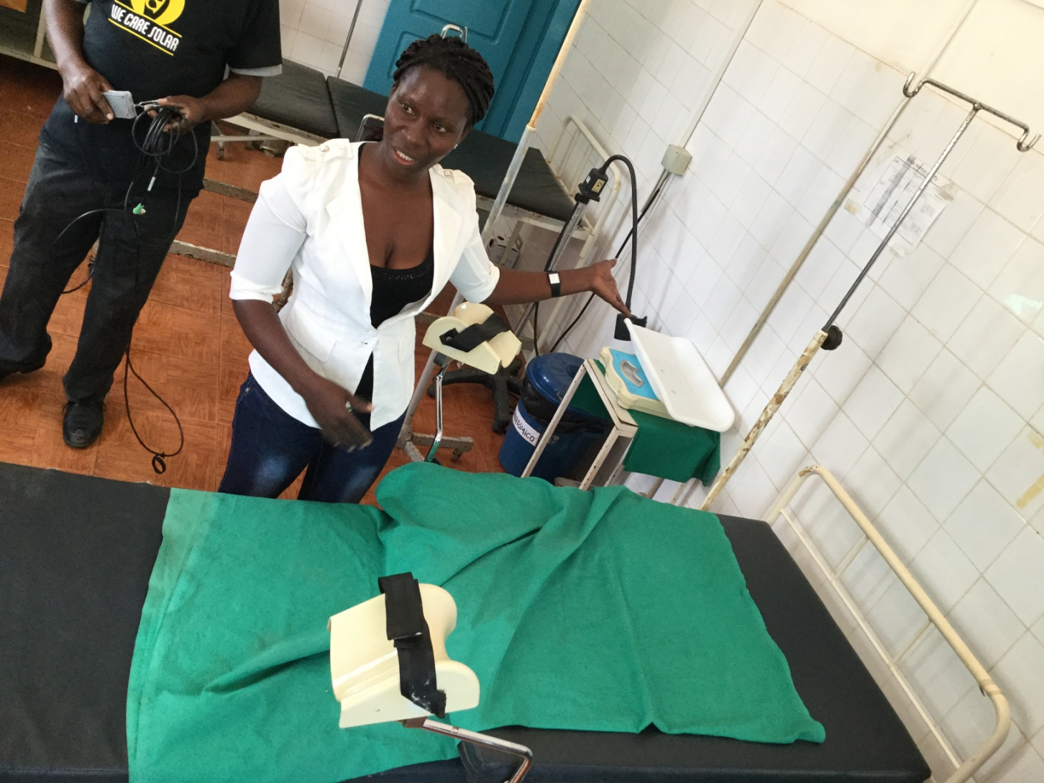
DELIVERING 198 BABIES A MONTH!!!

Slide 22
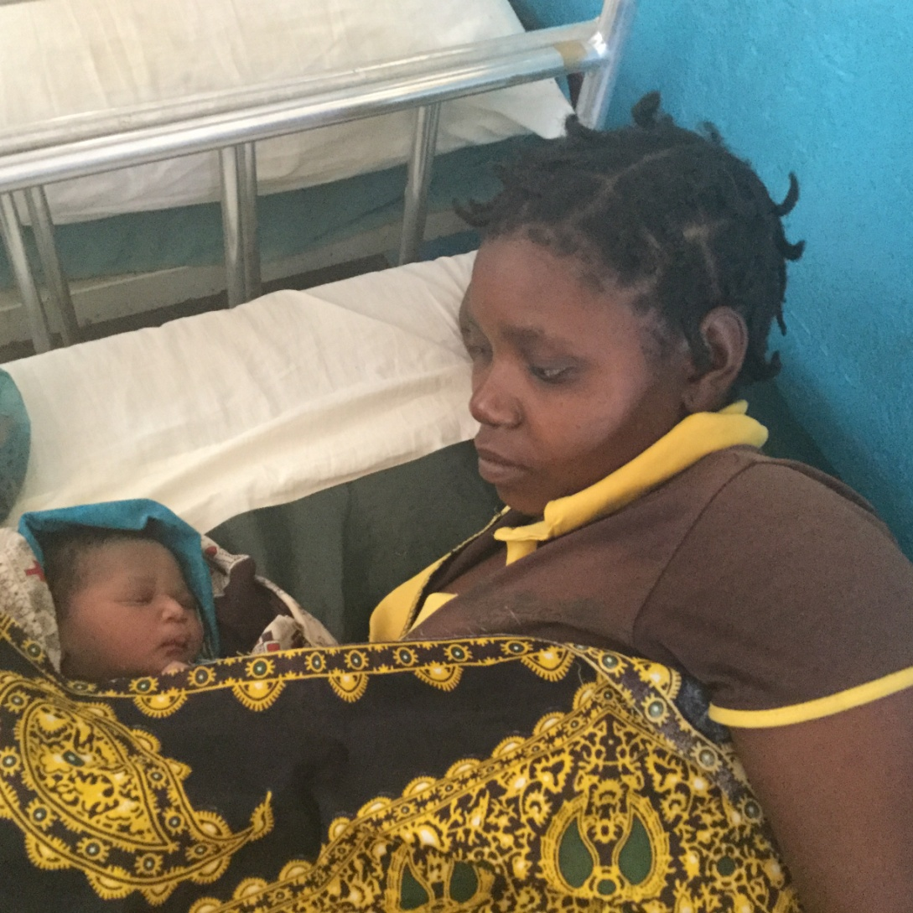
MOM JUST HAD THE BABY!!!

Slide 23
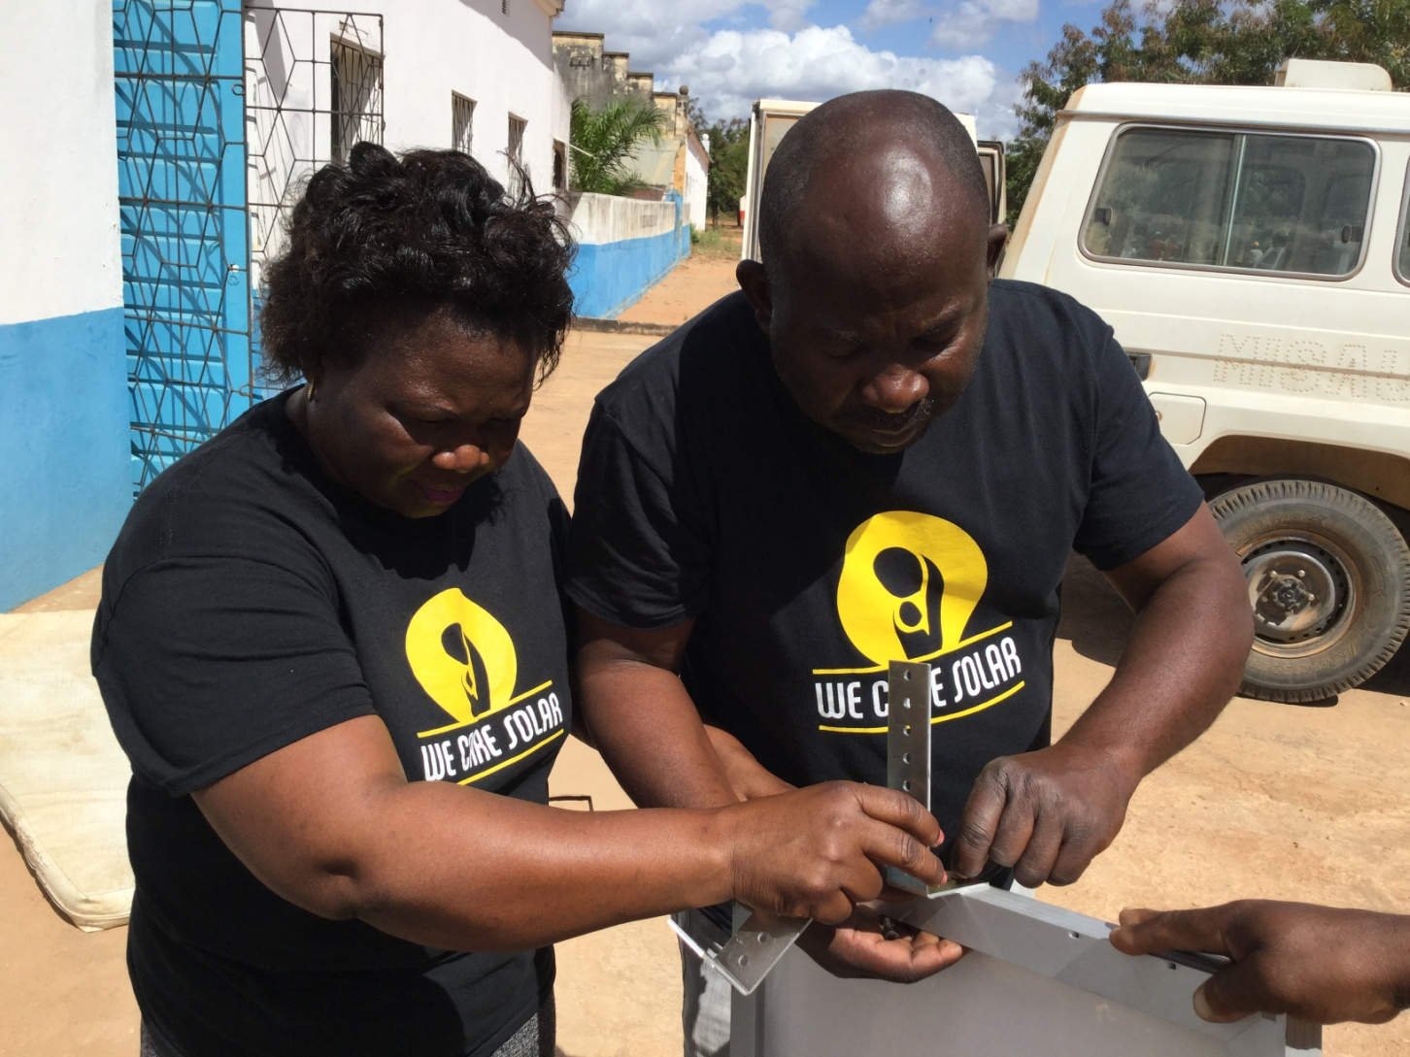
TEAM WORK

Slide 24
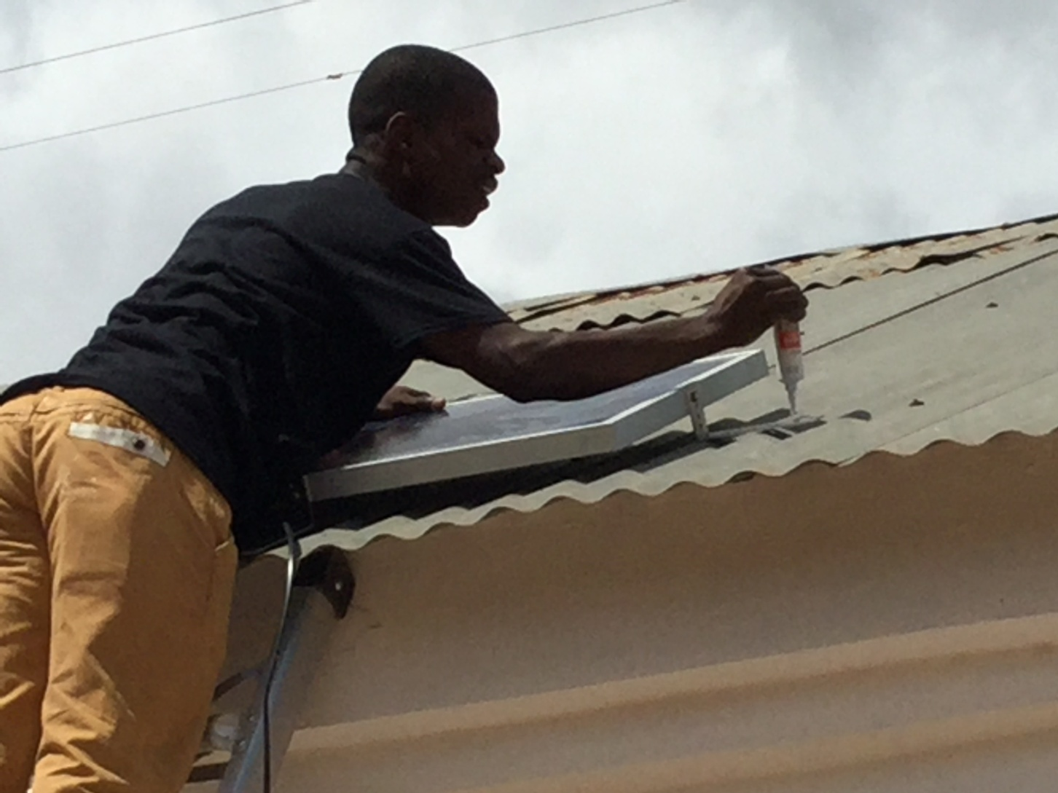
EVERY ROOF IS DIFFERENT

Slide 25
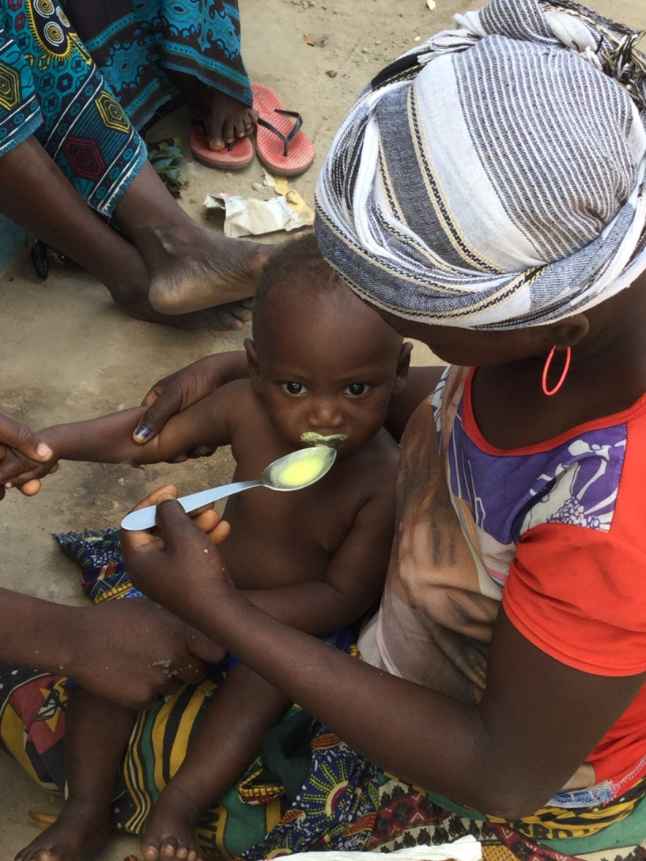
TREATING MALARIA

Slide 26
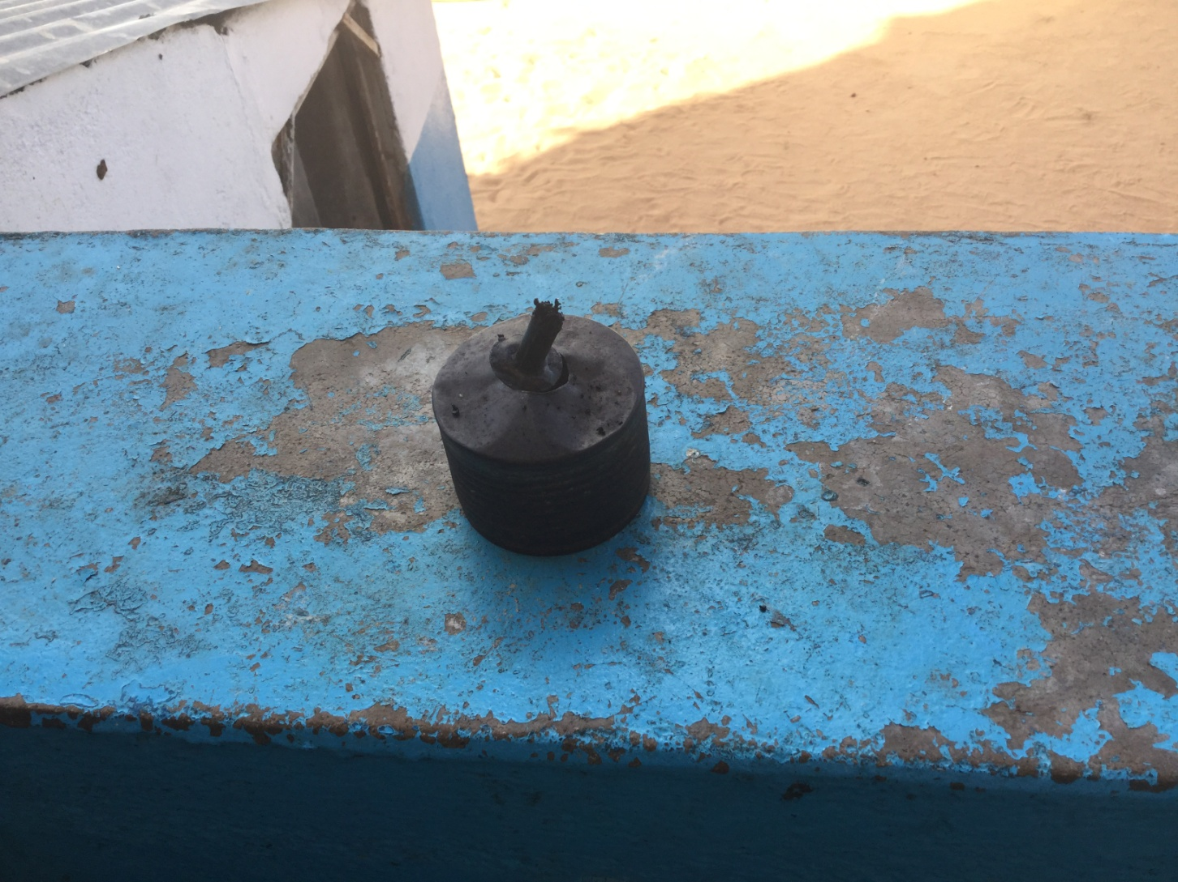
EXAMPLE OF TYPE OF LIGHTS USED IN CLINICS

Slide 27
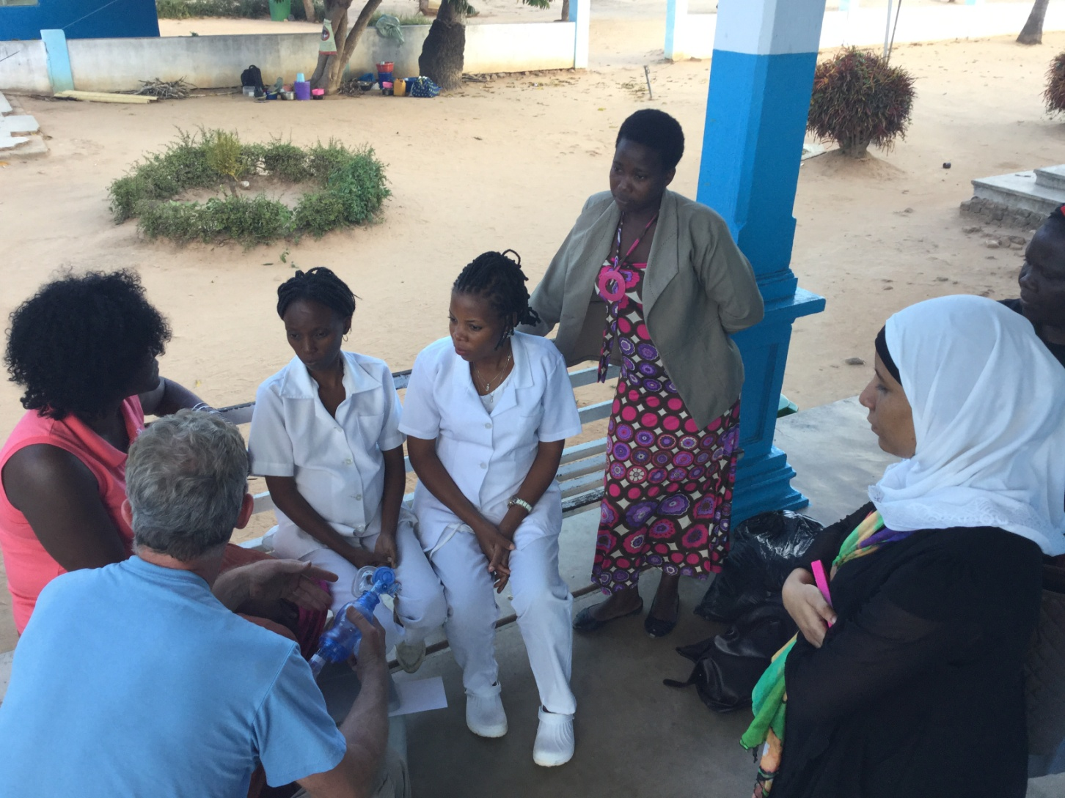
TRAINING NURSES HOW TO USE AMBU BAGS

Slide 28
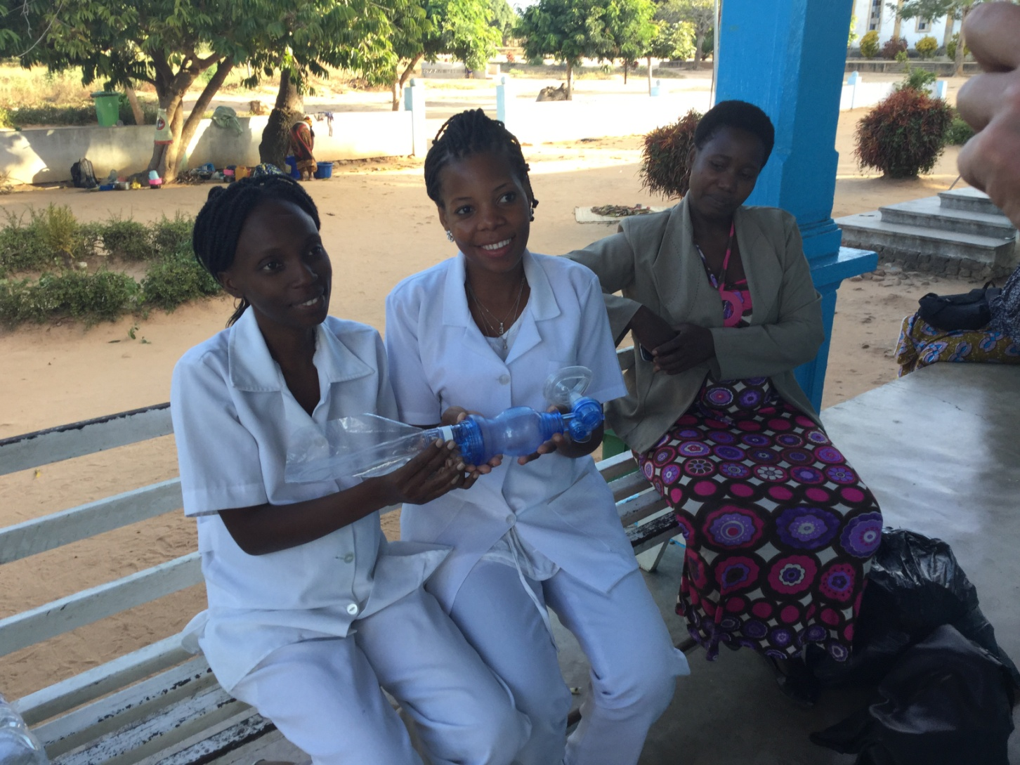
NURSES ACCEPTING A AMBU BAG

Slide 29
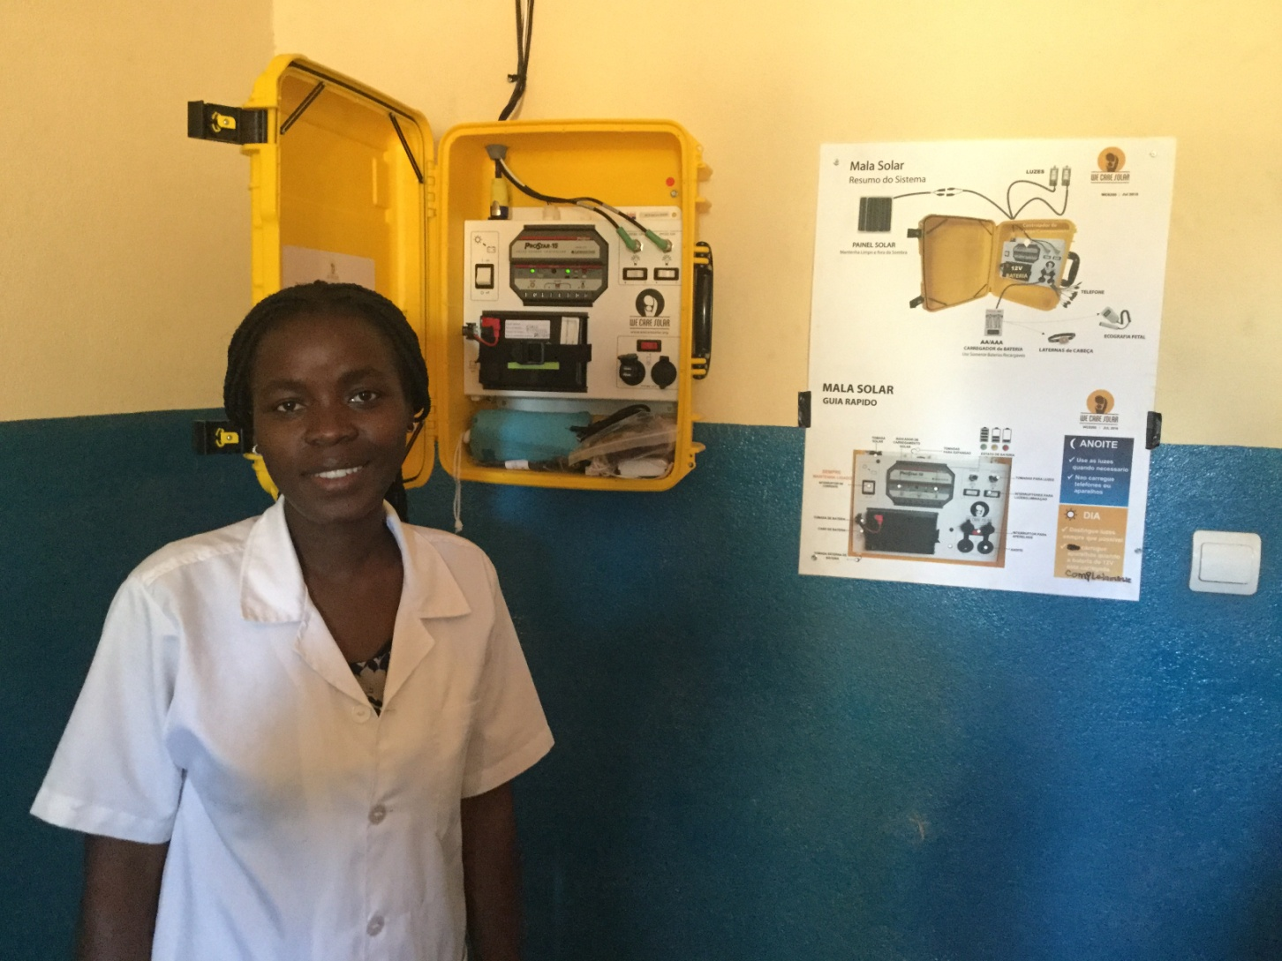
A SOLAR SUITCASE INSTALLED

Slide 30
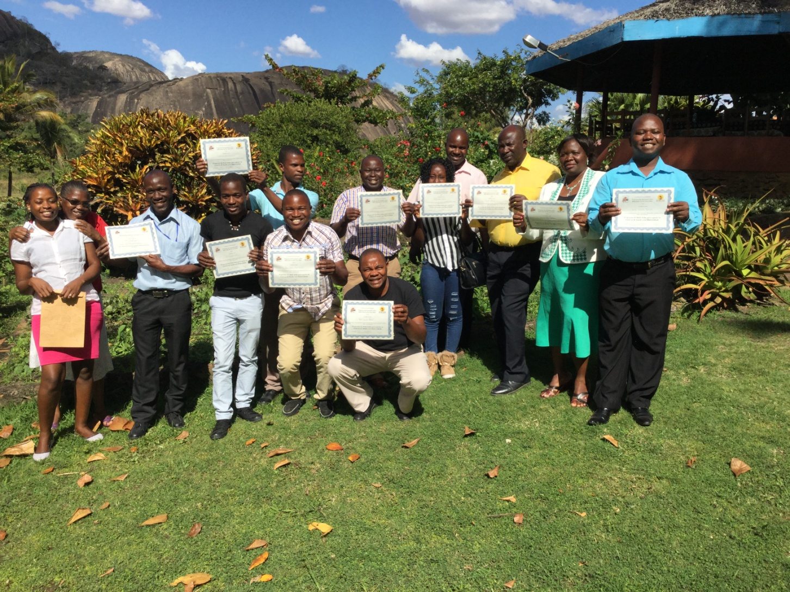
GRADUATION DAY!

Slide 31
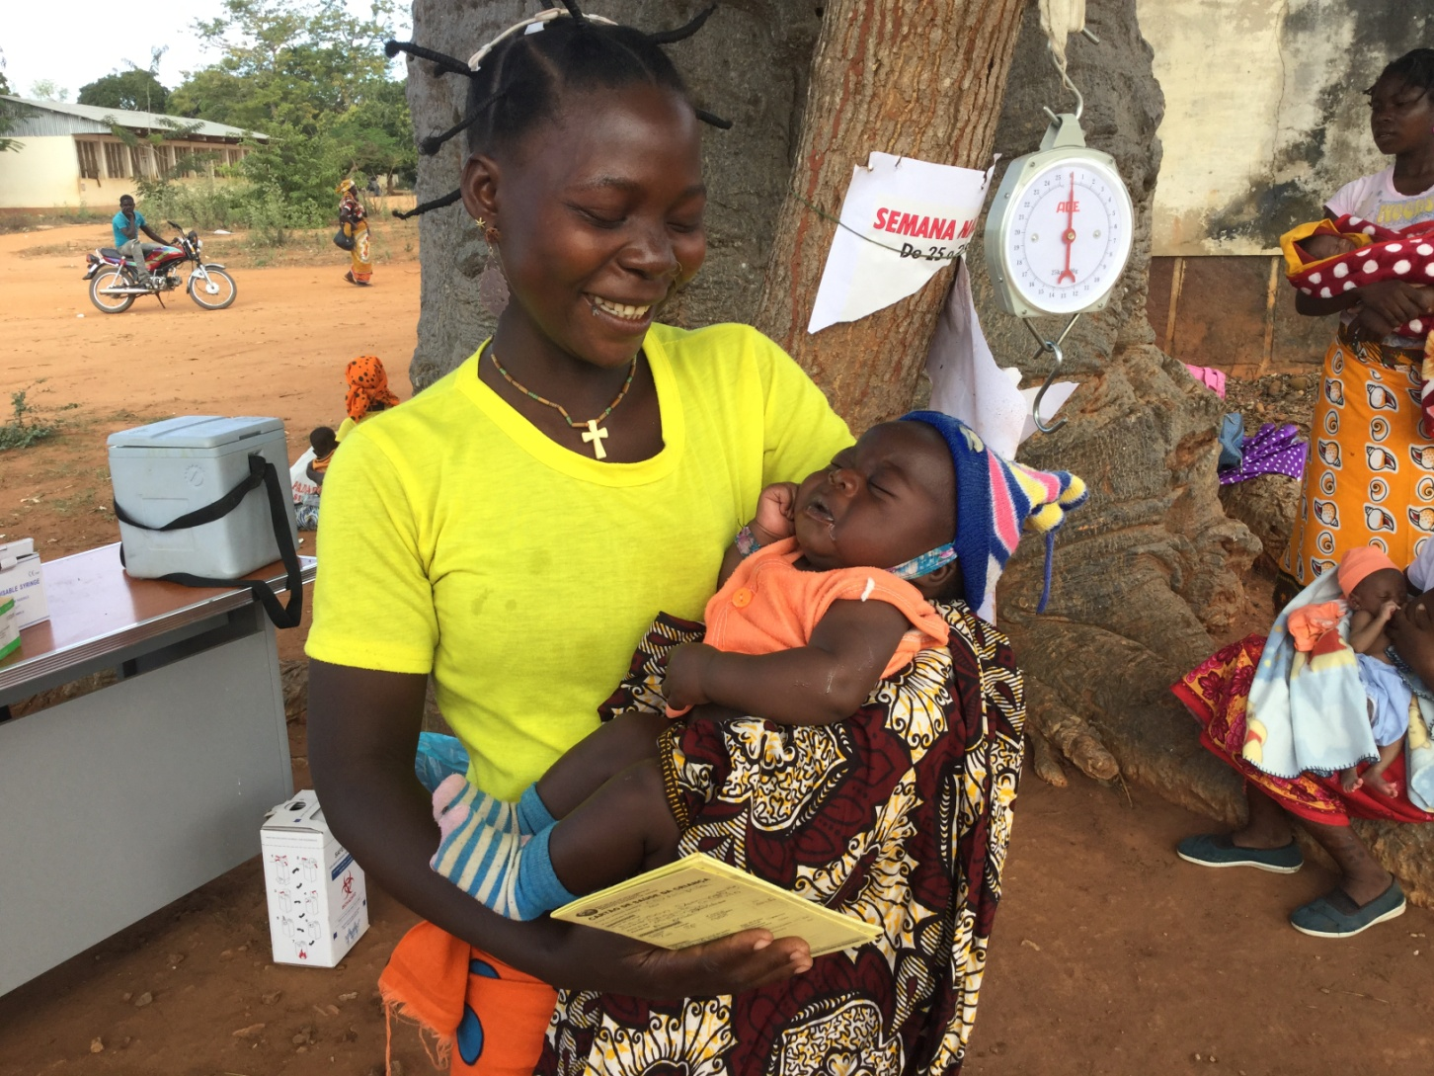
A HEALTHY BABY AND A HAPPY MOM!

