Slide 1
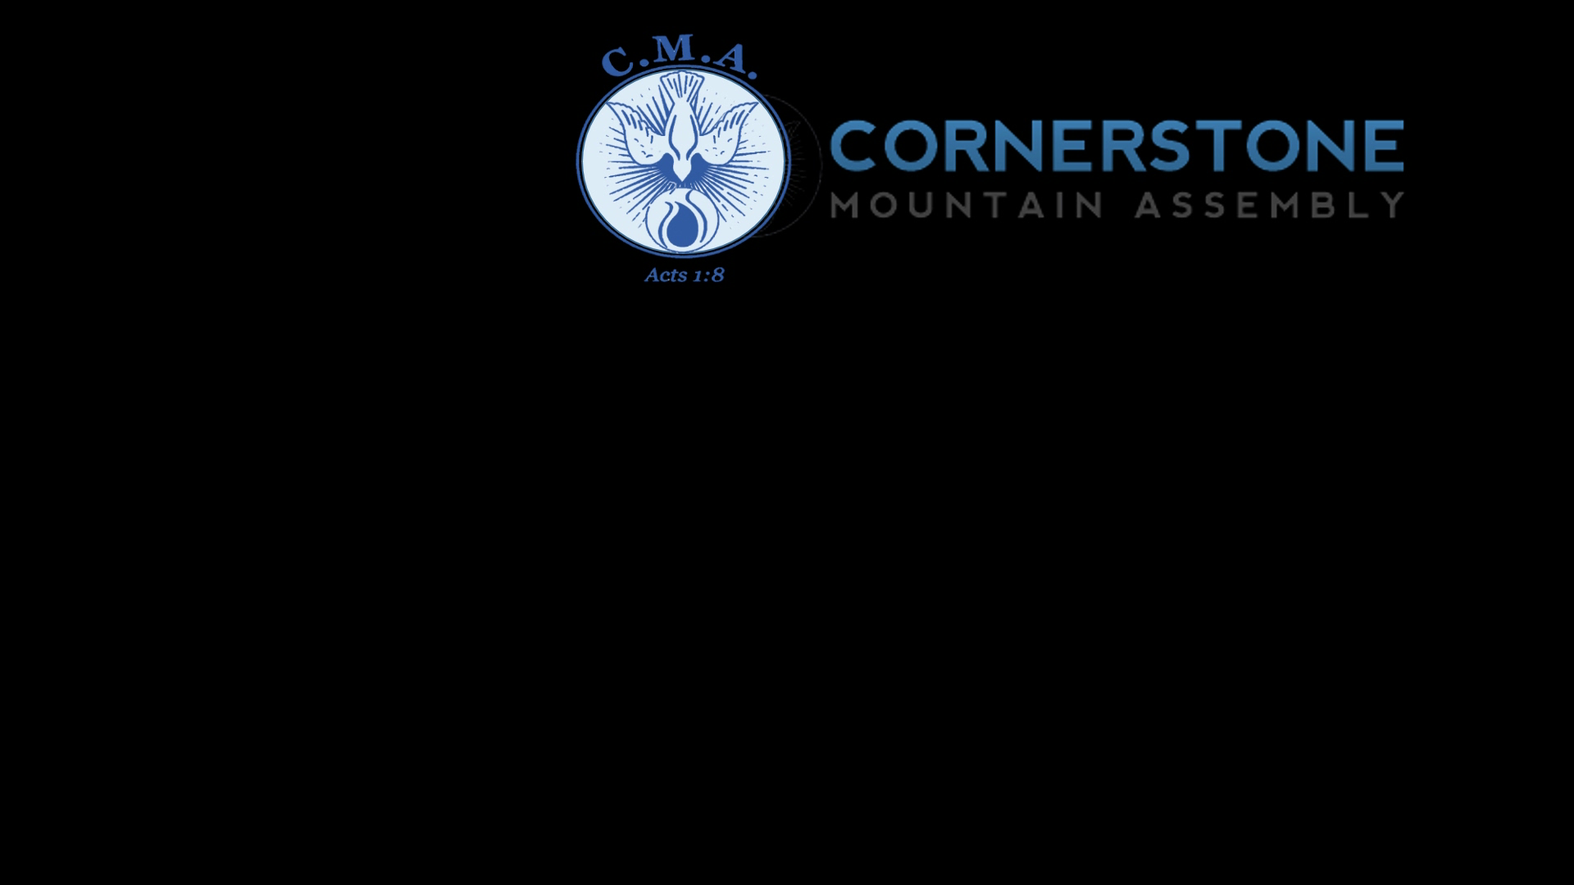

Slide 2
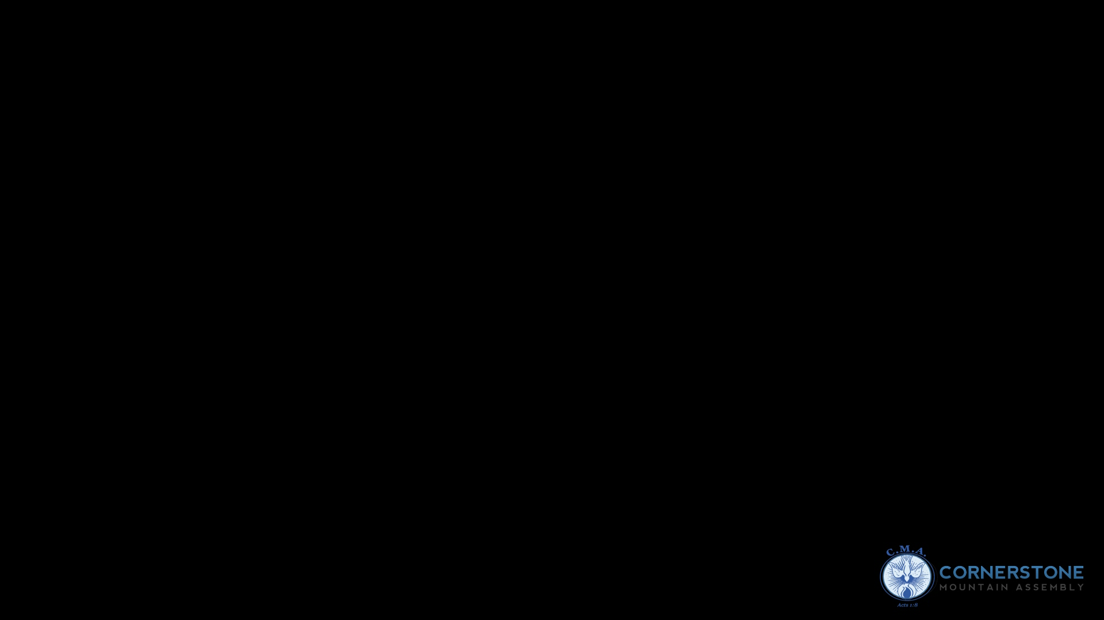
The Look

Slide 3

John 9:1
And as Jesus passed by, he saw a man which was blind from his birth.

Slide 4
^{LOOKING WITHOUT SEEING}
^{SEEING WITH LOOKING}

Slide 5
^{LOOK}
– to direct your eyes in a particular direction

Slide 6
SEE
- To notice or become aware of (someone or something) by using your eyes

Slide 7
PREJUDICE
Pre-judge
To form an opinion about (someone or something) before you have enough understanding or knowledge

Slide 8
^{John 7:24}
Judge not according to the appearance, but judge righteous judgment.

Slide 9
^{2 Chronicles 16:9}
For the eyes of the Lord run to and fro throughout the whole earth, to shew himself strong in the behalf of them whose heart is perfect toward him. Herein thou hast done foolishly: therefore from henceforth thou shalt have wars.

Slide 10
2 Corinthians 4:4
In whom the god of this world hath blinded the minds of them which believe not, lest the light of the glorious gospel of Christ, who is the image of God, should shine unto them.

Slide 11
^{Colossians 1:12}
Giving thanks unto the Father, which hath made us meet to be partakers of the inheritance of the saints in light:

Slide 12
^{Luke 24:30-33}
And it came to pass, as he sat at meat with them, he took bread, and blessed it, and brake, and gave to them.31 And their eyes were opened, and they knew him; and he vanished out of their sight.

Slide 13
32 And they said one to another, Did not our heart burn within us, while he talked with us by the way, and while he opened to us the scriptures?33 And they rose up the same hour, and returned to Jerusalem, and found the eleven gathered together, and them that were with them,

Slide 14
Isaiah 10:27
And it shall come to pass in that day, that his burden shall be taken away from off thy shoulder, and his yoke from off thy neck, and the yoke shall be destroyed because of the anointing.

Slide 15
Looking unto Jesus
Hebrews 12:2

Slide 16
Hebrews 12:2
Looking unto Jesus the author and finisher of our faith; who for the joy that was set before him endured the cross, despising the shame, and is set down at the right hand of the throne of God.

Slide 17
Hebrews 10:23
Let us hold fast the profession of our faith without wavering.
(for he is faithful that promised)

Slide 18
Turn your defeat into defiance
Turn your storm into a story
Turn your mess into a message
Turn your Worry into worship
Turn your fear into faith

Slide 19
Turn your doubt into dependence
Turn your disappointments into appointments
Turn your pain into praise and prayers

Slide 20
Turn your trials into testimonies
Turn your temptation into triumph
Turn your grind into glory

Slide 21
5. We are called out to bring joy
to the oppressed and not
to depressed people

Slide 22
Job 29:13
The blessing of him that was ready to perish came upon me: and I caused the widow's heart to sing for joy.

Slide 23
6. We are called out to be
agents of joy

Slide 24
Isaiah 55:12
For ye shall go out with joy, and be led forth with peace: the mountains and the hills shall break forth before you into singing, and all the trees of the field shall clap their hands.

Slide 25
7. Our lives is meant to make
people round us joyful
and not sorrowful

Slide 26
Matthew 5:16
Let your light so shine before men, that they may see your good works, and glorify your Father which is in heaven.

Slide 27
Psalm 34:2
My soul shall make her boast in the Lord: the humble shall hear thereof, and be glad.

Slide 28
Psalms 69:32-34
The humble shall see this, and be glad: and your heart shall live that seek God.
33 For the Lord heareth the poor, and despiseth not his prisoners. 34 Let the heaven and earth praise him, the seas, and every thing that moveth therein.

Slide 29
Proverbs 15:25
The Lord will destroy the house of the proud: but he will establish the border of the widow.

Slide 30
Proverbs 16:5
Every one that is proud in heart is an abomination to the Lord: though hand join in hand, he shall not be unpunished.

Slide 31
^{7.} Sin affects not only the one who sins, but others as well. Just like Achan our sins do not affect us alone.

Slide 32
Romans 5:12
Wherefore, as by one man sin entered into the world, and death by sin; and so death passed upon all men, for that all have sinned:

Slide 33
Romans 5:18-19
Therefore as by the offence of one judgment came upon all men to condemnation; even so by the righteousness of one the free gift came upon all men unto justification of life.19 For as by one man's disobedience many were made sinners, so by the obedience of one shall many be made righteous.

Slide 34
8. Choice then determines destiny
(I set before you this day)
Deuteronomy 30:15-16 Deuteronomy 30:19

Slide 35
9. Obedience is a matter of choice
Isaiah 1:19

Slide 36
10. Biblically the meaning of the name Achan is
- “He that troubleth”

Slide 37
DISOBEDIENCE
lack of regard for Authority
In the Old Testament it carries a stronger meaning
- stubbornness or violence

Slide 38
STUBBORN
- Refusing to change your ideas
- Refusing to stop doing something
- Refusing to change something difficult to deal with

Slide 39
1 Samuel 15:21-25

Slide 40
“Me” is the big obstacle to complete obedience

Slide 41
I saw it
I wanted it
I took it
I hid it

Slide 42
Obedience is the highest form
of praise and worship
you can offr God.

