Slide 1

2. Generosity
1 Timothy 6:17-19
p. 1100

Slide 2
Virtues
Virtues reflect the character of God – we grow in them as we develop our relationship with God

Slide 3
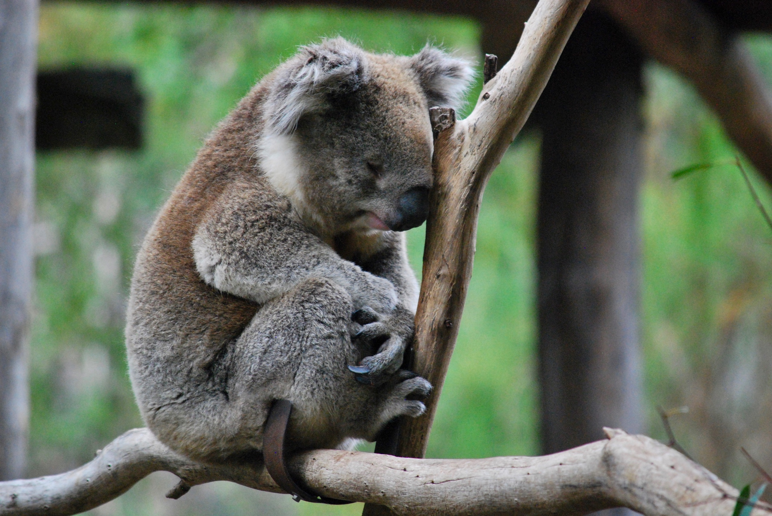
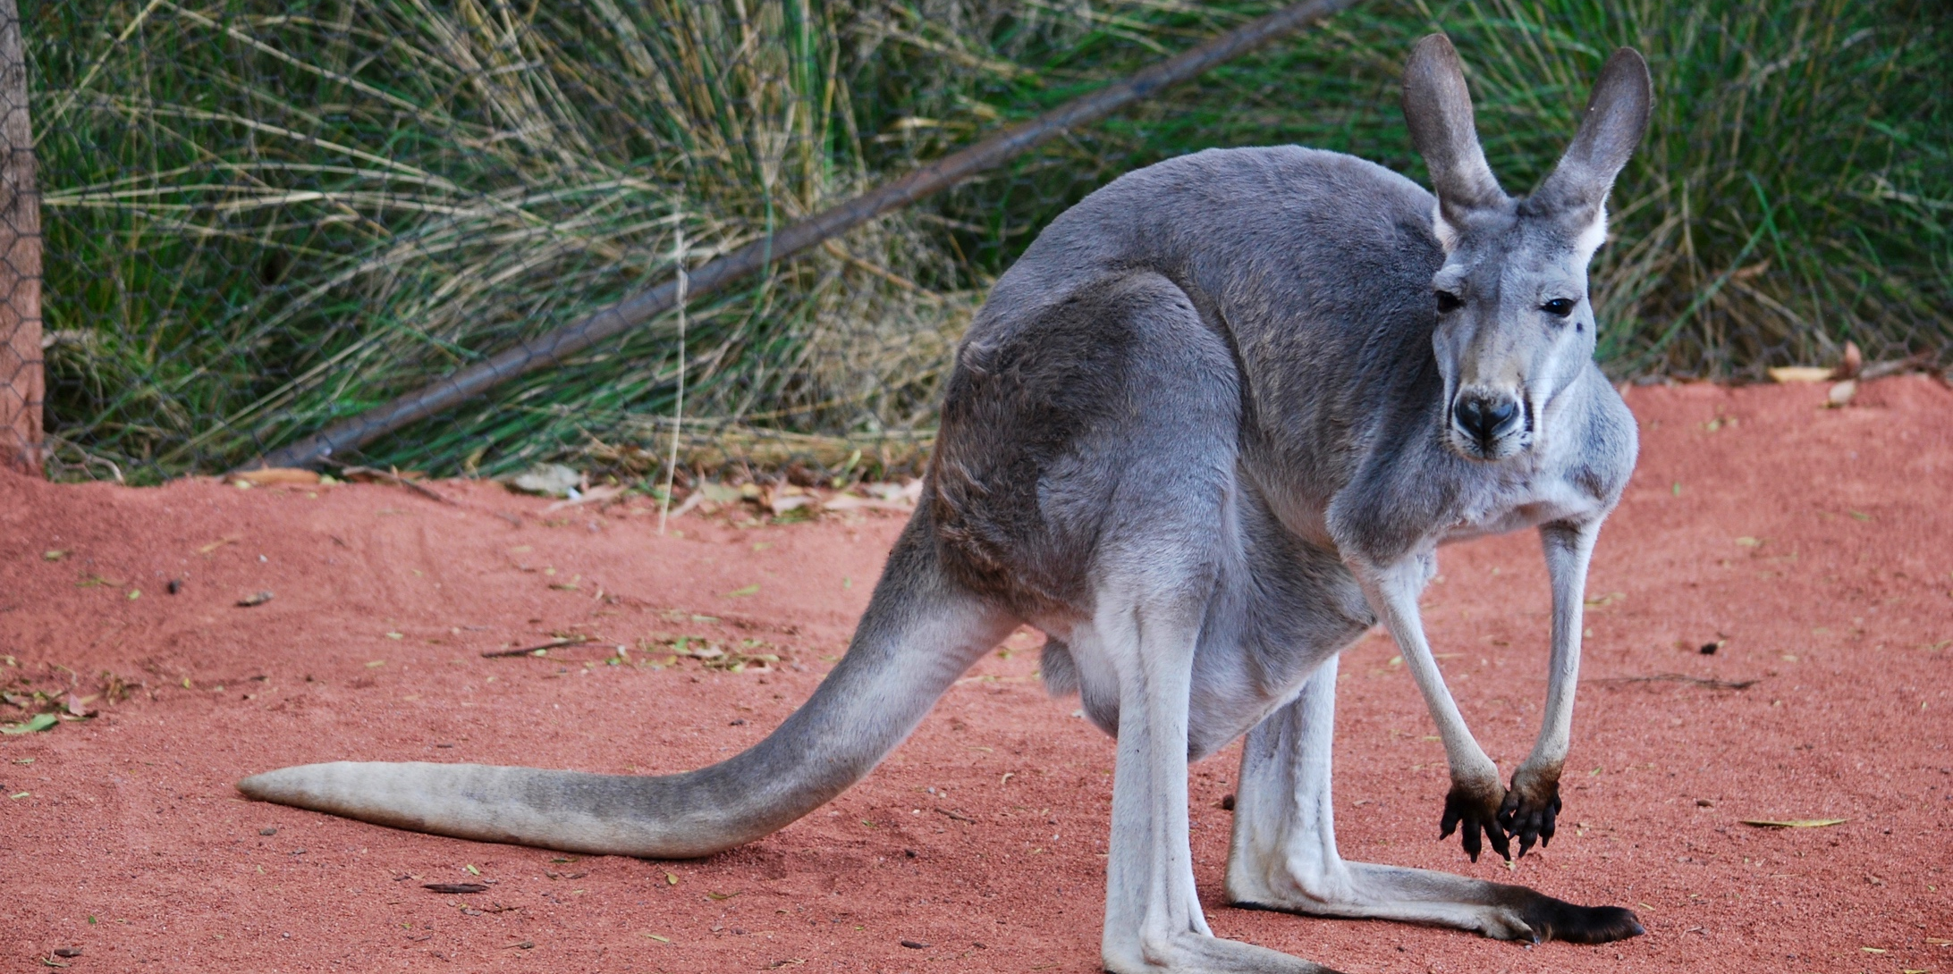
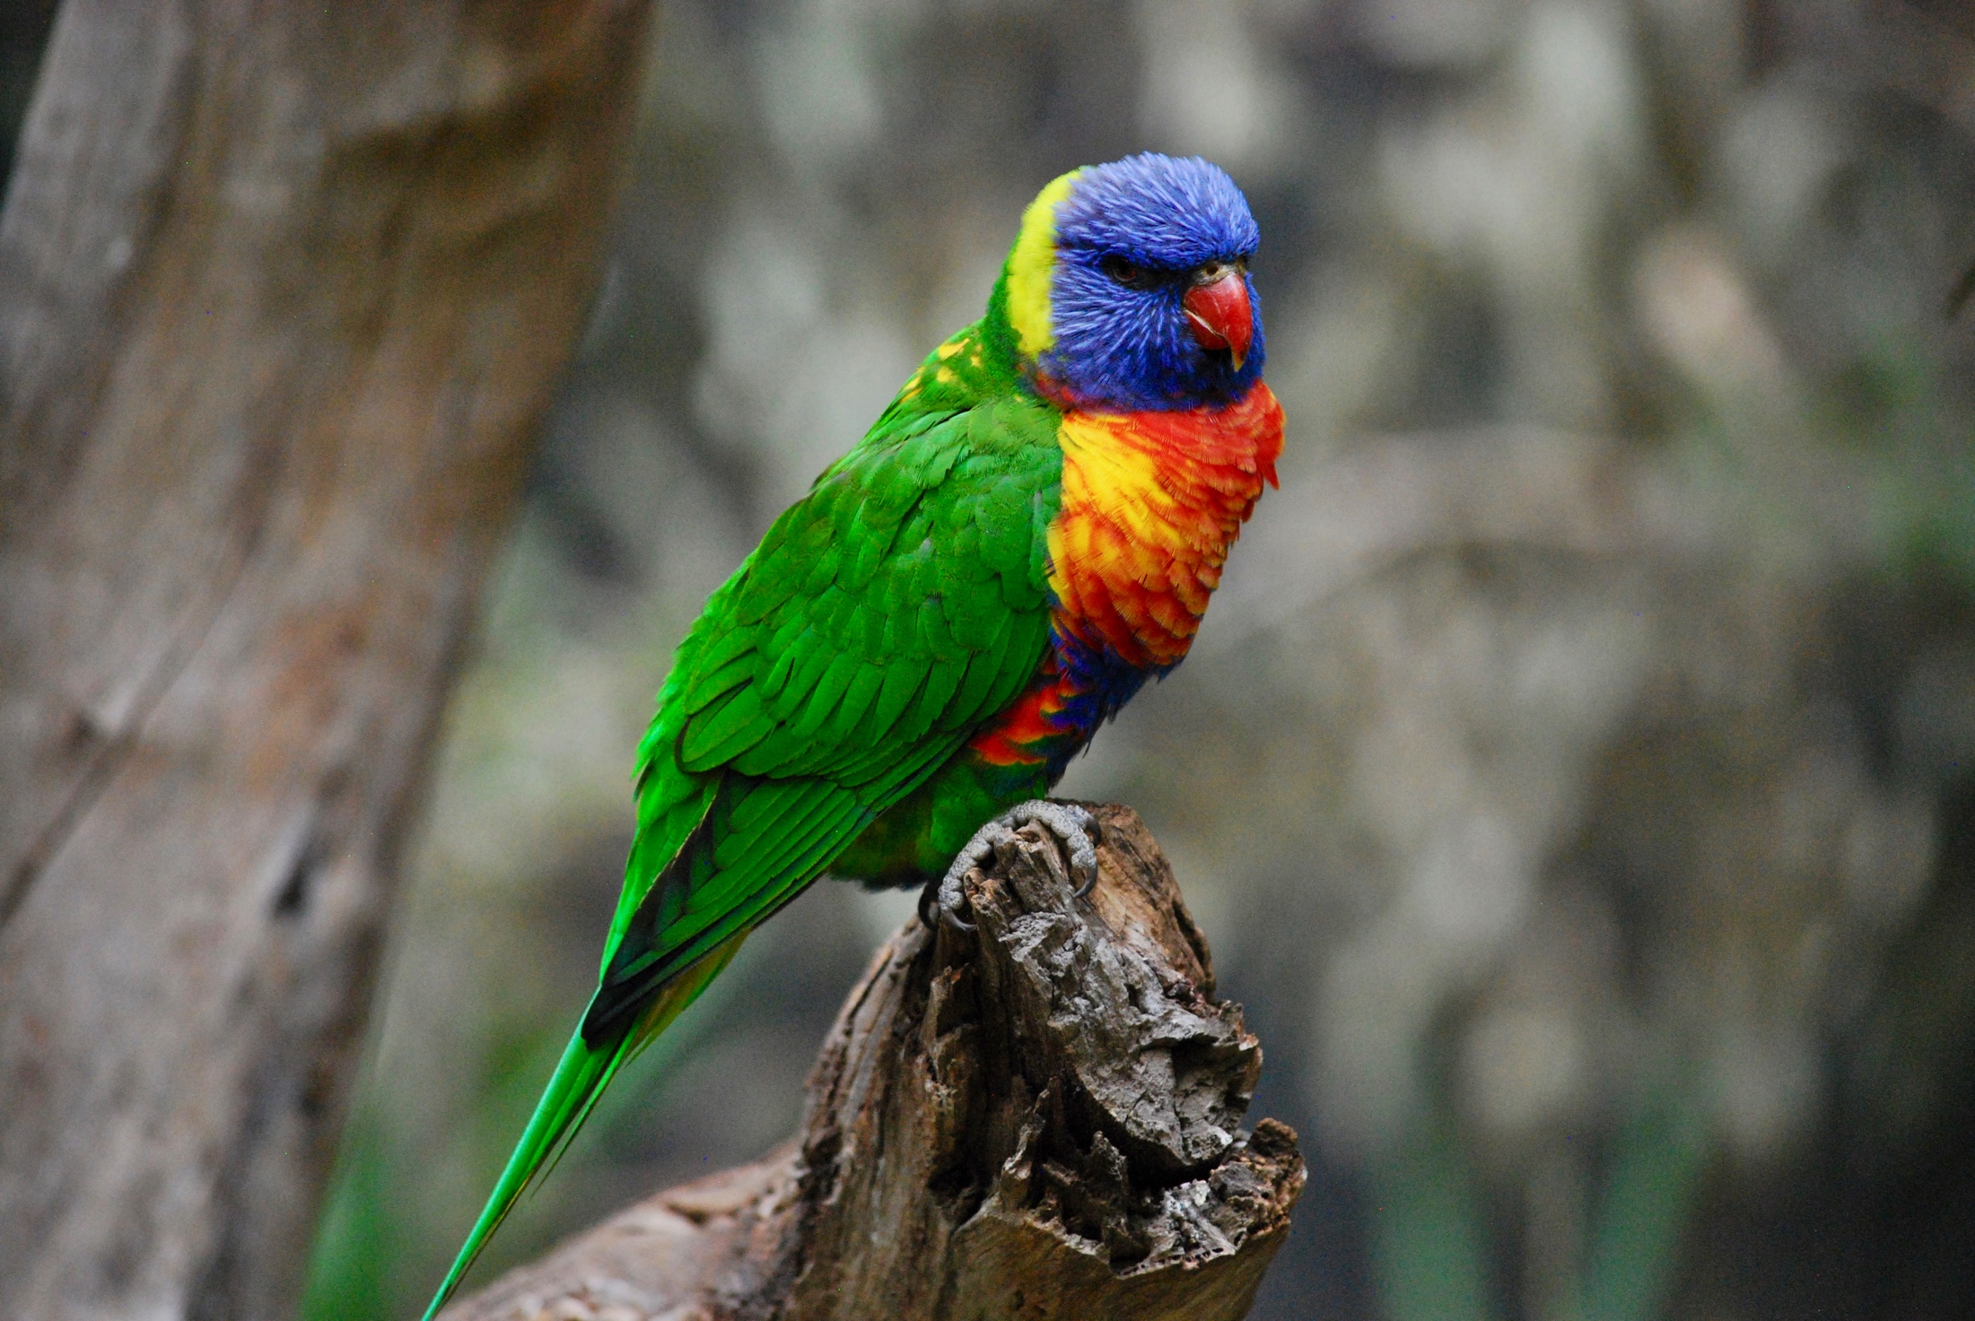
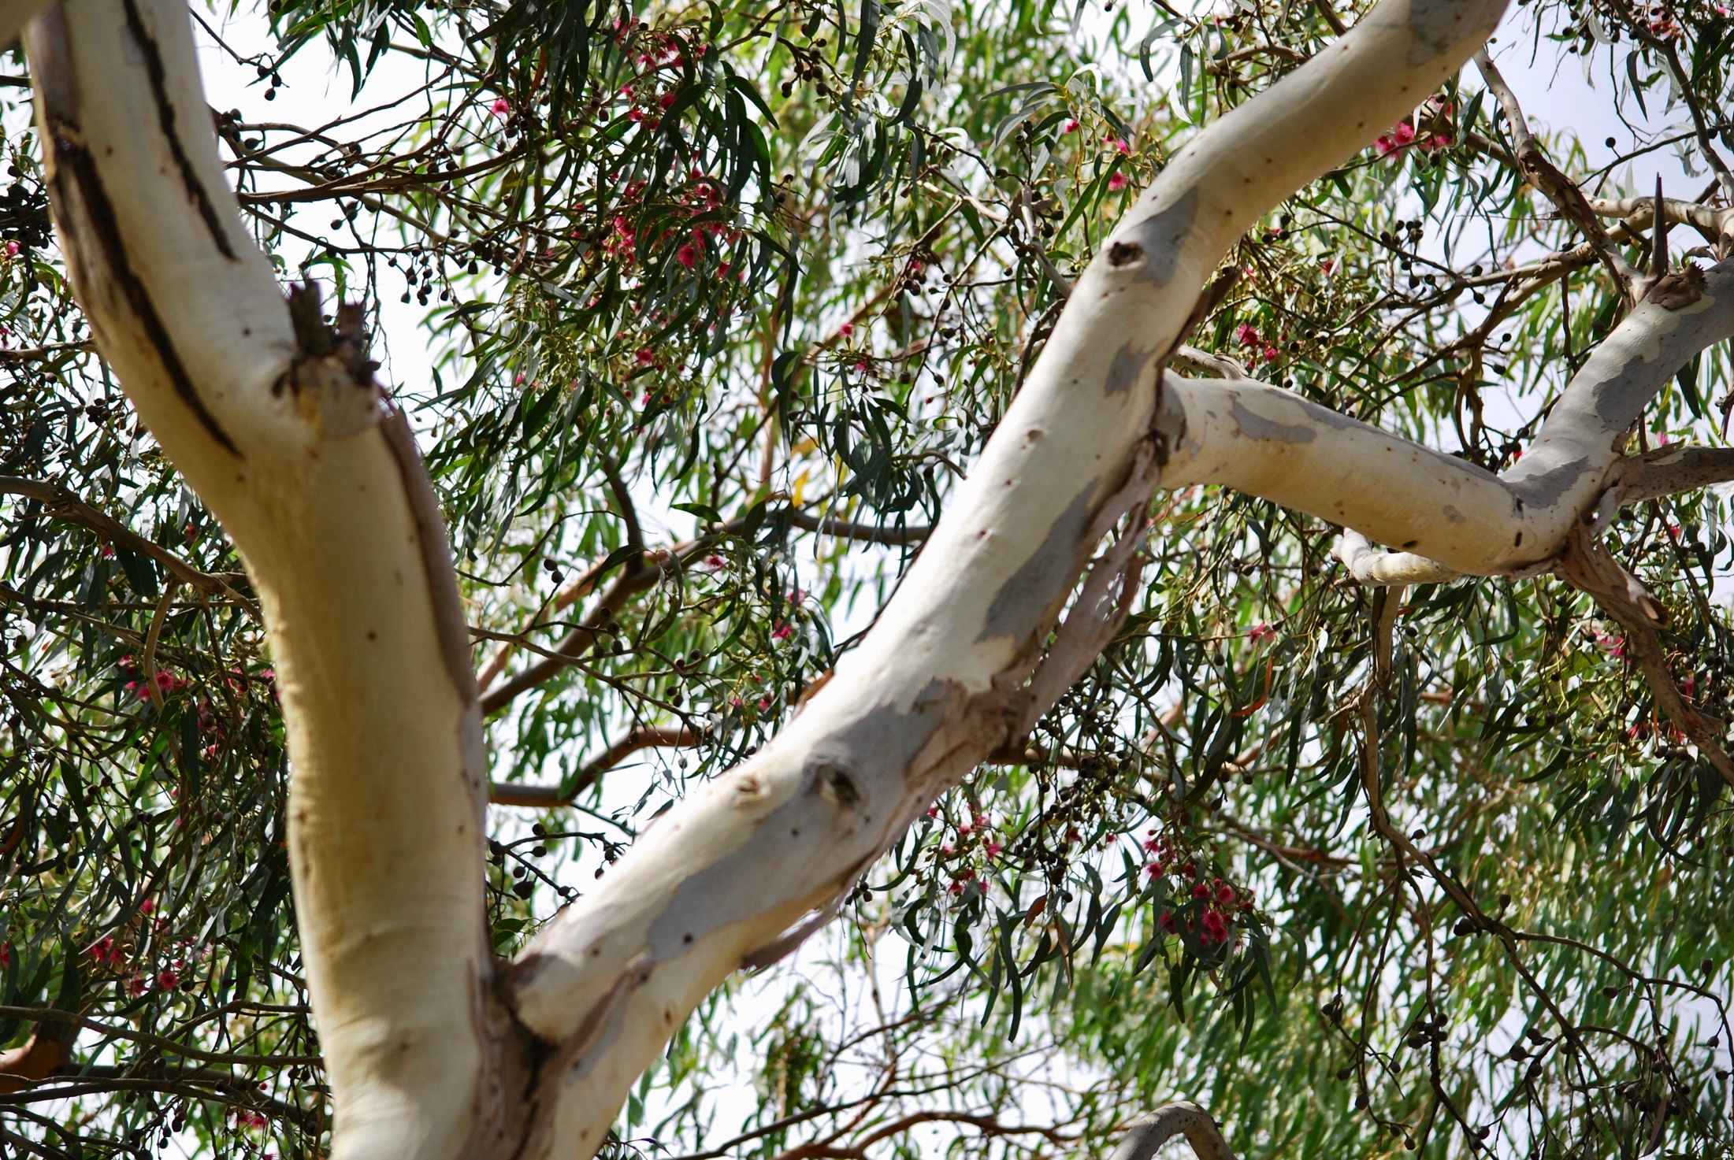

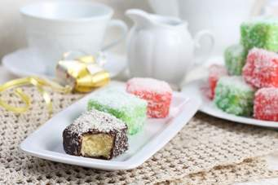


Slide 4
Generosity
“a willingness to give help or support, especially more than is usual or expected”
  Cambridge English Dictionary

Slide 5
1. Generosity as God’s Characteristic
“Every seed-bearing plant” (Gen 1:29-30)
Noah “I now give you everything” (Gen 9:3)
Abraham “All the land that you see … “ (Gen 13:15, 17)
Joshua “ … into the land I am about to give them” (Josh 1:2-3, 5)

Slide 6
1. Generosity as God’s Characteristic
“God so loved the world that he gave his one and only Son” (John3:16)
“If you love me, keep my commands. And I will ask the Father, and he will give you another advocate to help you and be with you forever – the Spirit of truth.” (John 14:26)

Slide 7
2. Generosity as our Characteristic
God’s special possession … that we may declare his praises (1 Peter 2:9)
“His divine power has given us everything we need for a godly life” (2 Peter 1:3-4)

Slide 8
Don’t put hope in wealth
Those who are rich in this world are not to be arrogant or to put our hope in wealth (1 Timothy 6:17)
Parable of the rich fool (Luke 12:13-21) “Take life easy; eat, drink and be merry.” “Life does not consist in an abundance of possessions.”

Slide 9
God’s gifts are to be enjoyed
God richly provides us with everything for our enjoyment (1 Timothy 6:17)
“Every good and perfect gift is from above” (James 1:16)
“God gives people wealth and possessions, and the ability to enjoy them” (Ecclesiastes 5:19)

Slide 10
Do good, be generous
Do good, be rich in good deeds, be generous and willing to share (1 Timothy 6:18)
Give generously without a grudging heart (Deuteronomy 15:10)

Slide 11
Repayment of our generosity
“Those who are kind to the poor lend to the Lord, and he will reward them for what they have done” (Proverbs 19:17)
“For with the measure you use, it will be measured to you” (Luke 6:38)
“Whoever sows sparingly will also reap sparingly” (2 Corinthians 9:6-8)

Slide 12
God takes note of our generosity
Treasure for ourselves in heaven (1 Timothy 6:19 and Mark 10:21)
Our reward is according to what we have done (2 Corinthians 5:10 and Revelation 20:12)
God will not forget our work (Hebrews 13:16)

Slide 13
– Living it –
“Freely you have received, freely give” (Matthew 10:8)
1. Decide in advance what to do (2 Corinthians 9:7 and 1 Corinthians 16:1-2)
2. Be attentive in the moment to the prompting of the Holy Spirit

Slide 14
Is there a limit to generosity?
Yes …
We are called to be wise stewards of resources (2 Thessalonians 3:7-9)
We are to support our families in order to support those who are really in need (1 Timothy 5:3-8)

Slide 15
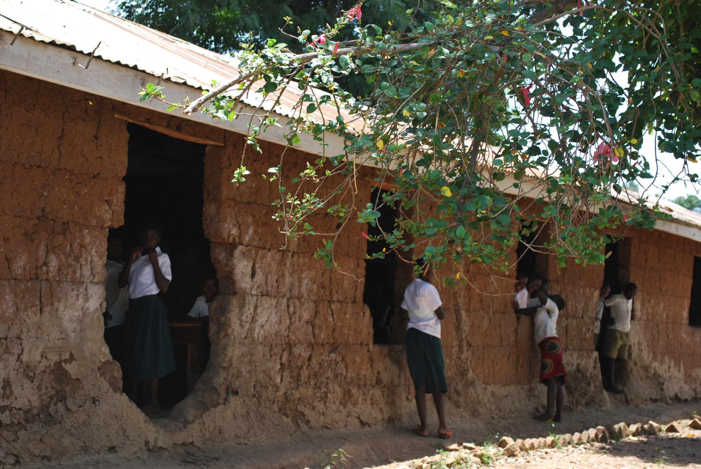
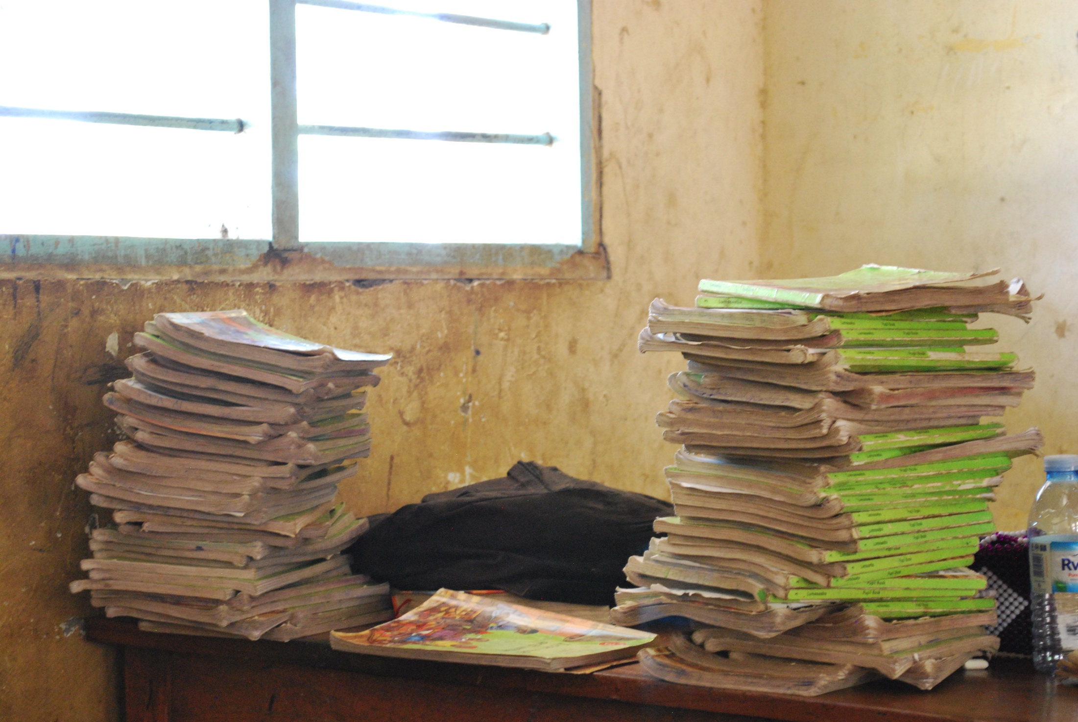
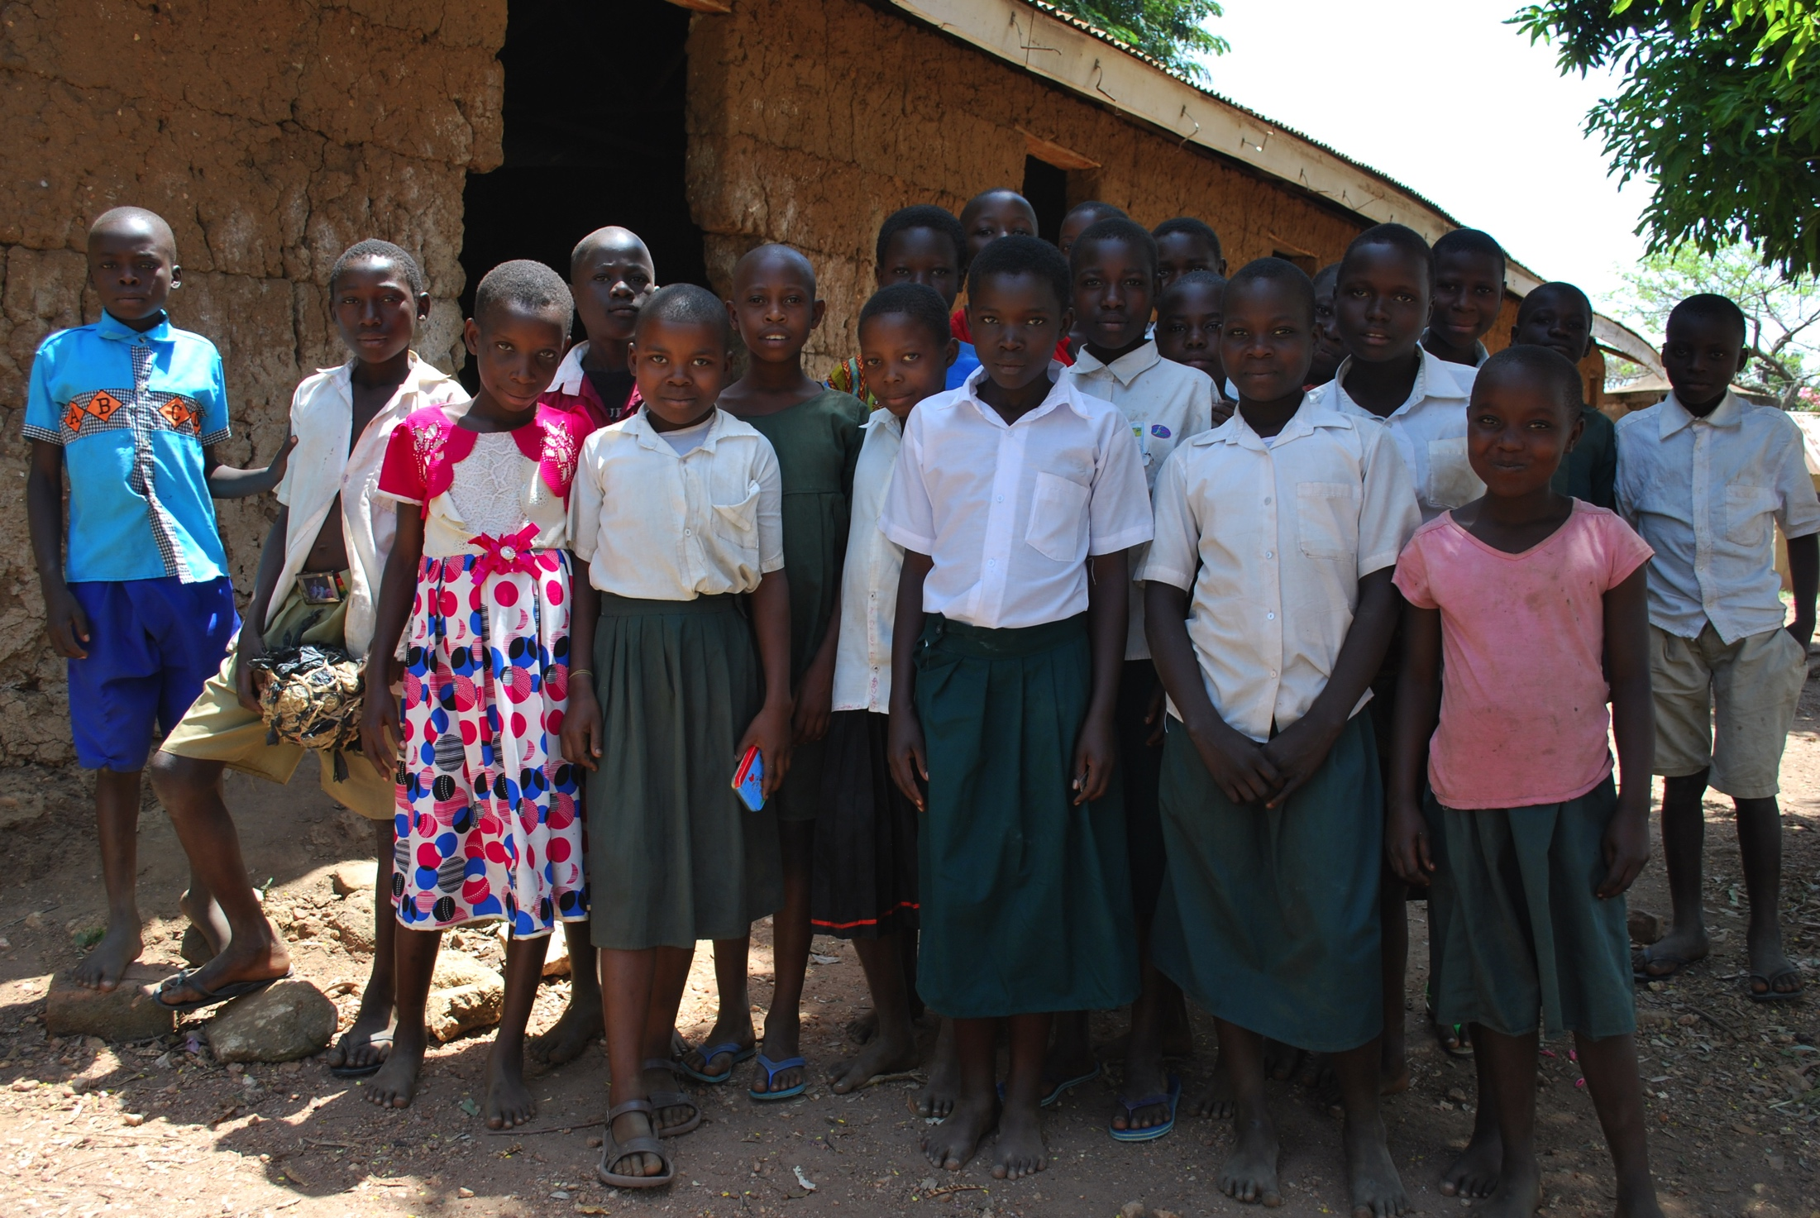
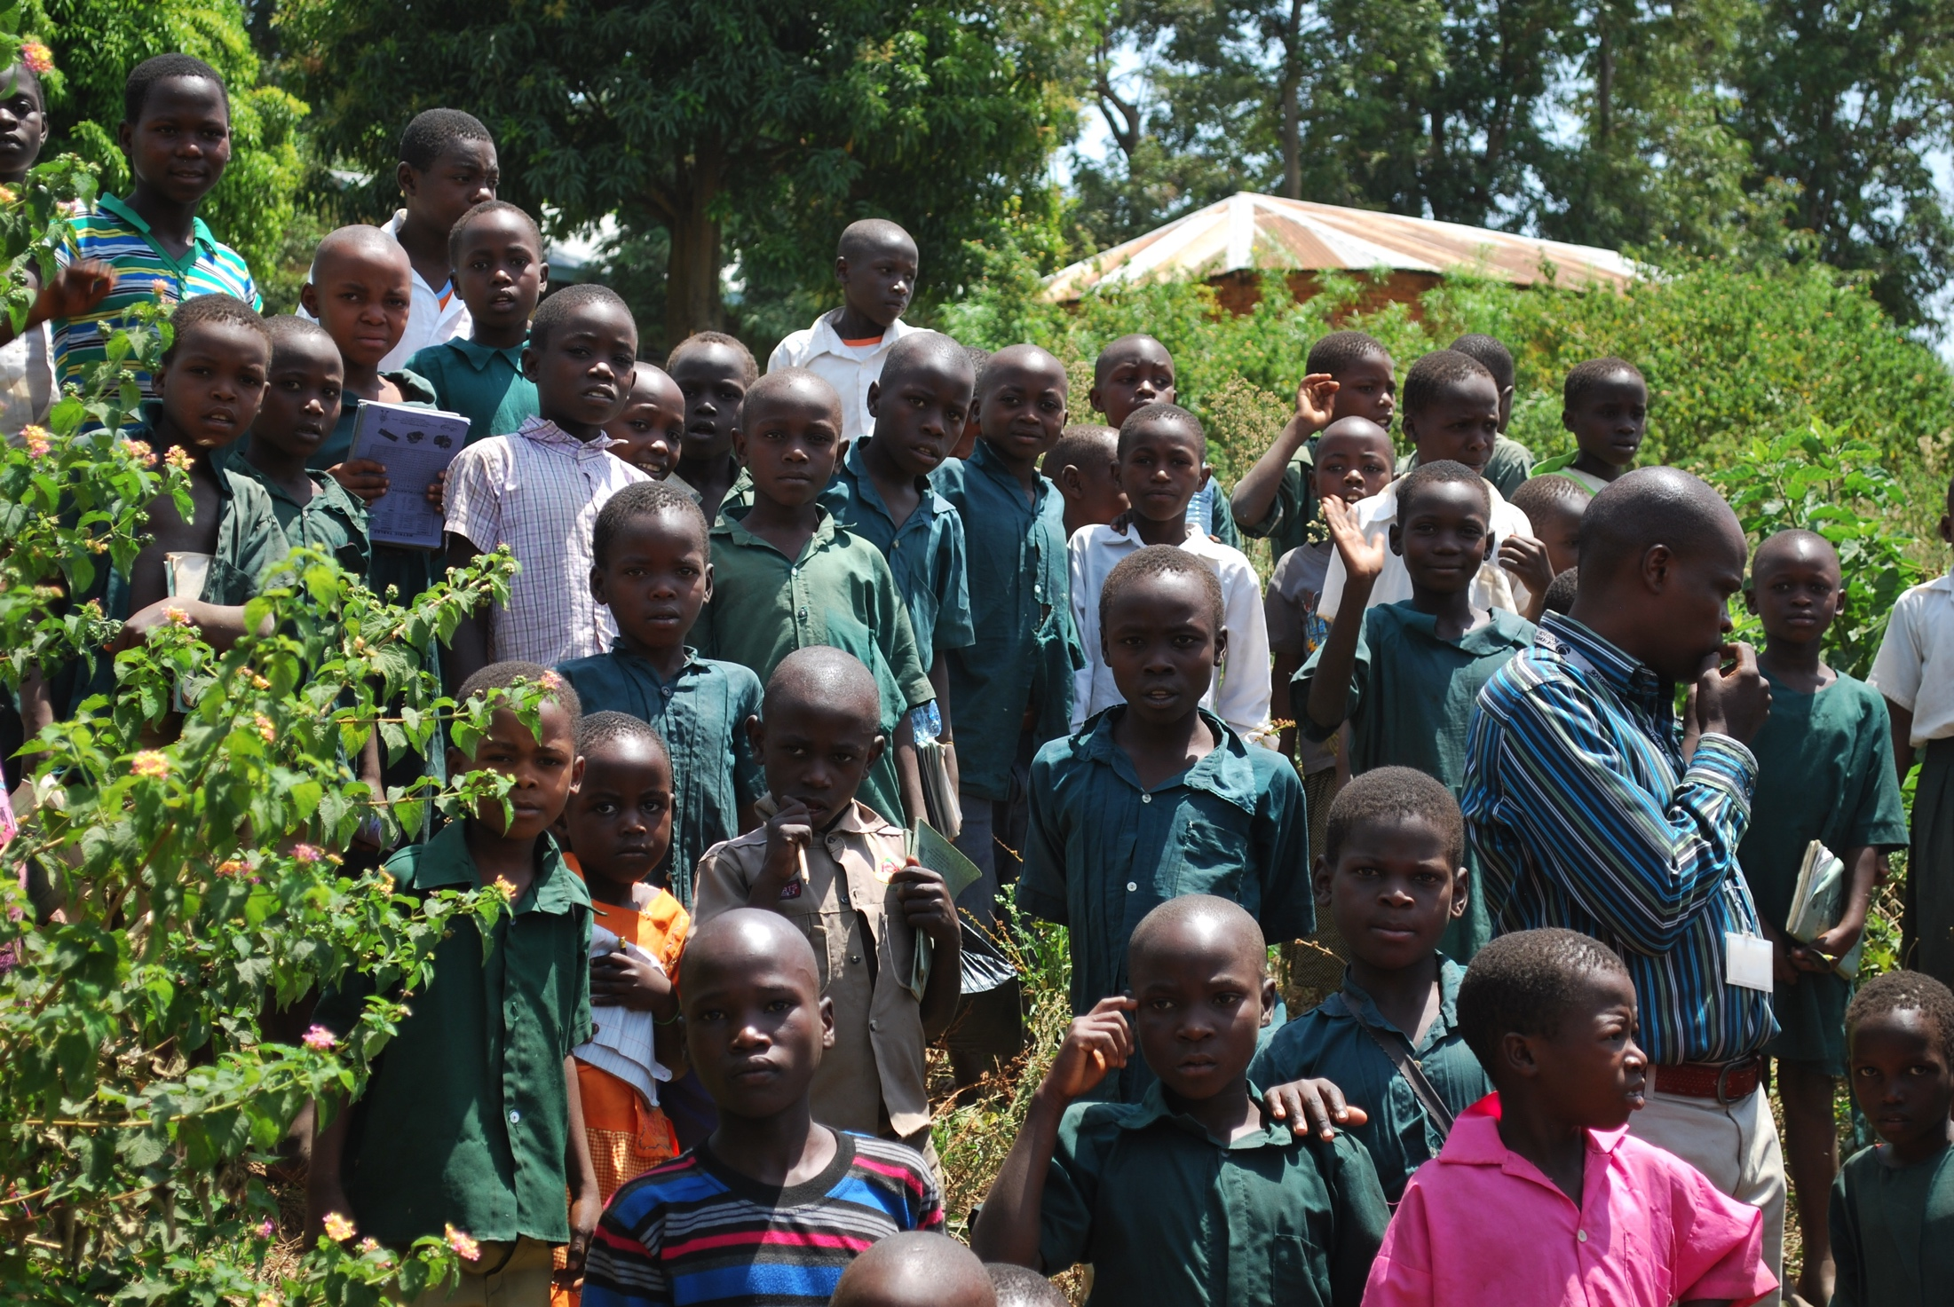
Food for the Hungry Uganda

Slide 16
Is there a limit to generosity?
… No
There is no sense in which we have done our duty and can take life easy (Luke 12:19)
We need not be anxious for the future (Malachi 3:10)
John Wesley: “Earn all you can, save all you can, and give all you can.”

Slide 17
Conclusion
We are generous because God is generous
All that we have comes from our heavenly Father
We have the Holy Spirit to help us discern needs and to steward wisely the resources entrusted to us
This is radical Christian living.

